Slide 1
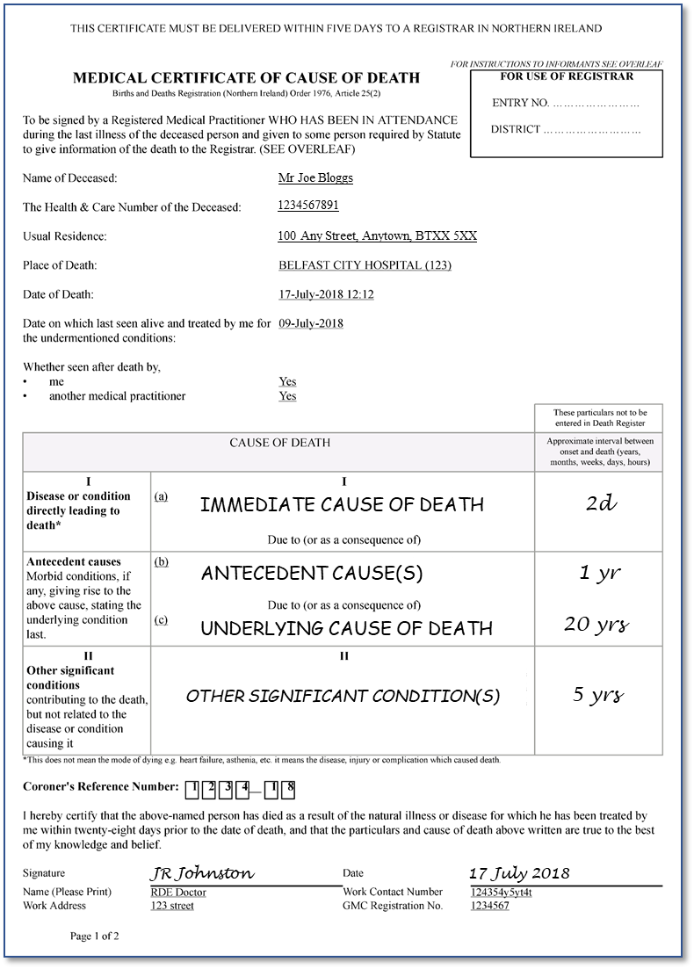
How to complete a Medical Certificate of Cause of Death using the NI Electronic Care Record mortality pathway
in NHS Hospital
Printed example

Slide 2
This set of slides needs to be viewed as a Slide Show.
Medical Certificate of Cause of Death = MCCD

Slide 3
Following a patient’s death
Please, ensure ALL the following steps are completed.
Record details in Clinical Notes.
Verification of Life Extinct.
Cause of Death sequence.
Details as discussed with Coroner (if needed).
Next of Kin discussion.
Sign and Date/Time.

Slide 4
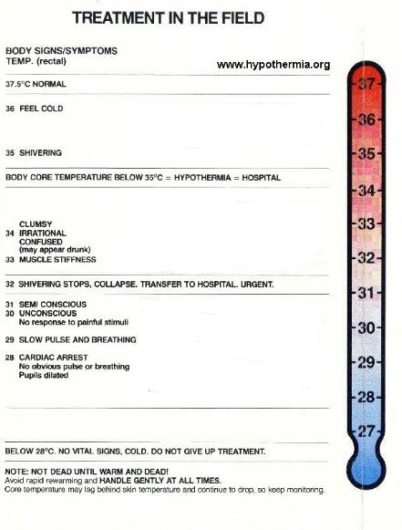
Verification of Life Extinct*
*DoH Guidance link to website
Cessation of,
circulation system
No central pulses
No heart sounds
respiratory system
No respiratory effort observed
No breath sounds
cerebral function
Pupils dilated & no reaction to light
No reaction to central painful stimuli
Exclude reversible causes
Hypothermia
e.g. Hypothermia
Drowning
Drug Overdose
The time of death is recorded as the time at which these criteria are fulfilled

Slide 5
Following a patient’s death
*DoH Guidance link to website
Please ensure ALL the following steps are completed.
Record details in Clinical Notes.
Consider whether to notify the Coroner*.
Record death on NIECR → Mortality Pathway
Produce MCCD
or
Record contact with the Coroner.
During COVID-19 pandemic
- send MCCD directly to GRO

Slide 6
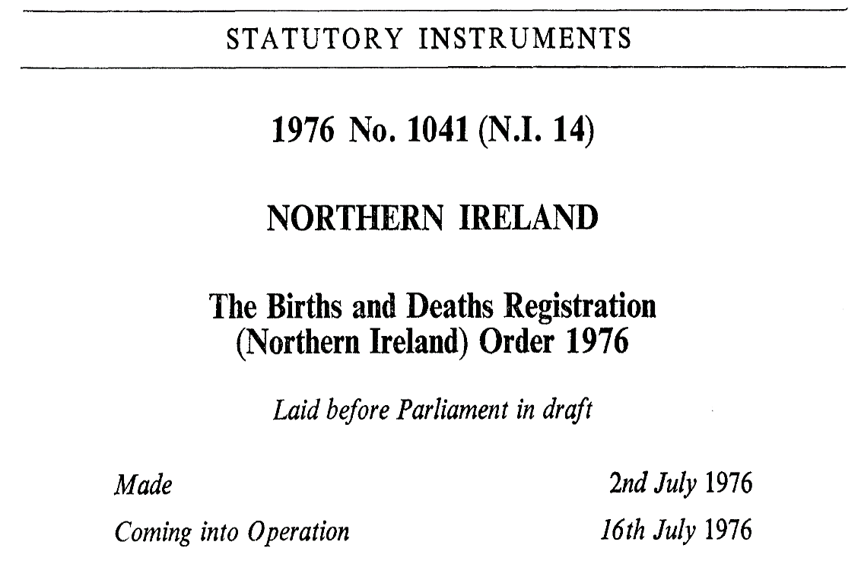
“Where any person dies as a result of any natural illness for which he has been treated by a registered medical practitioner within twenty-eight days prior to the date of his death, that practitioner shall sign and give forthwith to a qualified informant a certificate in the prescribed form stating to the best of his knowledge and belief the cause of death, together with such other particulars as may be prescribed.”
Regulation is not in place during COVID-19 pandemic

Slide 7
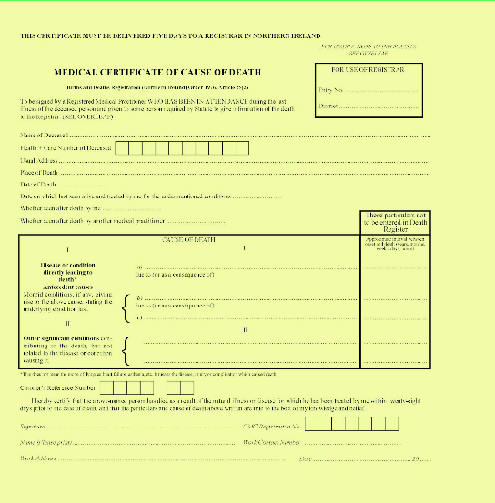
Two versions of MCCD
1. Handwritten version
Phased out from general use
Remains as a contingency form if the NIECR RM&MRs goes off-line.
2. eMCCD printed off NIECR*
* Regional Mortality & Morbidity Review system (RM&MRs)

Slide 8
eMCCD - printed version of MCCD
2. eMCCD printed off NIECR*
* Regional Mortality & Morbidity Review system (RM&MRs)

Slide 9
eMCCD - printed version of MCCD
2. eMCCD printed off NIECR*
Access NIECR.
Login with YOUR user name / password.
Find deceased’s record on NIECR.
Enrol deceased in Mortality Pathway.
Record the death as an Initial Record of Death (IRD).
* Regional Mortality & Morbidity Review system (RM&MRs)

Slide 10
There now follows screenshots of how to produce a MCCD.
You will need to,
record the death on the NIECR – Mortality Pathway
produce MCCD
arrange for completed MCCD → General Register Office

Slide 11
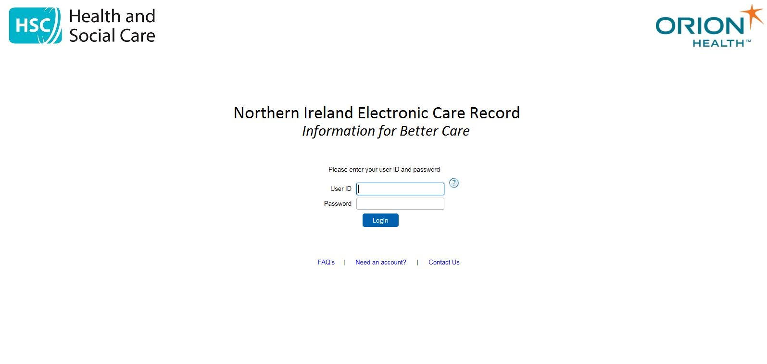
First – always Login to NIECR
You MUST always use your OWN NIECR login details
You can access
‘How to’ guides and
Screenshot training here.

Slide 12
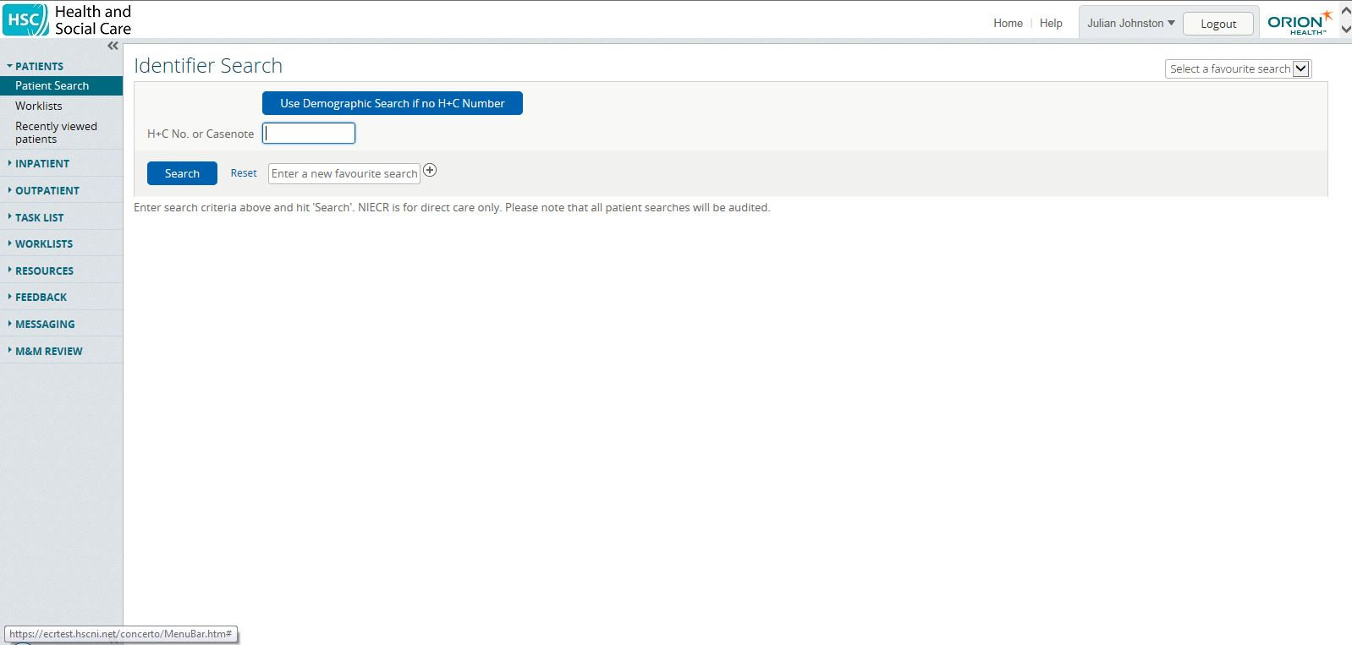
Find the deceased patient
Select correct patient on NIECR – by direct patient search using H&C number
H&C number
It is preferred that you,
do NOT pick deceased from recent encounter list,
to avoid picking the wrong patient.

Slide 13
Check the CORRECT patient is selected
Please ensure you have selected the correct patient !

Slide 14
Enrolling on Mortality Pathway
Click on Pathway tab

Slide 15
Enroll on Mortality Pathway
Select correct pathway from list – Mortality pathway → Enroll

Slide 16
Mortality Pathway now in Tasks tree
Select Initial Record of Death

Slide 17
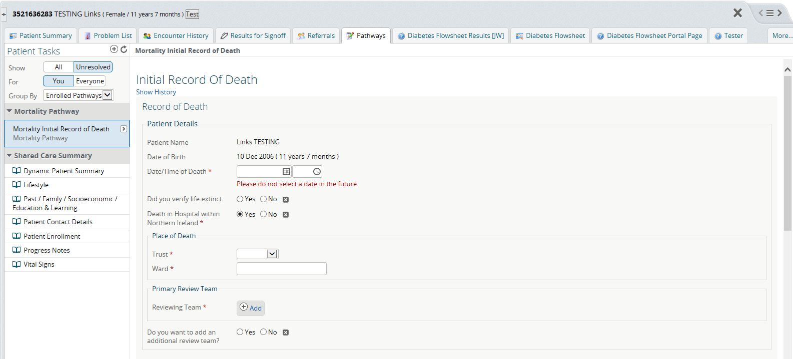
Initial Record of Death - 1
Enter Date and Time of Death (same date & time as for Verification of Life Extinct)

Slide 18
The Time of Death
There are 3 possible time measurements,
Actual Time of Death
Could be observed by member of public.
Verification of Life Extinct
Performed by any trained Healthcare professional.
Certification of Death
Must be done by Doctor
Doctor must see & treat patient within 28 days.
Regulation is not in place during COVID-19 pandemic
Notes:
3 possible ‘times of death’.
Actual time of death which might or might not be witnessed.
Time death is verified by appropriate professional.
this will then become the official ‘Time of Death’.
This should be done as close to the actual time of death.
Time of Certification of Death.
Must be done by qualified doctor, who
Has seen and treated patient within the last 28 days.

Slide 19
Date and Time of Death
In NHS Hospital practice,
The date and time of Death on a MCCD is taken as the date/time of Verification of Life Extinct (VLE).
You must ensure that the correct date of death is recorded on the MCCD,
when VLE occurred before midnight,
but
you certify the death on the following day.

Slide 20
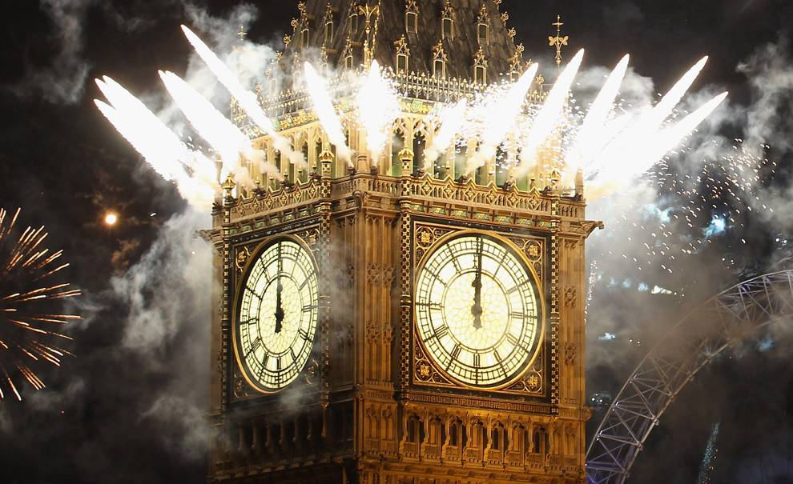
Be careful around mid-night!
You must ensure that the correct date of death is recorded on the MCCD
when Verification of Life Extinct occurred before midnight,
but you certify the death on the following day.
Correct Date and Time of Death
Verification
Certification
Notes:
Actual time of death which might or might not be witnessed.
Time death is verified by appropriate professional.
Be careful if these 2 times straddle midnight. It is conceivable that the actual time could be on one day and the verification is done the next day which conceivably could have important repercussions.
Time of Certification of Death.
Again, vigilance is especially needed around midnight to ensure that the correct time and date of death is recorded.

Slide 21
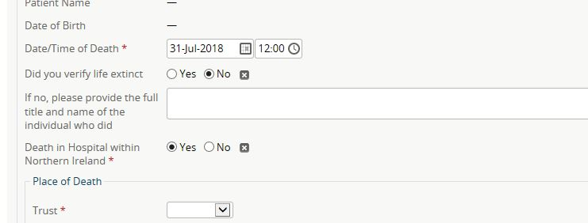
Initial Record of Death - 2
Enter who Verified Life Extinct
Please
If you did not verify death, provide name of person who did.

Slide 22
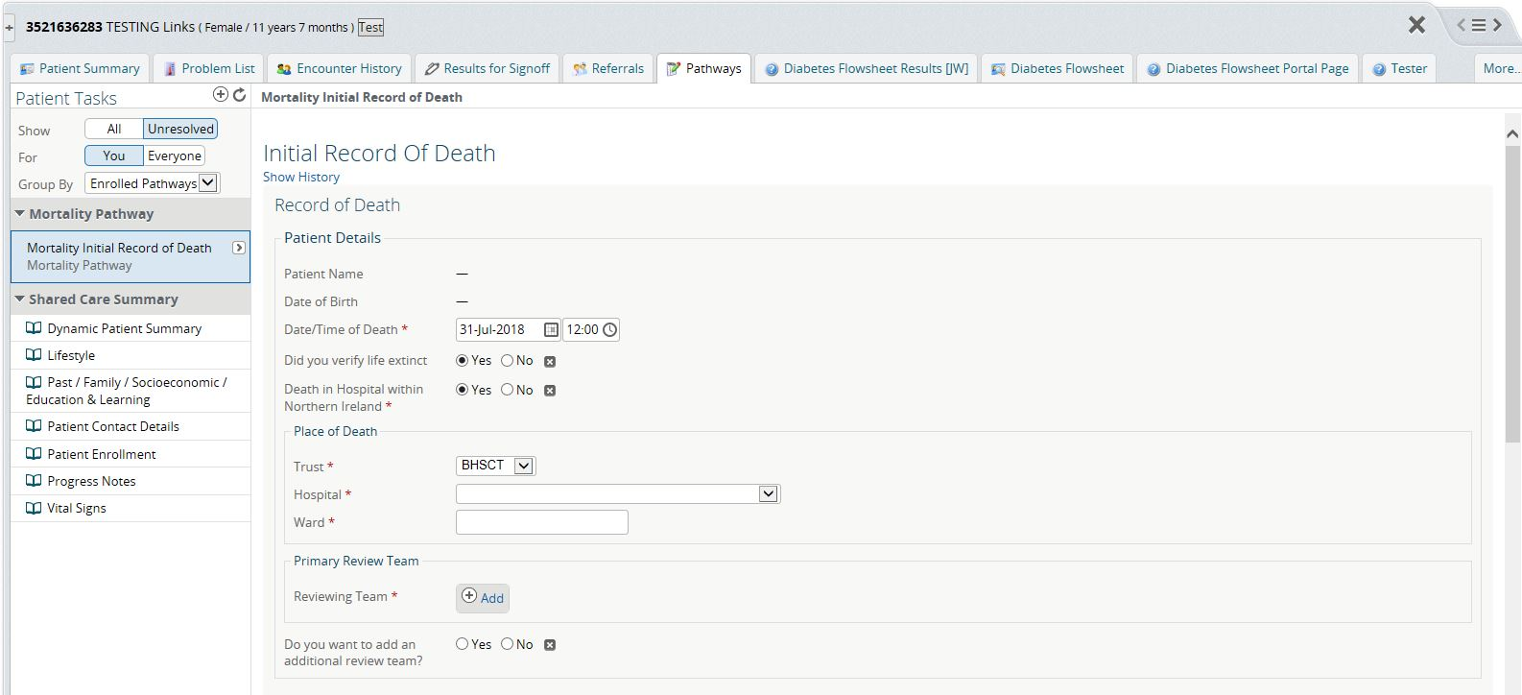
Initial Record of Death - 3
Answer question, “Death in Hospital in Northern Ireland”?
If YES,
Complete Trust, Hospital and Ward.

Slide 23
Initial Record of Death - 3
Answer question, “Death in Hospital in Northern Ireland”?
If NO,
Please provide correct address of Place of Death

Slide 24
Initial Record of Death - 4
Select Primary Reviewing M&M Team and Reviewing Consultant

Slide 25
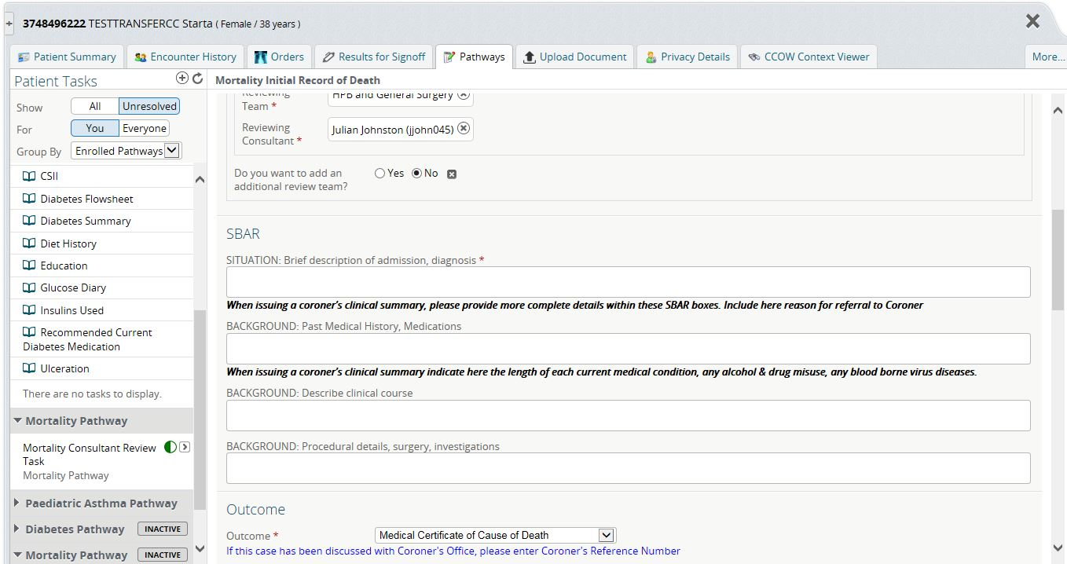
Initial Record of Death - SBAR
Complete SBAR fields to provide the clinical details
→ Clinical Summary
If not a Coroner case,
provide details as requested

Slide 26
Initial Record of Death - SBAR
Complete SBAR fields to provide the clinical details
If Coroner requests Proforma & MCCD,
also provide details as requested by bold text.
This will provide a full Clinical Summary for printing for the Coroner.

Slide 27
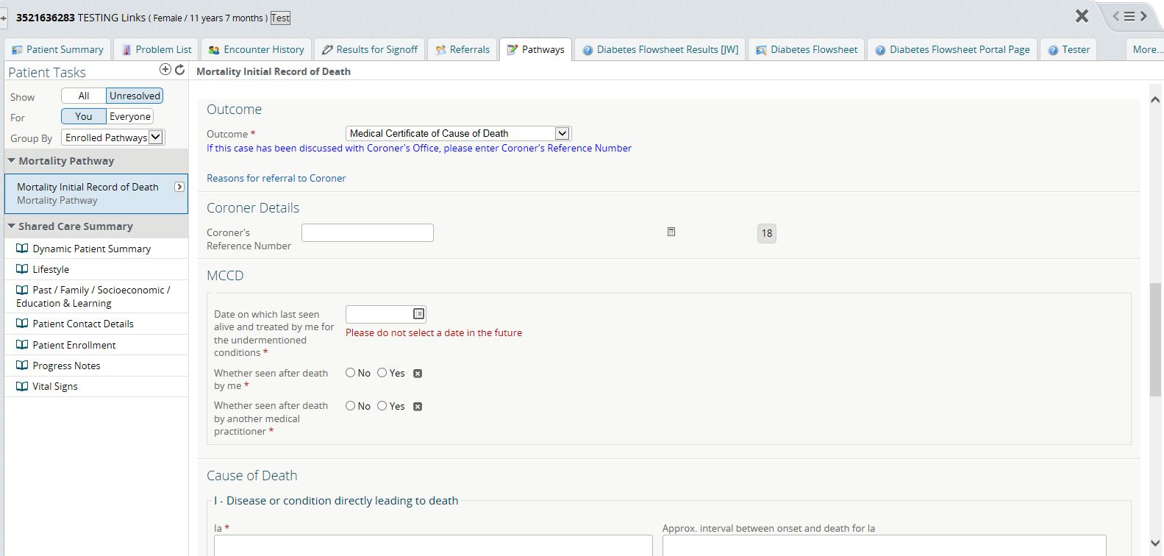
Initial Record of Death - Outcome
Select Outcome

Slide 28
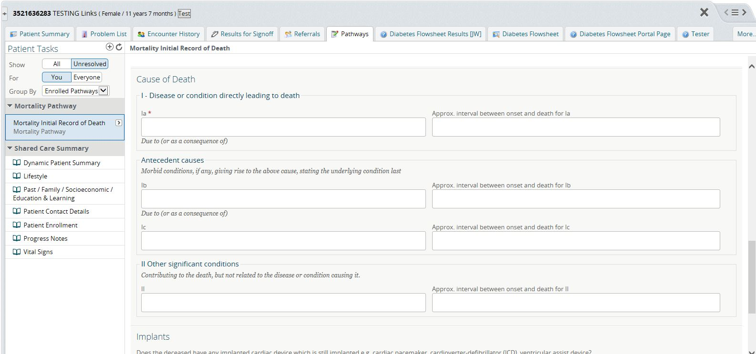
Initial Record of Death – MCCD
MCCD Outcome selected → Complete fields
Examine the next series of slides to see how to complete the Cause of Death section

Slide 29
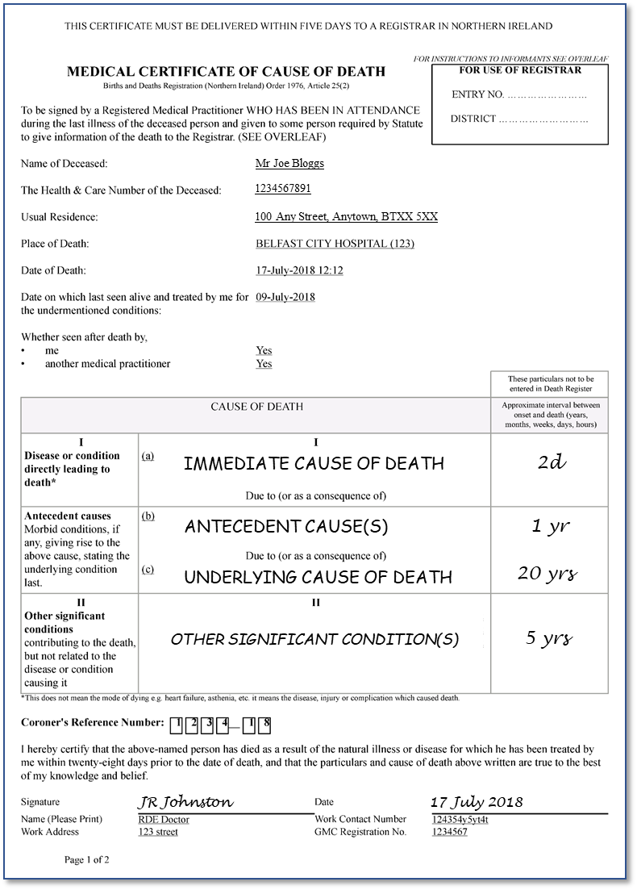
Initial Record of Death – Cause of Death
Immediate cause of Death
Time
Antecedent cause(s)
Time
2. Cause of Death
Underlying Cause(s) of Death
Time

Slide 30
Initial Record of Death – Cause of Death
Cause of Death
Part I
Start with immediate, direct cause of death = 1a.
Continue with the sequence of conditions,
finishing with the underlying cause of death.
e.g. Ia Hepatic Failure.
Ib Liver Cirrhosis.
Ic Chronic hepatitis C infection.
Notes:
Part I is a sequence of clinical conditions starting with the immediate cause of death and is followed by a series of conditions leading back to the underlying cause of death.
An example is given.

Slide 31
Initial Record of Death – Cause of Death
Immediate cause of Death
Time
Antecedent cause(s)
Time
2. Cause of Death
Underlying Cause(s) of Death
Time
Other Significant Conditions
Time

Slide 32
Initial Record of Death – Cause of Death
Cause of Death
Part I
Part II
Significant conditions contributing to death
but were NOT part of the direct sequence in Part I.
e.g. Ia Hepatic Failure.
Ib Liver Cirrhosis.
Ic Chronic hepatitis C infection.
II Chronic obstructive airways disease
Do not put underlying cause of death in Part II
Notes:
Part II should contain any conditions that contributed to the death but were not part of the direct sequence.

Slide 33
Initial Record of Death – Cause of Death
Cause of Death
Part I
Part II
Do not use abbreviations.
(except for HIV, AIDS and MRSA).
Please do not use these alone and unqualified.
Old Age, General Debility, Weakness, Senility,
Organ Failure,
Pneumonia,
Infection, Sepsis,
Malnutrition, Cachexia, Inanition,
Cancer.
Do not enter terms in Part II that should be in Part I.
Notes:
Please do not insert abbreviations because the Registry Office are unlikely to know all of them and there can be misinterpretations e.g. MS may mean mitral stenosis or multiple sclerosis.
Also
Do not use attached terms alone and unqualified
Please do not enter immediate cause of death or underlying cause of death in Part II.

Slide 34
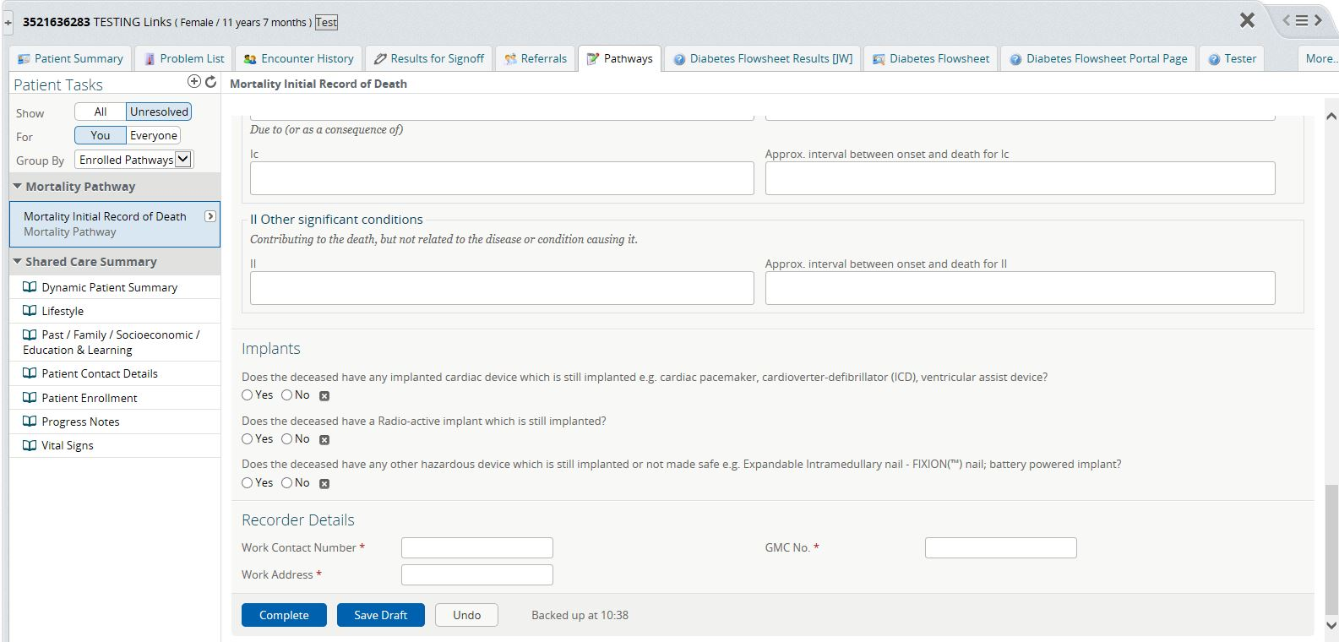
Initial Record of Death – Implant Questions
Complete implant questions

Slide 35
Initial Record of Death – Complete
Complete Initial Record of Death with your work details → click Complete
Please use ‘Work’ contact telephone number
i.e. not group pager or just an extension number.
Provide GMC number for whoever signed onto NIECR
Please provide Ward and Hospital name

Slide 36
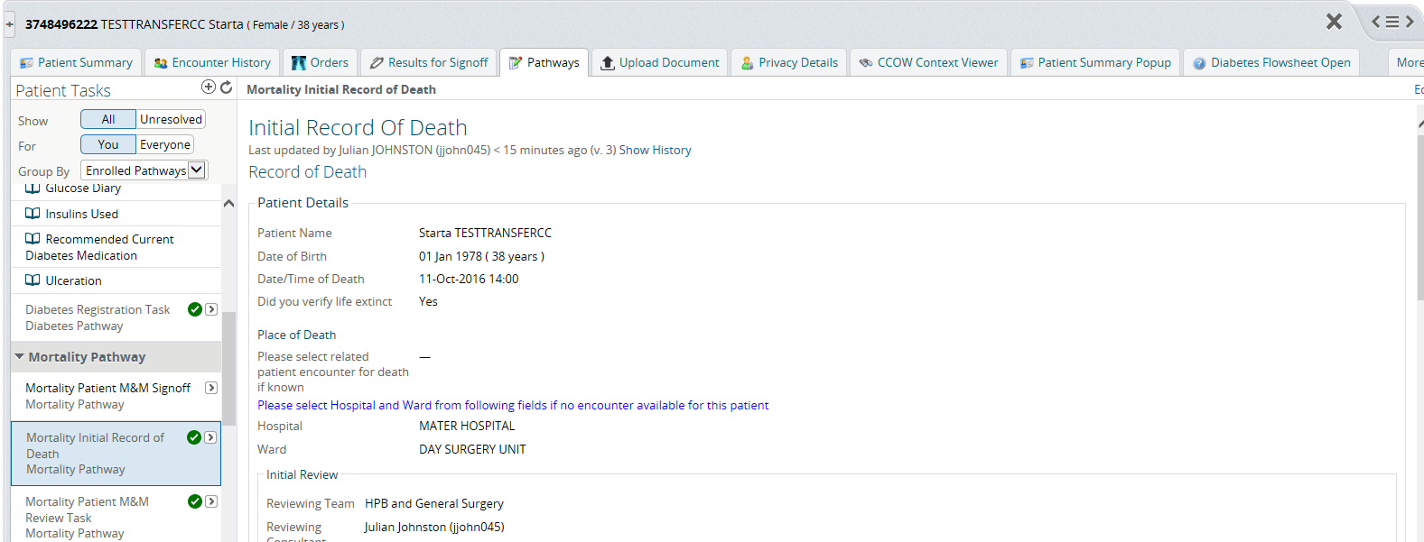
Finding MCCD / Clinical Summary
Select Patient Summary tab and click

Slide 37
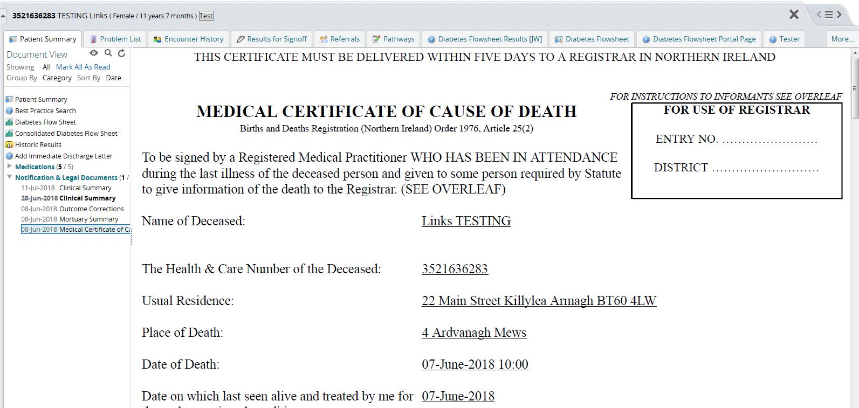
Finding MCCD / Clinical Summary
Select Notification & Legal Documents and click on MCCD for pdf

Slide 38
MCCD will complete and print
Arrange for MCCD to go to the GRO
Please make sure you have explained MCCD to family/NOK/informant
&
answer any questions they may have.
JR Johnston
Xx xxxx XXXX

