Slide 1
Family Nurse Partnership's contribution to Making Life Better
Monica Martin FNP Supervisor WHSCT

Slide 2
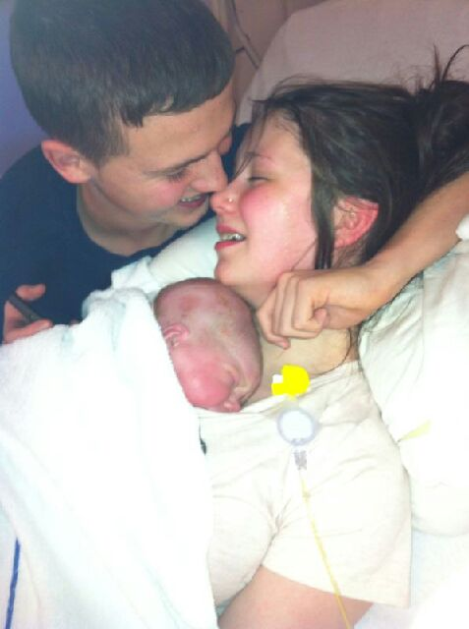
Clients are at the heart of the programme

Slide 3
The FNP Model
Evidence based
Human ecology
Self-efficacy
Attachment
Guiding style
Healthier lifestyles for parents and children
Plan for their own future
Strengths based
Agenda matching
Supervision informing practice

Slide 4
Relationship with the Family Nurse Key
People are generally better persuaded by the reasons which they have themselves discovered, than by those which have come into the minds of others.”
(Blaise Pascal, Pensees, 1670)

Slide 5
What clients tell us about the programme
“I got a lot of confidence in my parenting. I remember thinking at the start, I'm never going to be able to do this. I'm to young but I now know that I can be a really good parent she helped me to believe that”
“The thing I was worried about that, because I was so young people would look down on me ,she didn’t judge and was always there for me if I had any problems”

Slide 6
One year later
Hi Angela, it’s Brianna, just giving you a wee update on how everything’s going. I passed my driving test, bought a wee car, got a distinction in my course, got a job, starting university in September and Daibhin is starting nursery. Just wanted to let you know cause you helped me get there lol, you always made me feel like I could do what I wanted and helped me set my goals. Thanks for everything and hope you are well x

Slide 7
Conclusion
FNP sits with the MLB strategy
Giving children the best start
Equipping young mothers and children for life
Empowering people to make the right choices
Helping to create the conditions
Helping young mums engage with services
Working closely with our health and social care colleques for best outcomes
Safeguarding vulnerable families

Slide 8
