Slide 1

Geographical Analysis
DEA – District Electoral Area;
80 DEAs within NI across 11 Local Government Districts;
10 DEAs within Belfast City Council area;
10 DEAs encompass 60 electoral wards
Stats as at 30.04.26
Zone | DEA
North | Castle, Oldpark
South | Balmoral, Botanic
East | Ormiston, Titanic, Lisnasharragh* (for purposes of analysis)
West | Blackmountain, Collin, Court* (for purposes of analysis)
Multi zone | *Court – split between N & W, connecting areas such as Shankill and Lower Falls *Lisnasharragh – primarily situated in East Belfast but historically and geographically tied to southeast pockets (South Belfast) via areas such as Rosetta
Notes:
– only info only, will be reviewed in detail at Implementation

Slide 2
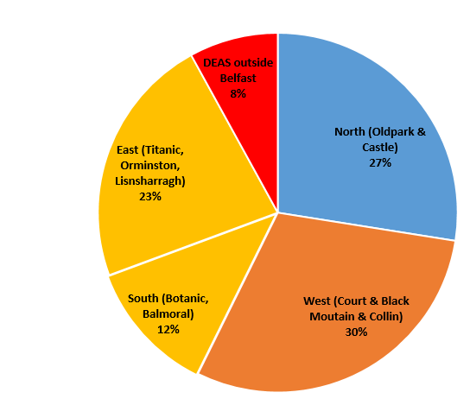
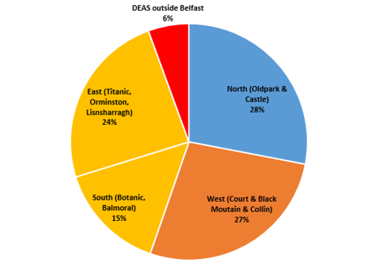
Gateway Referrals and CPR
CPR
Gateway Referrals
Notes:
Consider high

Slide 3

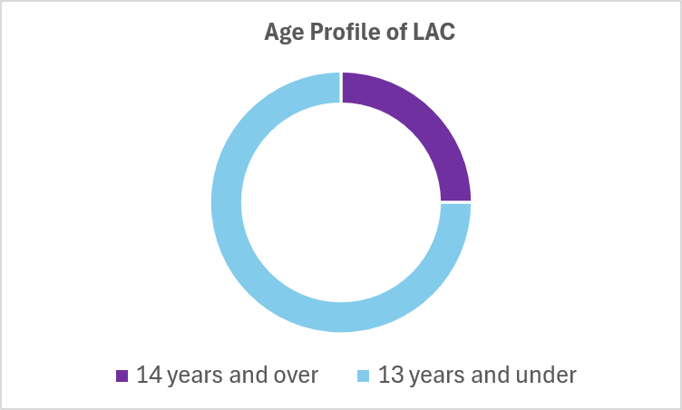
Age Profile
75% aged
13 years and under

Slide 4
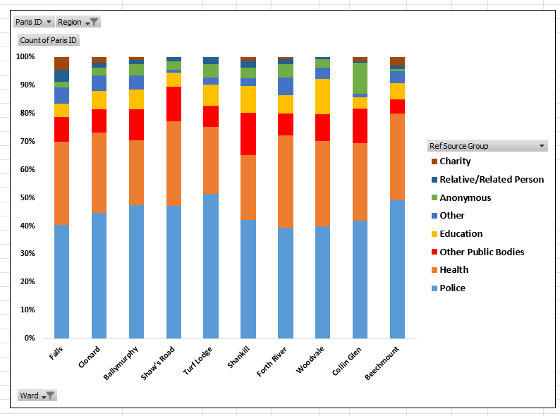
West Belfast Top 10 Wards – GW with % GW Referral Source

Slide 5
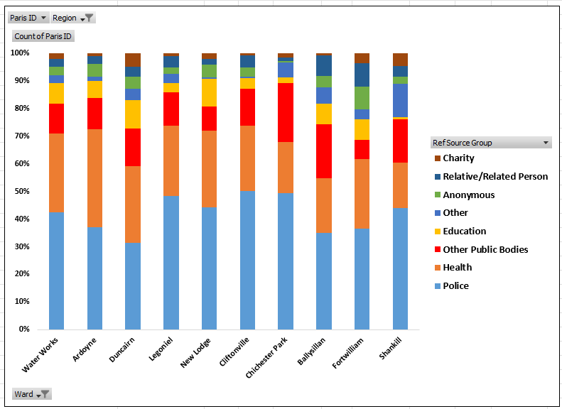
North Belfast Top 10 Wards – GW with % GW Referral Source

Slide 6
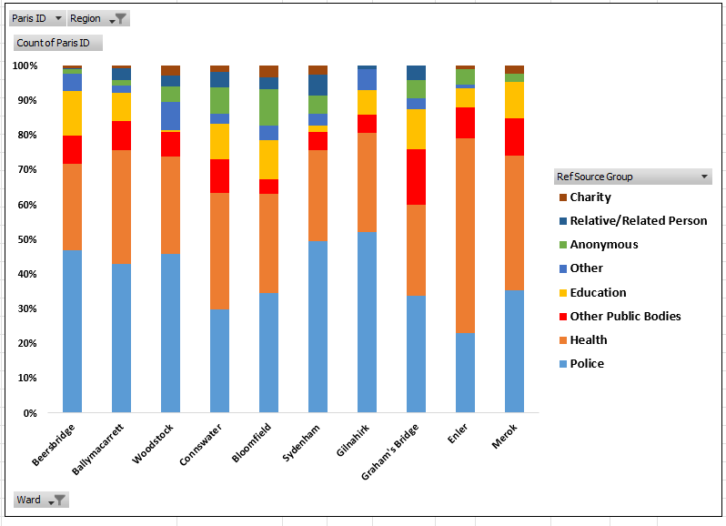
East Belfast Top 10 Wards – GW with % GW Referral Source

Slide 7
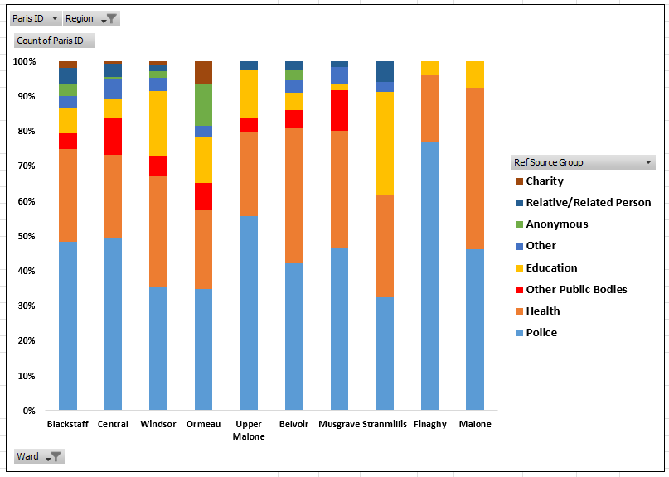
South Belfast Top 10 Wards – GW with % GW Referral Source

Slide 8
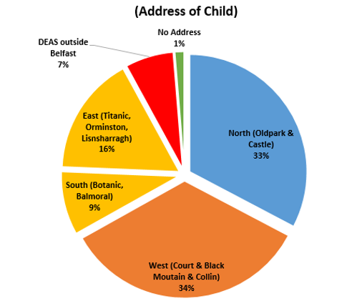
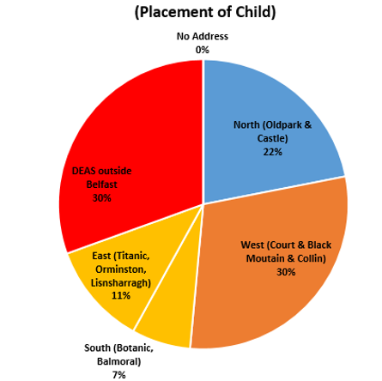
LAC

Slide 9
Summary
 | GW Referrals (Count = no. of children) | LAC (by placement address) | CPR
North (Oldpark & Castle) | 27% | 22% | 28%
West (Court, Back Mountain & Collin) | 30% | 30% | 27%
South (Botanic & Balmoral) | 12% | 7% | 15%
East (Titanic, Orminston, Lisnasharragh) | 23% | 11% | 24%
Outside DEAs/no address | 8% | 30% | 6%
TOTAL | 6,228 | 1,216 | 396
Notes:
Add placement address

