Slide 1

Notes:
For staff teams – last updated Aug 2026

Slide 2
What is Our Pact?
Our Pact is a co-designed framework that guides services supporting children, young people and families to ensure they are respected, heard and involved in decisions about their lives
Our Pact was developed in direct response to the guiding principles of the Children’s Social Care Services Reform Programme
Our Pact applies to everyone supporting children, young people and families across Northern Ireland

Slide 3
Who is Our Pact for?
Our Pact is for everyone involved in supporting children, young people and families. This may include:
social workers
family support workers
youth workers
teachers
health professionals
managers from both statutory agencies and community and voluntary organisations.
Notes:
It is equally for the children, young people and families who receive support.
This shared approach helps everyone understand what to expect from services, how we work together and gives staff practical guidance on how to deliver these expectations in everyday work.

Slide 4
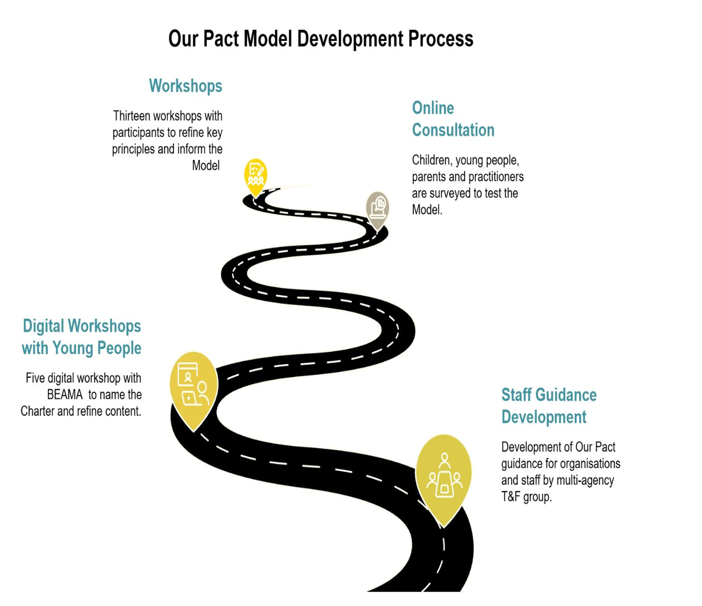
Our Pact Development Process
Through an iterative process, over 150 participants took part in workshops and surveys to refine the content, shaping the initial 14 ideas into the four key principles that form Our Pact today.
Young people create the name, design the logo, and develop awareness content, ensuring Our Pact reflects the voices and ideas of those it is designed to support.
Notes:
The Our Pact Model was created in partnership with children, young people, parents, carers, community and voluntary organisations and Health and Social Care Trust staff.

Slide 5
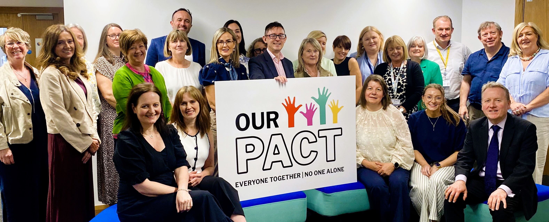

Our Pact has been endorsed by member organisations of the Children’s Social Care Services Reform Programme Board
Notes:
Our Pact has been endorsed by the Children’s Social Care Programme Reform Board – highlight Joint Statement /add orgs logos
Organisations include
Deputy Secretary, Social Care and Public Health Policy,
Chief Social Work Office
Directors of Trusts Children’s Services
Lead for Together for Families
Chief Executive of the Youth Justice Agency
Reimagine Children’s Collective
Representatives from the Community and Voluntary Sector

Slide 6
Children’s Rights
The Our Pact Model is built on the principle that children have the right to be listened to and taken seriously (The United Nations Convention on the Rights of the Child, Article 12). This means that children’s voices must be heard in decisions about their lives, families should be fully involved, and services must act with fairness, respect and transparency.

Slide 7
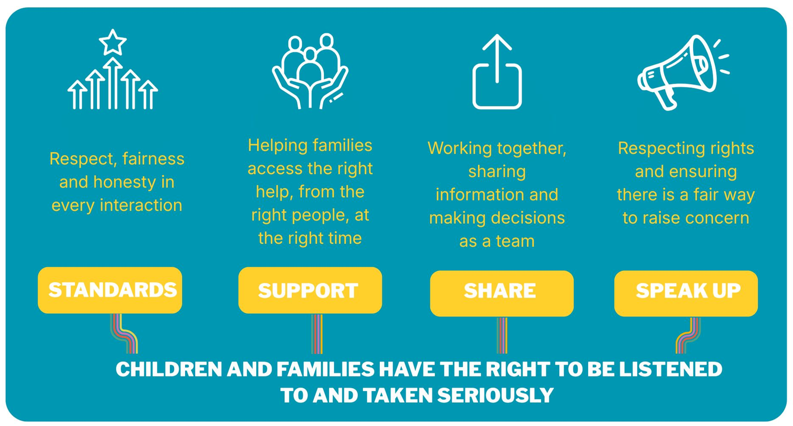
Notes:
The Our Pact Model is made up of 4 key principles:
1. Standards: Respect, fairness and honesty in your interaction
2. Support: Helping families get the right help, from the right people, at the right time.
3. Share: Working together, share information and make decisions as a team
4. Speak Up: Respecting rights and ensuring there is a fair way to raise concerns
The Our Pact Model is underpinned by the UN Convention on the Rights of the Child, particularly Article 12, which states that children’s voices must be heard and taken seriously.

Slide 8


Children, young people and families should be treated with respect, fairness and honesty. These values guide how we work with children and families.
Key Leadership Actions
Commit to the principles of Our Pact and appoint champions to promote them.
Embed respect, fairness and honesty into policies
Promote children’s rights and use them to guide decisions.
Provide staff with training and support to follow Our Pact.
Key Staff Actions
Treat children, young people and families with respect, even during difficult conversations.
Explain decisions and processes clearly in a way they can understand.
Check understanding, answer questions and respond to concerns.
Be honest about delays or limits to support.
Keep clear records and explain what will happen next.
Notes:
This guidance, co-developed with staff, supports practitioners to understand and apply the Our Pact Model and provides the tools and organisational backing needed to respond effectively to the feedback they receive.
Key Leadership Actions
Commit to the principles of Our Pact and appoint champions to promote them.
Embed respect, fairness and honesty into policies
Promote children’s rights and use them to guide decisions.
Provide staff with training and support to follow Our Pact.
Key Staff Actions
Treat children, young people and families with respect, even during difficult conversations.
Explain decisions and processes clearly in a way they can understand.
Check understanding, answer questions and respond to concerns.
Be honest about delays or limits to support.
Keep clear records and explain what will happen next.

Slide 9
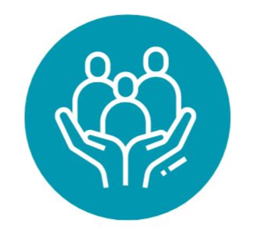

Helping families access the right people, services and information at the right time.
Key Staff Actions
Introduce themselves and explain their role
Communicate clearly and appropriately
Explain options, processes and next steps
Make sure families know who to contact for support
Respond promptly and follow up concerns
Key Leadership Actions
Provide clear and accessible information about services and access
Create clear communication routes for families
Work to reduce waiting times and improve processes
Promote multi-agency partnership working
Support staff with training and tools
Notes:
Support: Helping families access the right people, services and information at the right time
Key Leadership Actions
Provide clear and accessible information about services and access
Create clear communication routes for families
Work to reduce waiting times and improve processes
Promote multi-agency partnership working
Support staff with training and tools
Key Staff Actions
Introduce themselves and explain their role
Communicate clearly and appropriately
Explain options, processes and next steps
Make sure families know who to contact for support
Respond promptly and follow up concerns

Slide 10


Children, young people, parents and carers should be listened to, actively involved in decisions that affect their own lives and kept updated about plans and progress.
Key Leadership Actions
Embed shared decision-making
Value children, young people and families’ lived experience
Create meaningful opportunities to influence services
Support staff with tools and training to increase participation
Share information effectively across services and partners
Use feedback to improve practice
Staff Key Actions
Prepare children and families for meetings
Listen to, record and consider their views
Support questions and understanding
Explain how decisions were made
Share information appropriately with partner agencies
Encourage involvement in improving services
Notes:
Share: Children, young people, parents and carers should be listened to, actively involved in decisions that affect their own lives and kept updated about plans and progress
Key Leadership Actions:
Embed shared decision-making
Value children, young people and families’ lived experience
Create meaningful opportunities to influence services
Support staff with tools and training to increase participation
Share information effectively across services and partners
Use feedback to improve practice
Staff Key Actions
Prepare children and families for meetings
Listen to, record and consider their views
Support questions and understanding
Explain how decisions were made
Share information appropriately with partner agencies
Encourage involvement in improving services

Slide 11


Children, young people, parents and carers should know their rights as service users, including the right to speak up about their care, have their views listened to and have them considered in decisions that affect them.
Leadership Key Actions
Explain rights, feedback and complaints processes
Provide clear routes to raise concerns
Support staff to manage complaints confidently
Promote access to advocacy and independent support
Learn from feedback to improve services
Staff Key Actions
Encourage children and families to speak up
Listen and take concerns seriously
Respond promptly and follow procedures
Explain processes, support and next steps
Record concerns and outcomes clearly
Notes:
Speak Up: Children, young people, parents and carers should know their rights as service users, including the right to speak up about their care, have their views listened to and have them considered in decisions that affect them.
Leadership Key Actions
Explain rights, feedback and complaints processes
Provide clear routes to raise concerns
Support staff to manage complaints confidently
Promote access to advocacy and independent support
Learn from feedback to improve services
Staff Key Actions
Encourage children and families to speak up
Listen and take concerns seriously
Respond promptly and follow procedures
Explain processes, support and next steps
Record concerns and outcomes clearly

Slide 12

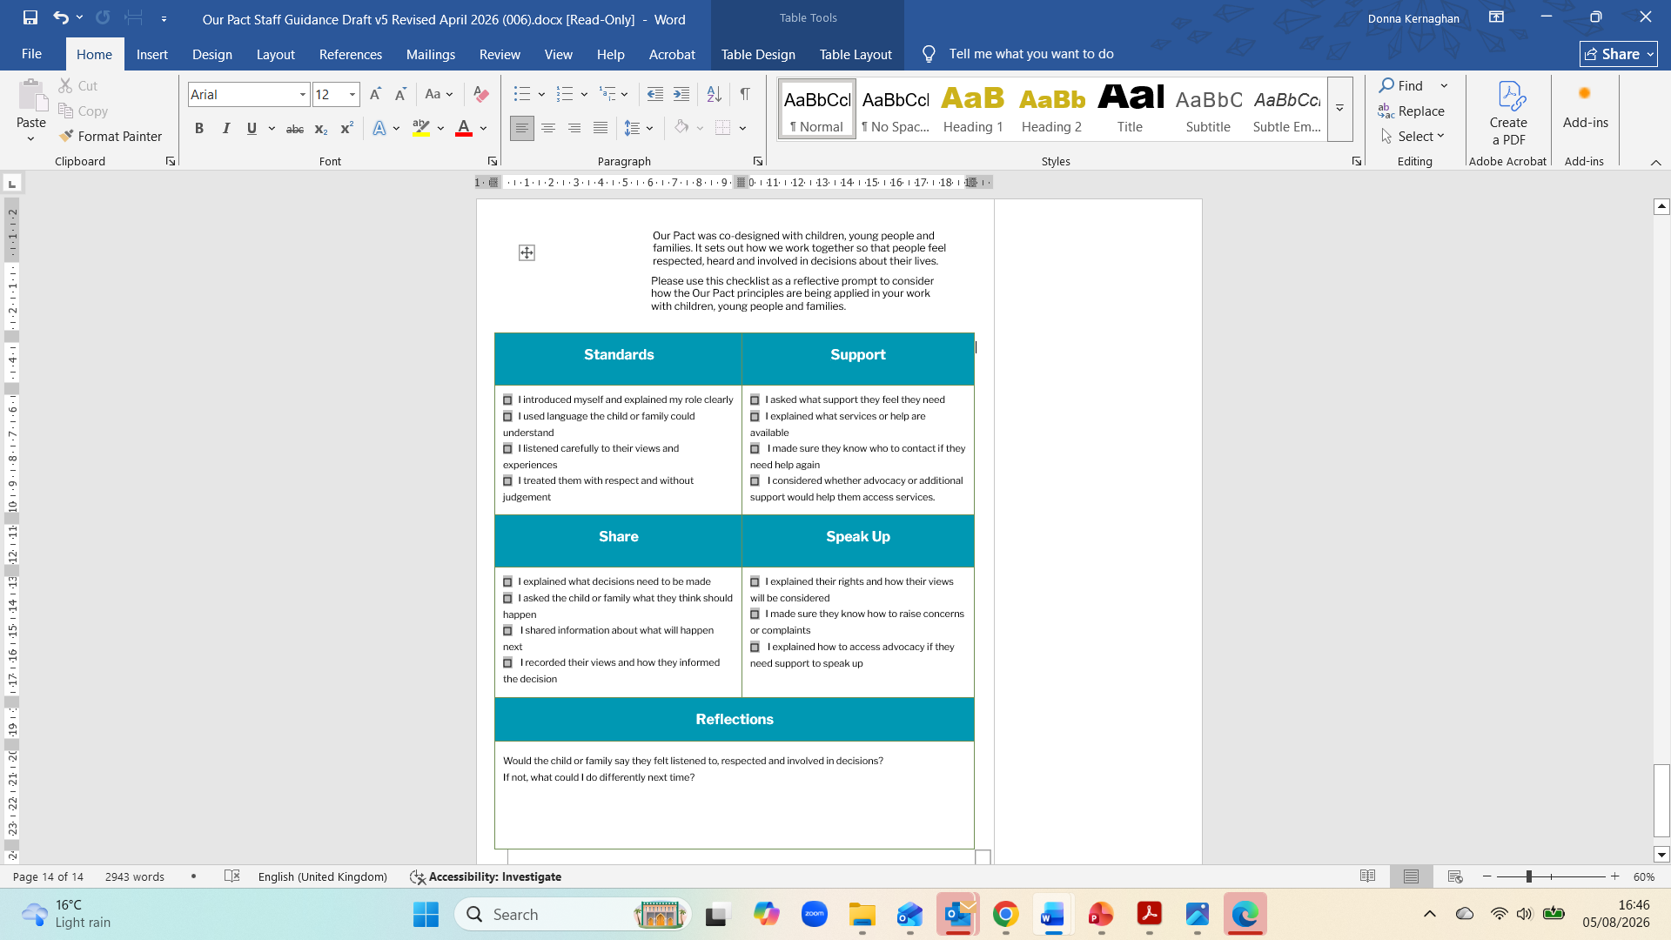
Notes:
To support staff a checklist has been developed as a reflective prompt to consider how the Our Pact principles are being applied in your work with children, young people and families. This can be found in the staff guidance.
Add link to where staff can find staff guidance

Slide 13
Why Does Our Pact Matter?
Young people told us that Our Pact matters because:
It matters because I get to be heard and people take me seriously.
Our Pact helps me know what my choices are and who I can ask for help.
It makes things clear so I understand what’s happening and why.
I feel safe and respected when adults listen.

Slide 14

Our Pact Video
Notes:
Click to play Our Pact video (2.5 mins) https://www.dropbox.com/scl/fo/jerq7g4p76a52ga174n2p/AHl-3h2ACWeAEspgBA3UVA0/VIDEO/Full%20Video?rlkey=2pzbc2eoq6fenzmshi56rfvpk&subfolder_nav_tracking=1&st=blgwnq8f&dl=0

Slide 15

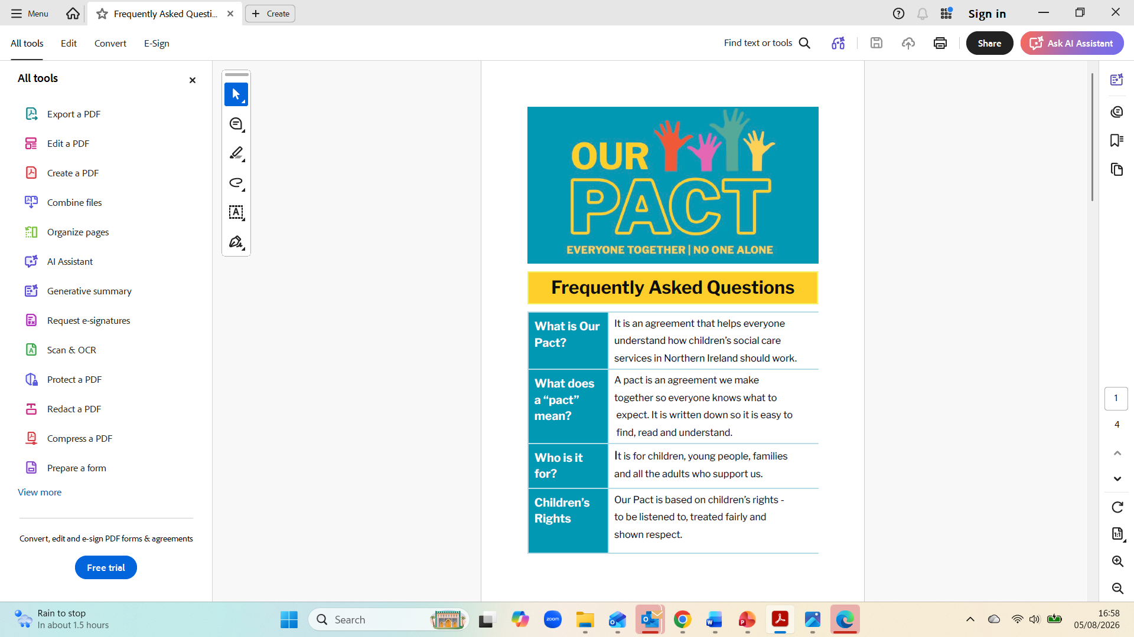
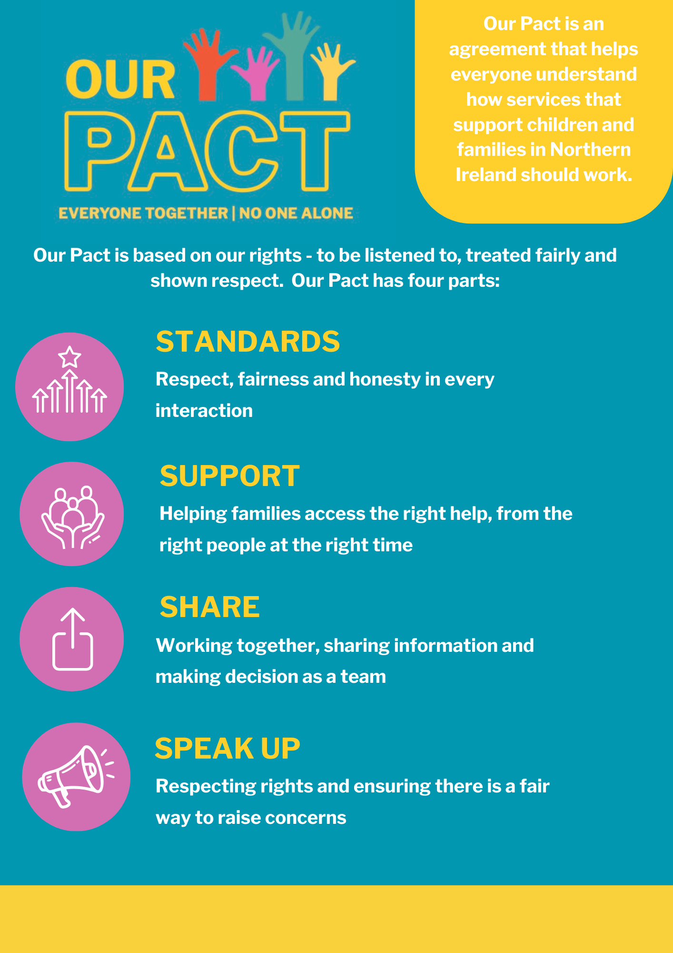
Our Pact Resources
Notes:
For more information visit: Add link
Resources include:
Our Pact Video
Social Media Assets
Staff Guidance
Poster
FAQs

