Slide 1

MARKET ENGAGEMENT
Identifying Emerging Needs:
Shaping Early Intervention Services for Children and Families in the Western Trust
A partnership conversation about earlier, practical and coordinated support
TOGETHER FOR FAMILIES
Enhanced Family Support Service
Western Trust market engagement

Slide 2
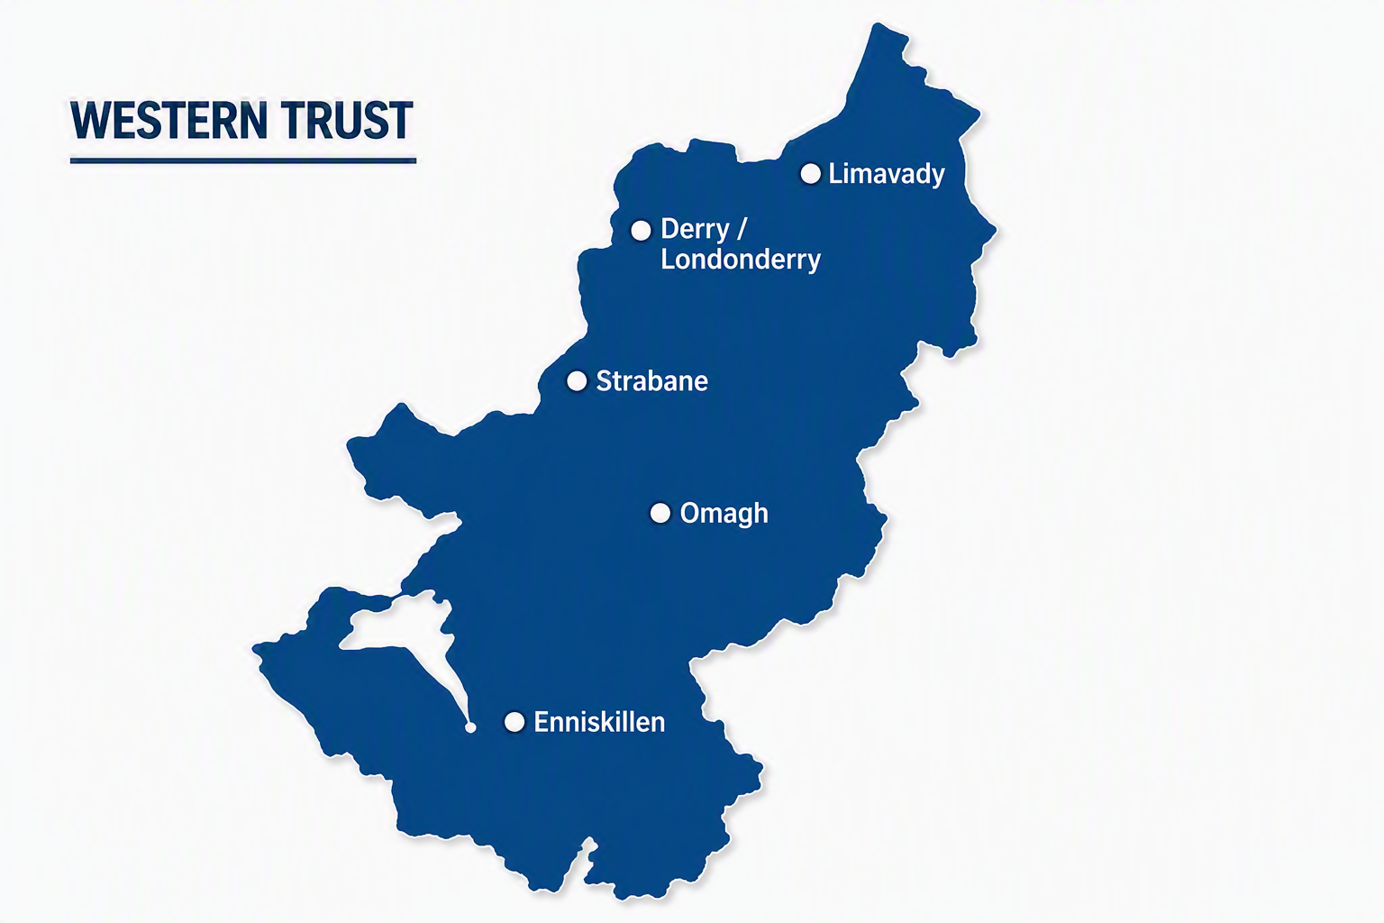
WHSCT CONTEXT
Our context makes early support harder to access
300,000
4,842 km²
25%
PEOPLE
SERVED
LIVING IN POVERTY
5 of NI’s 10
most deprived areas are within the Trust
10 of NI’s 20
areas with poorest access to services are in Fermanagh & Omagh
Rurality
Rising complexity
Distance and transport shape how families reach support.
Increasing numbers of looked-after children add pressure.
A large, rural geography with uneven access
Source: User-provided Western Trust context data
02

Slide 3
GATEWAY REFERRAL PATHWAY
Existing Gateway Referral Pathways
Further assessment
Transfer
1
Referrals
2
Single Point of Entry
3
Gateway Initial Assessment
4
Family & Childcare Teams
One route in
Identify the right response
Omagh • Derry • Enniskillen
Child Protection • Looked After • Family Support
Closure Pre Assessment
Closure Post Assessment
Closure
No Further Action
Closure
Level 2 Supports
Closure
No Further Action
Closure
Level 2 Supports
Together for Families Enhanced Service will support those families who need more that existing Level 2 Provision can currently provide
Referral pathway supplied for the market engagement presentation
04

Slide 4
GATEWAY DEMAND | AUG 2025–JUL 2026
Only 7% of referrals move into ongoing statutory support
6,618
7%
1,577
491
REFERRALS
children and expectant mothers
INITIAL ASSESSMENTS
ONGOING STATUTORY
24% of referrals
31% of assessments
of all referrals
Where demand is concentrated
INITIAL ASSESSMENT
ONGOING
Derry
995
311
Most families need a response before statutory intervention becomes necessary.
Omagh
338
75
Enniskillen
208
105
Source: Gateway data supplied in the user-provided deck
03

Slide 5
LEARNING FROM CASE REVIEWS
Four signals that earlier support could prevent escalation
A November 2025 sample found needs that could potentially be met by an enhanced service.
12.7%
71.4%
40%
50%
Closed NFA before assessment
Closed after assessment
Referred to another service
Gateway Unallocated >20 days
Would have benefited from enhanced support
Would have benefited from enhanced support
Would have benefited from enhanced support
Would have benefited from enhanced support
Opportunity: offer practical help without statutory Social Work Intervention.
Source: Sample-review findings supplied in the user-provided deck
05

Slide 6
EVIDENCE OF UNMET NEED | 2024/25
Gaps in Service Provision
Family Support Hubs most frequently reported unmet need
Gateway referral reasons
Parenting support + counselling
Home circumstances
01
for both parents and children
02
Domestic violence
03
Alcohol and drug issues
Other recurring gaps
Emotional & behavioural support
04
Parental mental health
Financial hardship
Mental health & disability support
Fermanagh reported the highest breadth of unmet need: 9 categories.
Mentoring • housing • childcare • family breakdown
Source: Family Support Hub and Gateway evidence supplied in the user-provided deck
06

Slide 7
WHAT FAMILIES NEED
Five connected needs are emerging
Families need one coordinated response—not separate services.
01
Parenting & relationships
Boundaries, routines and behaviour management; co-parenting, mediation and support where conflict affects parenting.
02
Emotional wellbeing & specialist support
Bereavement, trauma, parental mental health, addictions and neurodiversity supports.
03
Practical family help
Hands-on, responsive support that builds parenting capacity and stabilises daily family life.
04
Children & young people
Youth work, mentoring, diversionary activities and practical internet-safety support.
05
One coordinated family plan
Case coordination with other services such as Mental Health, Addictions & Women's Aid , housing, GP and therapeutic services, including family group conferencing.
Source: Emerging needs supplied for the market engagement presentation
07

Slide 8

THE OPPORTUNITY
Together, we can bridge the gap to earlier support
01
A new partnership model
A unique, innovative model for the Trust and Community & Voluntary Sector.
02
Stronger relationships
Shared learning and collaborative practice that build trust and local connections.
03
Earlier, coordinated help
Earlier whole-family support for complex needs—improving outcomes for children and families.
Building stronger relationships across sectors
GATEWAY SERVICE
Direct referral • risk support • safe response to new and emerging concerns
Support and safety go hand in hand.
Generated illustrative graphic; partnership principles supplied for the presentation
08

Slide 9

WHAT COULD WORK
Design for access, flexibility and lasting change
Six design principles
01
Adaptable across northern and southern sectors
04
Build family networks that sustain progress
02
Intensive, tailored practical support
05
Coordinate support as needs emerge
03
Flexible after 5pm and at weekends
06
Accessible through close referral communication
What would make this work in your community?
Illustrative image; service principles condensed from the user-provided deck
09

Slide 10
CLOSING TAKEAWAY
Earlier support. Stronger partnership. Safer outcomes.
There is a clear need for practical, coordinated support before statutory social work is required.
PRACTICAL
COORDINATED
COLLABORATIVE
Earlier help
Connected pathways
A new way of working
Responsive support that helps families manage daily challenges and prevents needs from escalating.
Community, voluntary and Trust services working as one network—without routine social work involvement where it is not required.
Close communication, shared risk management and joint learning that build on our combined knowledge and expertise.
OUR COMMITMENT
The Western Trust will work closely with you to transform how families receive support.
Together, support and safety can go hand in hand.
Closing remarks supplied for the market engagement presentation
10

