Slide 1
Together for Families
Market Engagement
Notes:
Introduce the briefing purpose
Recognise the immense contribution that VCS already make to CYP and families across SHSCT
Session re; Sharing the vision for development of EFSS based on the needs of the SHSCT area targeted population to give CYP the best start in life, to live well and thrive into the future.
Hopes for session that all partners work together to support CYP and families at earliest point of need.

Slide 2
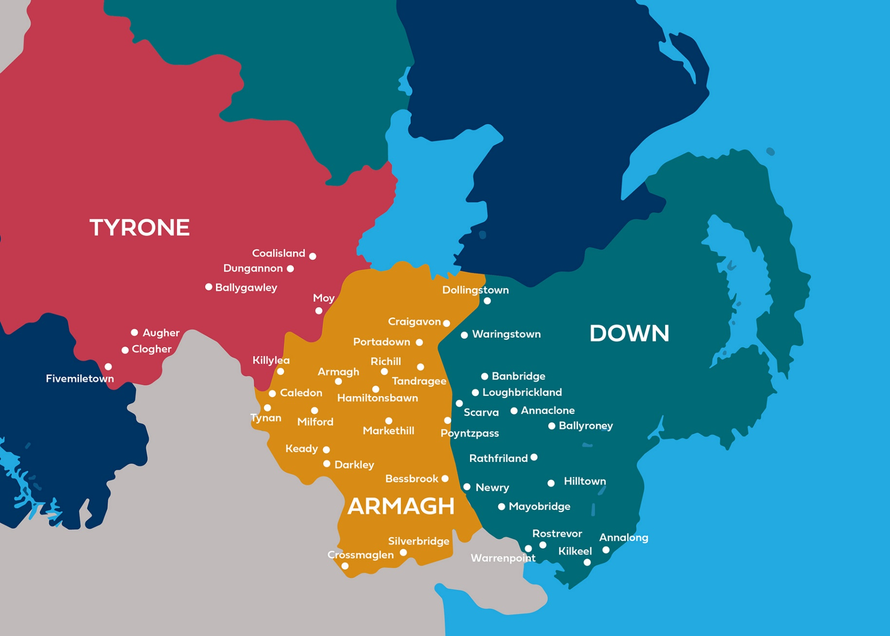
Southern Health & Social Care Trust
391k population, 94k 0-17 yrs. Increasing complexity
Second largest population of the HSC Trusts.
Growth in CB and Newry
Increasing diversity across Dungannon & Portadown.
Notes:
Within SHSCT VCS have deep local knowledge and trusted relationships within the Community and therefore important to harness this in a collaborative model for EFSS.
Areas of Deprivation;
Pockets of areas in Newry Mourne Area, (Inner city Newry and South Armagh areas), Armagh, Banbridge and Craigavon areas, (Craigavon and Lurgan areas and Upper Bann) and within Armagh City.

Slide 3
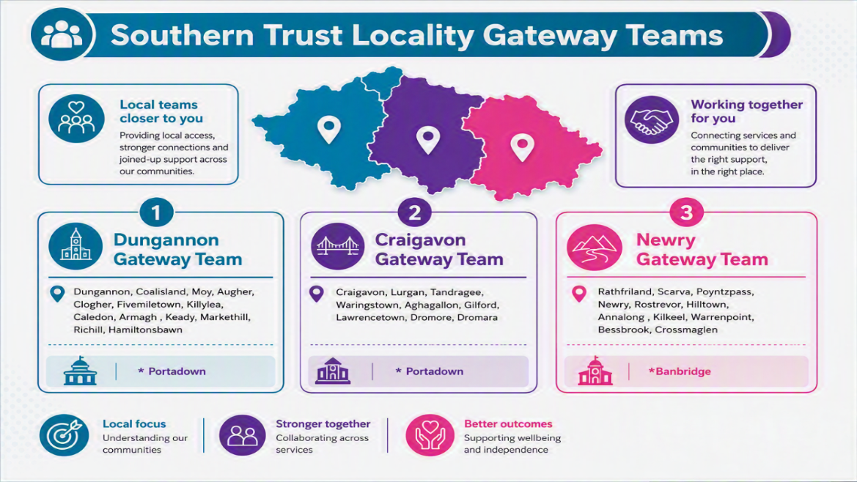

Notes:
Note demand in areas reference re Portadown and Banbridge resulting in spread across locality GW Teams.
Reference FSH are co-terminus with GW Teams.

Slide 4
Using the Census 2021 age profile for this area (approximately 24% aged 0-17), the child population can be estimated as:
Age Band | Southern Trust Total | % of Total Population | Craigavon & Banbridge | Armagh & Dungannon | Newry & Mourne
0-4 years | 24,000 | 6.1% | 9,500 | 8,000 | 6,500
5-11 years | 38,000 | 9.7% | 14,900 | 12,500 | 10,600
12-15 years | 21,000 | 5.4% | 8,300 | 7,000 | 5,700
16-17 years | 11,000 | 2.8% | 4,300 | 3,600 | 3,100
Total 0-17 years | 94,000 | 24.0% | 37,000 | 31,100 | 25,900
18+ years | 296,976 | 76.0% | - | - | -
Total Population | 390,976 | 100% | 154,000 | 130,000 | 107,000
Notes:
Trust’s work aligns to both strategies — prevention, protection, partnership, and performance. Total population of 390k and 94k children across Trust area.
No single org can meet the all levels of need across SHSCT area; partnerships are critical to providing support to CYP and families.

Slide 5
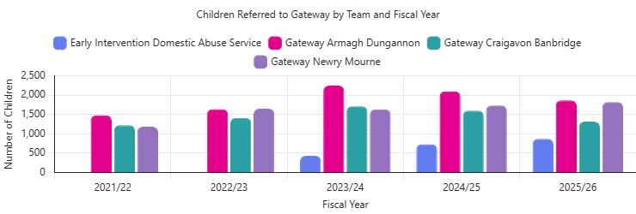
Notes:
Reflect overarching no of referrals to service from 2021/22 to 25/26 on average 7-7.5k children referred per year.
GW teams receive significant referrals across all localities.
Significant proportion of referrals are closed by GW teams following initial assessment; (approx. 70%).
Many families present with emerging needs that do not require statutory intervention but would benefit from timely, targeted support.
Reference EIDAS – is an early intervention support for children, victims and families who have experienced domestic abuse and do not meet threshold for statutory intervention, however, would benefit and are consenting to early help and support. This is provided via a skills mix team in SHSCT.

Slide 6
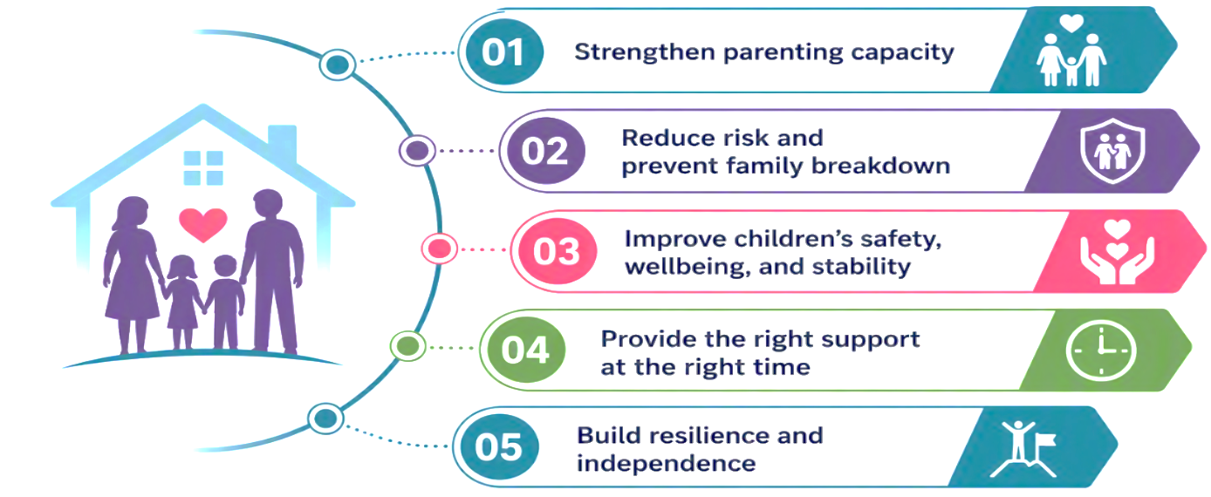
Vision for the Enhanced Family Support Service
The Vision for the Enhanced Family Support Service should include a clear, shared intention to:
Strengthen parenting capacity
Reduce risk and prevent family breakdown
Improve children’s safety, wellbeing, and stability
Provide the right support at the right time
Build resilience and independence
Notes:
Reference demand / unallocated cases and the Trust approach to collaborative working with VC sector in response to these challenges; Family Focus pilot with VCS, Trust led intervention, (ELEOS) and engagement with FSH and providers,.

Slide 7
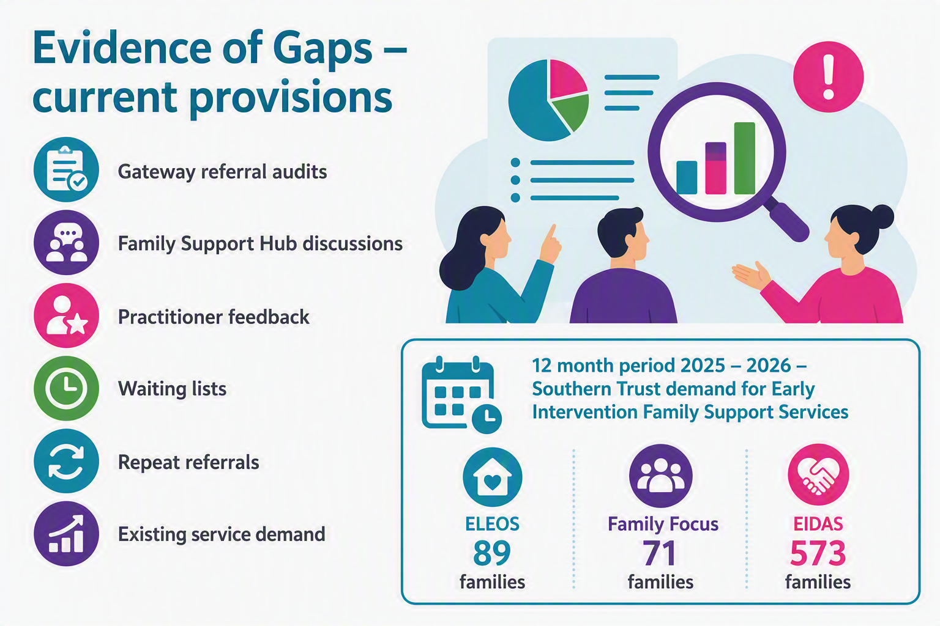
Notes:
Evidence gathering;
Due to vacant SW posts support was piloted via FS interventions via Family Focus with VCS Provider and ELEOS pilot within SHSCT, both providing family support to CYP in need.
EIDAS – skills mix service is available within SHSCT and note the demand and uptake of support has been high. Outcomes are reported as positive. Therefore, whilst we have a service in this area, the key would be that all service providers would have a good knowledge and understanding to recognise and respond to domestic abuse and to navigate CYP and victims to appropriate supports. This should include all victims of domestic abuse.

Slide 8
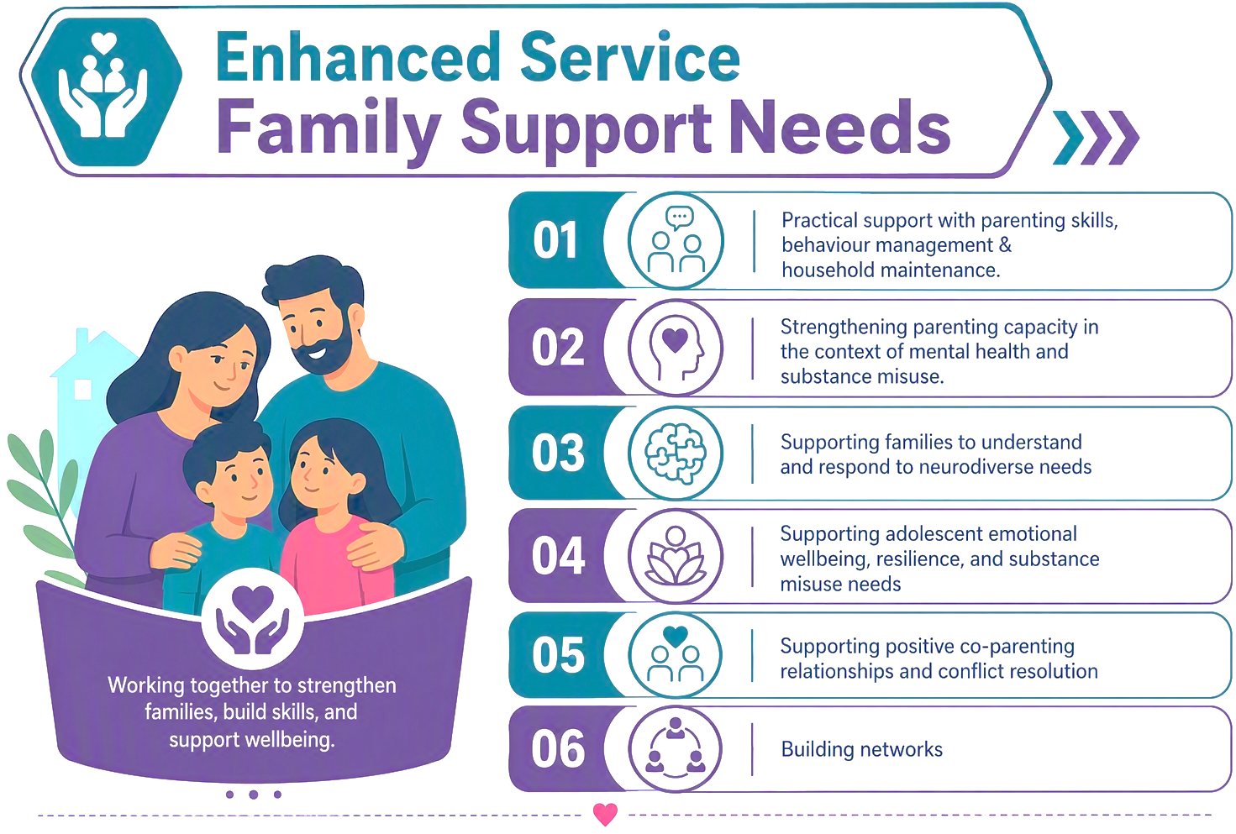
Notes:
Draw out key themes and include flexible, holistic and family centred supports.
Service design is around family needs.

Slide 9
Locality Specific issues.
Already established a successful early intervention domestic abuse service
Large concentration of ethnic minorities in the Portadown / Dungannon areas – limited support networks.
Large geographical area of Dungannon & Newry localities

Slide 10
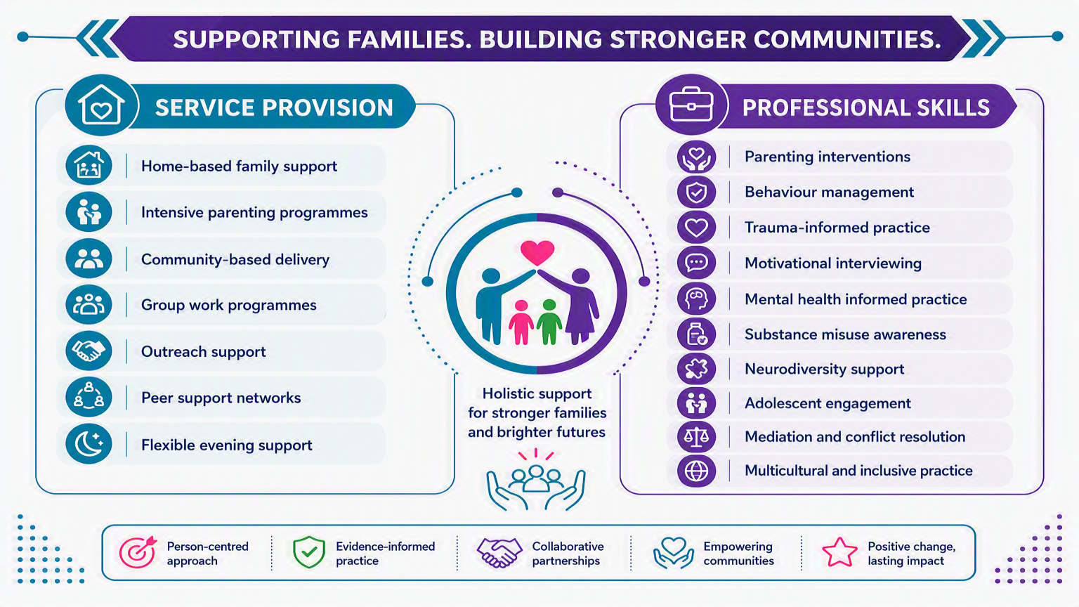
Notes:
Families tell us they need flexible and responsive supports, traditional hours do not fit around family life, work commitments and children’s routines.
Access to support that is practical, accessible and welcoming.
Professional skill are wide and varied.

Slide 11

Opportunity for future service Provision
Enhanced Services Model aims to support the development of a responsive, strengths-based family support service that helps children thrive, builds family resilience, and enables families to remain safely together.
Collaboration to work together to strengthen early intervention and prevent families from reaching crisis point.
Partnership with the community and voluntary sector.
Notes:
TFF is built on a simple belief when we combine the strengths of stat service, community organisations and local families – we create better opportunities, therefore this marks a new beginning and an exciting opportunity to collaborate on partnerships for years to come.

