Slide 1


South Eastern Trust
Enhanced Family Support Service: Our Need

Slide 2

Gateway Referral Pathway
SPOE
CLOSED
REFERRALS
Community & Voluntary
Family Support Hubs
LOCALITY GATEWAY
DOWN
ARDS
LISBURN
Notes:
All referrals come into our Single Point of Entry Service (front door). Here they are triaged and if a further social work assessment is required, they are transferred to our Gateway Service- comprising of 3x locality teams.

Slide 3
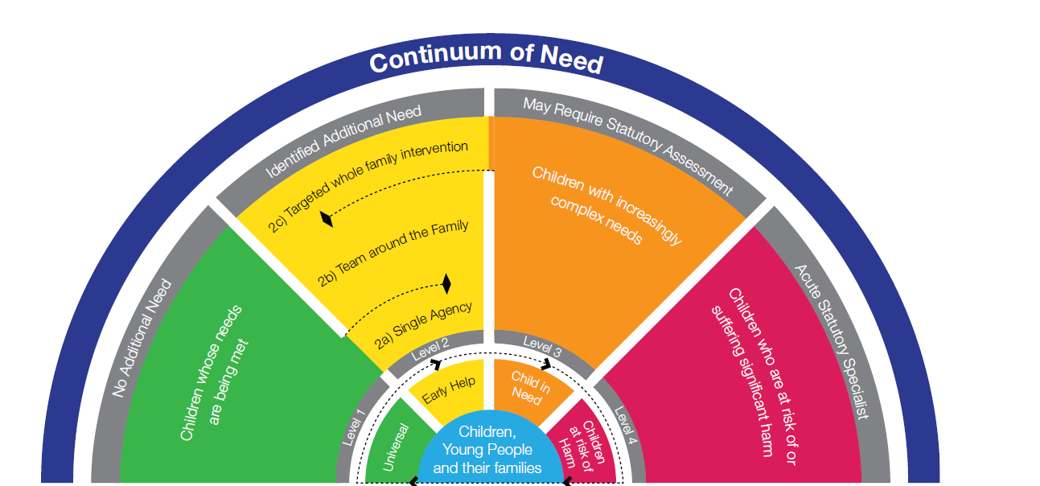
The Enhanced Family Support Service
Not all families referred to Gateway will require Statutory Social Work, but they do need help to reduce risk and improve family dynamics. It is anticipated that EFSS will work with referrals identified as a ‘high level 2’ on the Continuum of Need.
Notes:
A high level 2 is characterised by multiple complexities, but after assessment, determined that it does not necessarily need a statutory intervention. Every case is going to be different and have different levels of complexities, but the hope is that with enhanced family support work and early non-statutory intervention, these families can avoid the need for onward referral to our Family Support Team in the Trust.

Slide 4
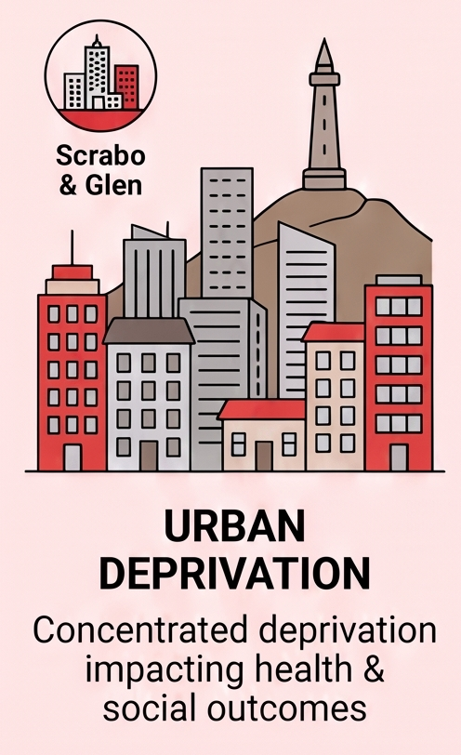
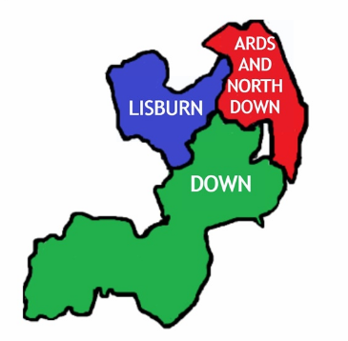
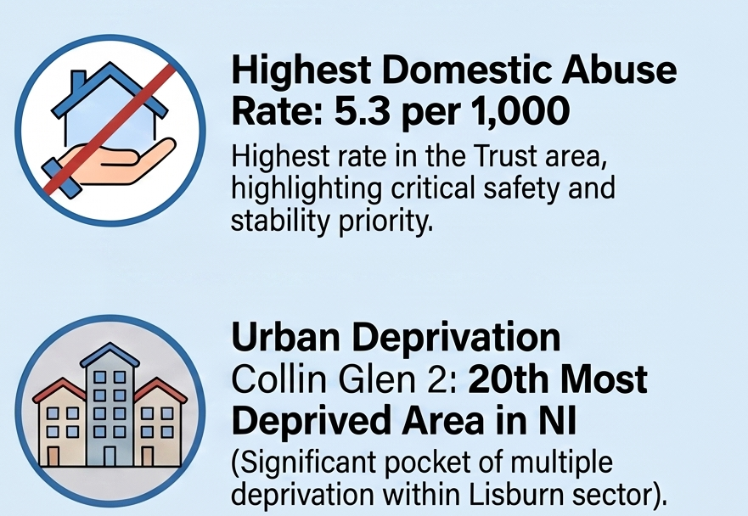
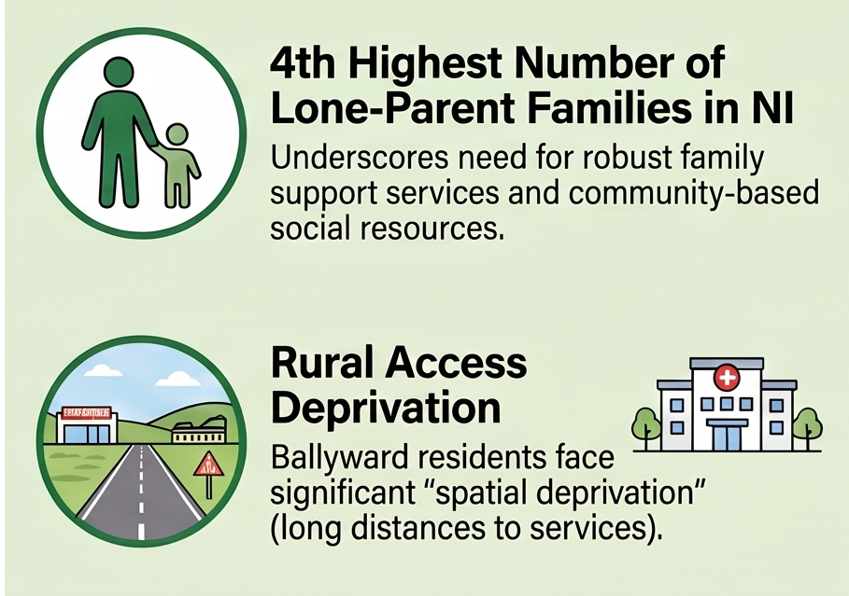
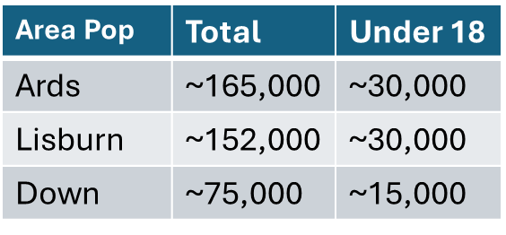
Our Landscape
Notes:
The SET is spread across 3x locality areas. Within our trust, we have 1x single point of entry and 3x locality Gateway Teams. Whilst Down in the largest geographical area, it typically receives less referrals, reflective of population size. Lisburn and Ards receive comparative referrals into Gateway. Each locality area has its own complexities, so whilst Down receive less referrals, approximately 70% of the population in Down are from rural areas, which makes access to services harder, along with the highest number of lone-parent families or single parent households. Ards have concentrated areas of deprivation- particularly in Scrabo and Glen, as well as a large spread (down the peninsula)- which makes travel and providing support to the Ards area more of a challenge, similar to Down.. Lisburn has a lot of affluence and is an predominantly urban area, but it has the highest incidences of DV across the Trust, along with areas of Deprivation, such as the Colin Glen Area that is the 20th most deprived area in NI.

Slide 5
Our Landscape
281 Initial Assessments completed in Gateway
274 Initial Assessments completed in Gateway
Between January-June 2026 we received a total of 2380 referrals into SPOE. This is approximately 4000 children.
724 (30%) referrals transferred from SPOE to Gateway locality teams for Initial assessment.
169 Initial assessments completed in Gateway
GATEWAY
SERVICE
Closed (NFA)
Family Support Hubs
Community & Voluntary Sector
Family Support Service
Safeguarding Service
Some of these referrals could be worked through EFSS
Notes:
We carried out a recent data grab for Gateway – We looked at referrals received in the 6 month period from Jan – June 2026 and the journey both through Gateway and beyond the service. Although this is a small sample, this is generally reflective of the typical referral rates and the spread of these across the geographical areas.
Gateway in SET generally receives between 4 and 5 thousand referrals each year, involving approx. 8 thousand children.

Slide 6
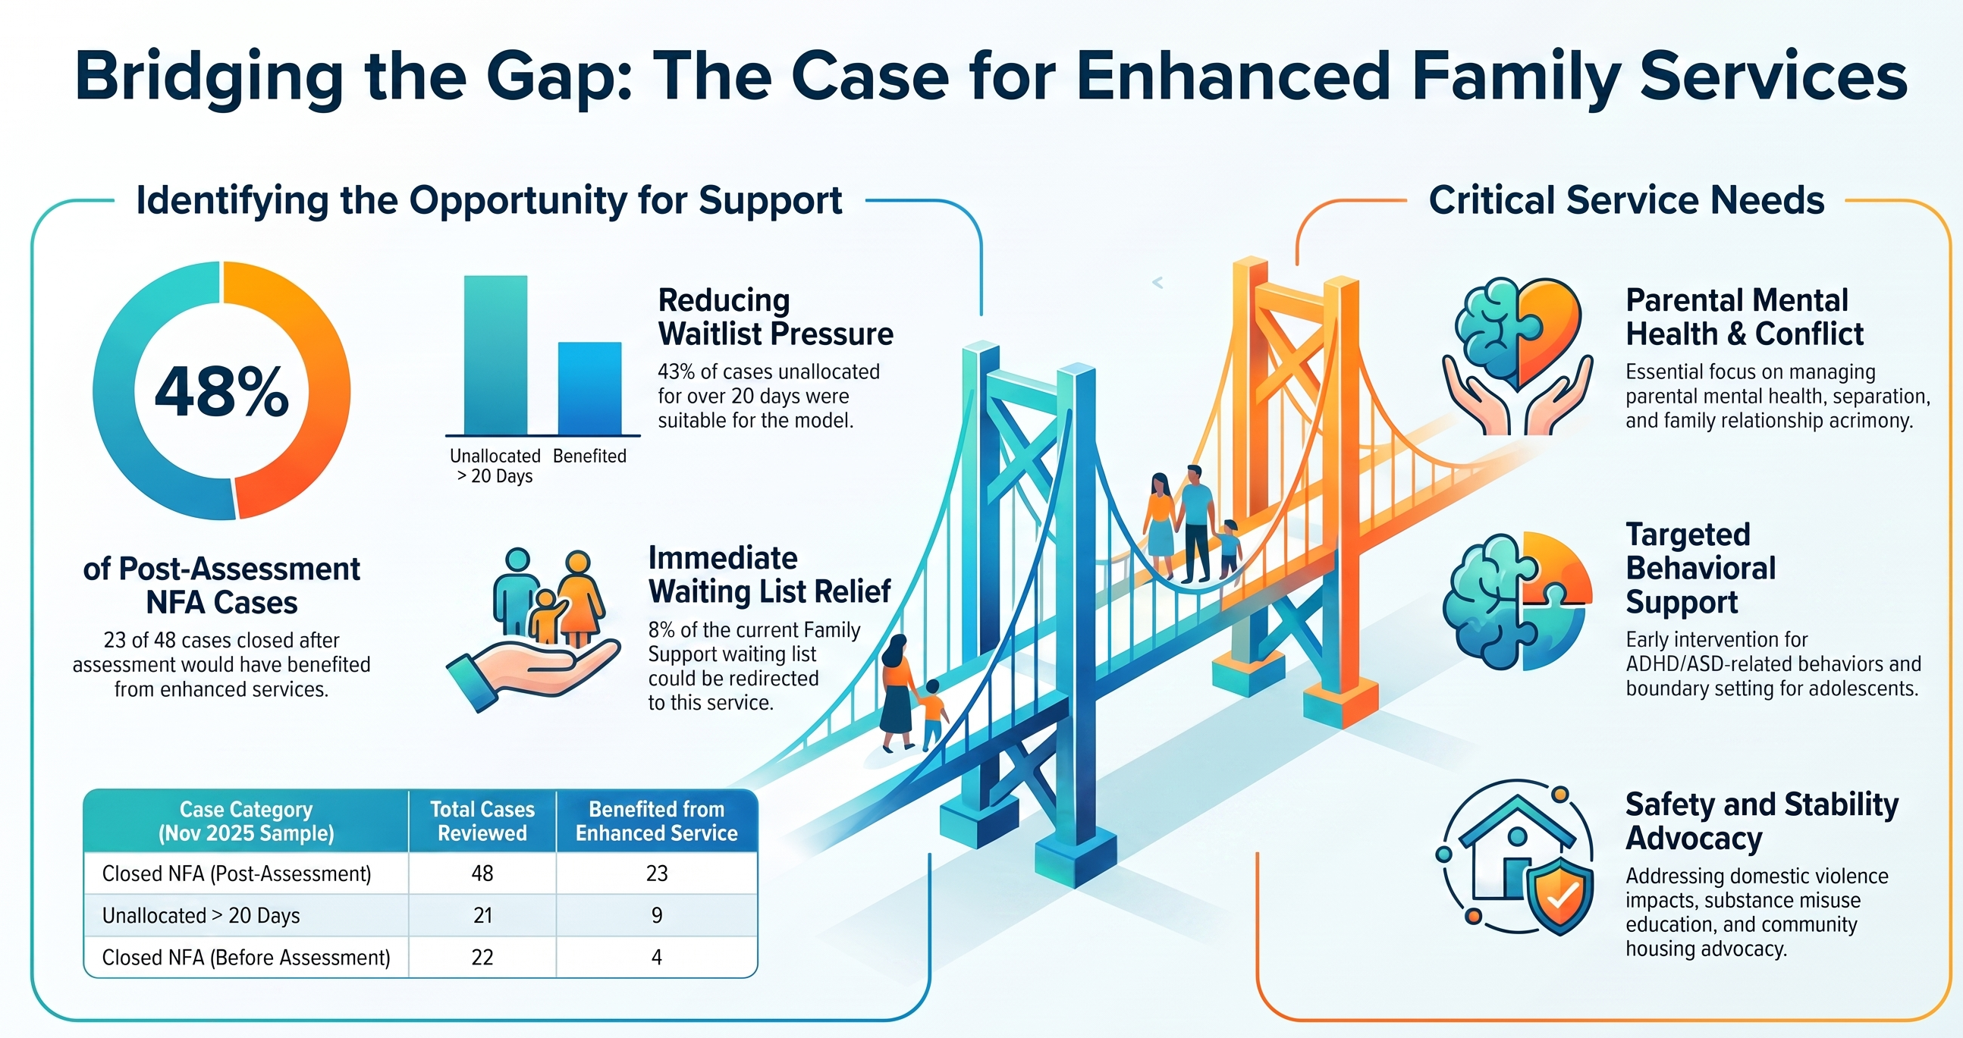
Emerging Need for Enhanced Support
48% cases closed following assessment at Gateway would have benefitted from EFSS
Notes:
Based on a scoping exercise from a small sample of cases being worked in gateway and on our waiting list in November 2025*- a small sample but evidently shows the need for a service that could help reduce waiting list pressures on our family support team and provide more targeted support to families at that earlier stage without a statutory social work service. For example, 48% cases assessed at gateway and closed could have benefitted from the EFSS. Equally, 43% of (a small sample of our waiting list cases) could benefit from this enhanced service and 8% of those that we sampled that where transferred to the Family Support Service waiting list could have been supported by the EFSS.
Key areas across the sample indicated working with families to help manage mental health, help with broken homes and family dynamics, challenging behaviour and impact of ASD/ADHD within families- both from a parent and child perspective, and targeted support for households impacted by DV and substance misuse.

Slide 7
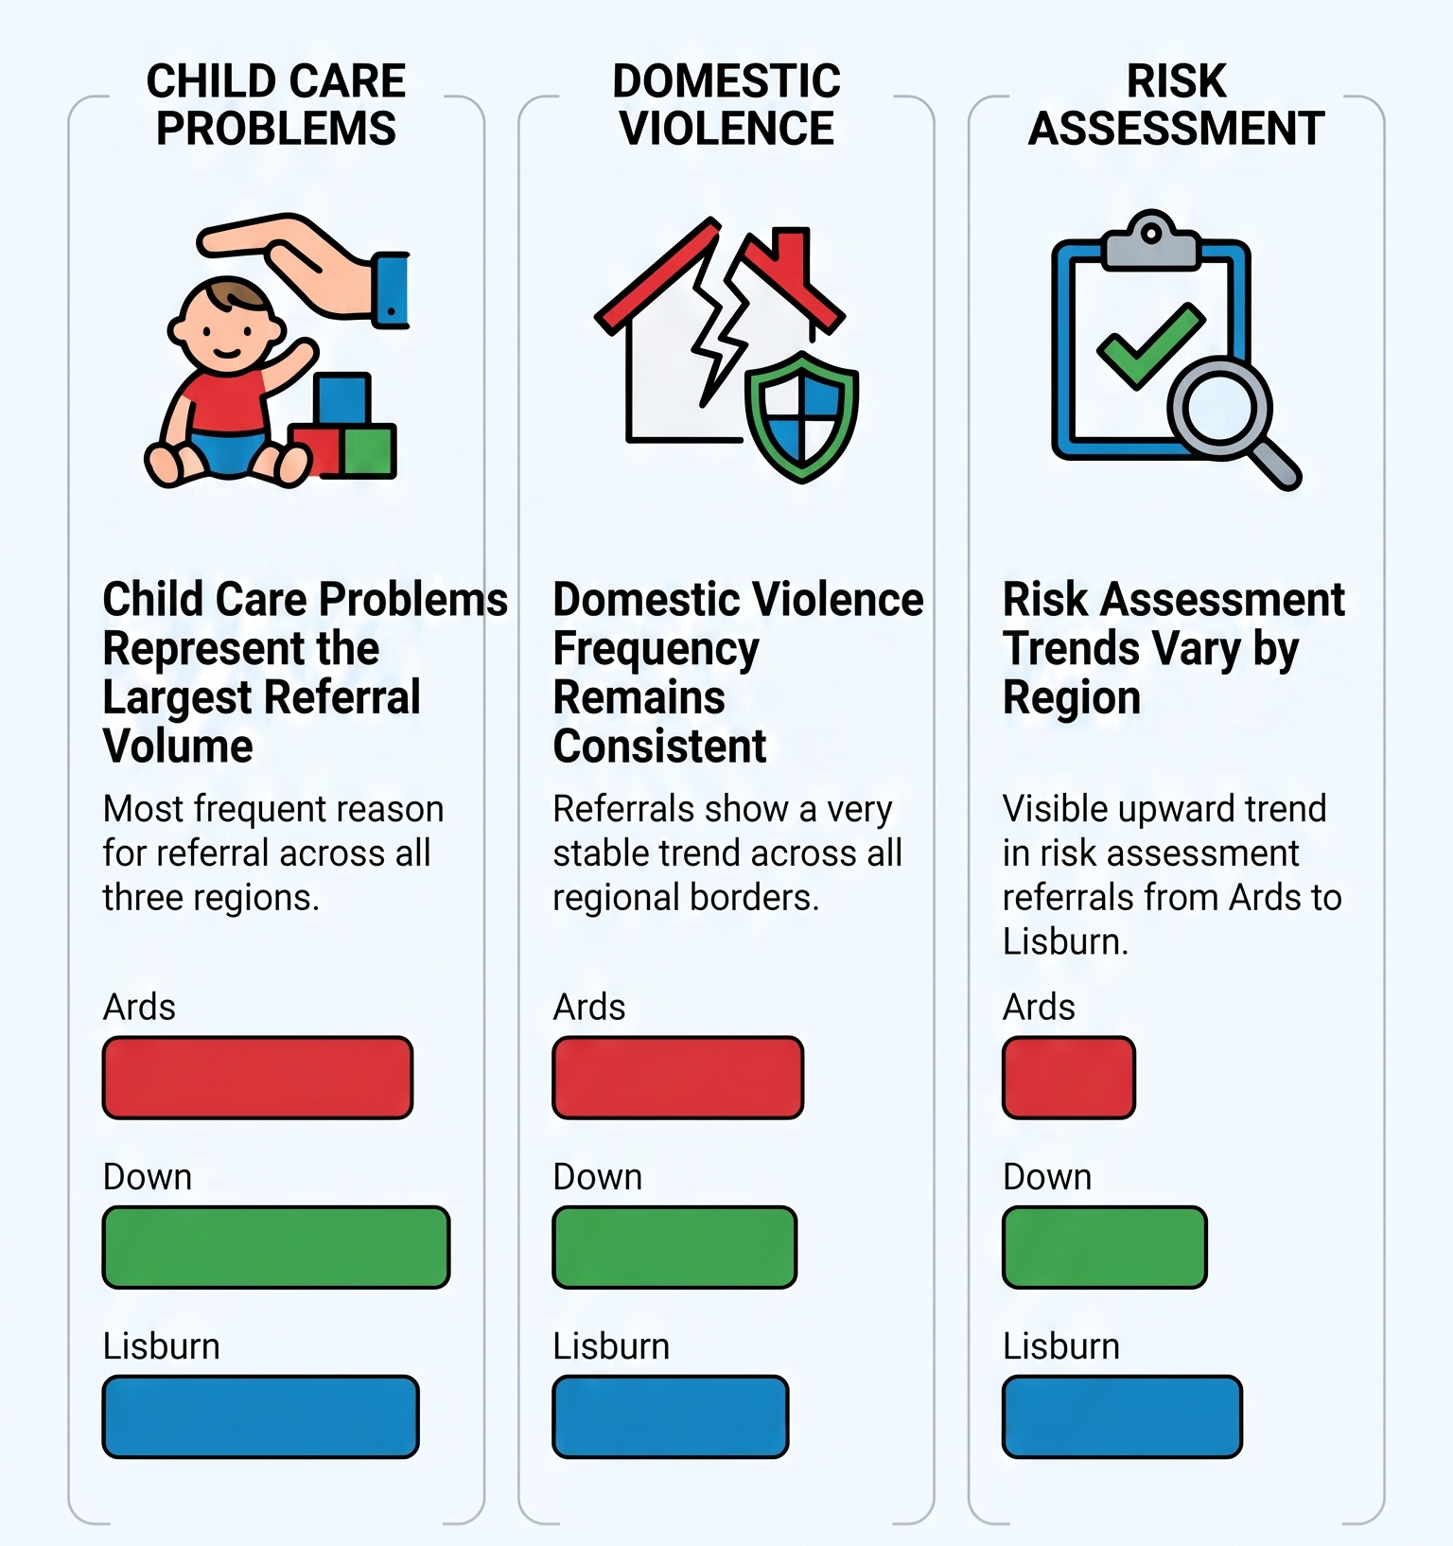
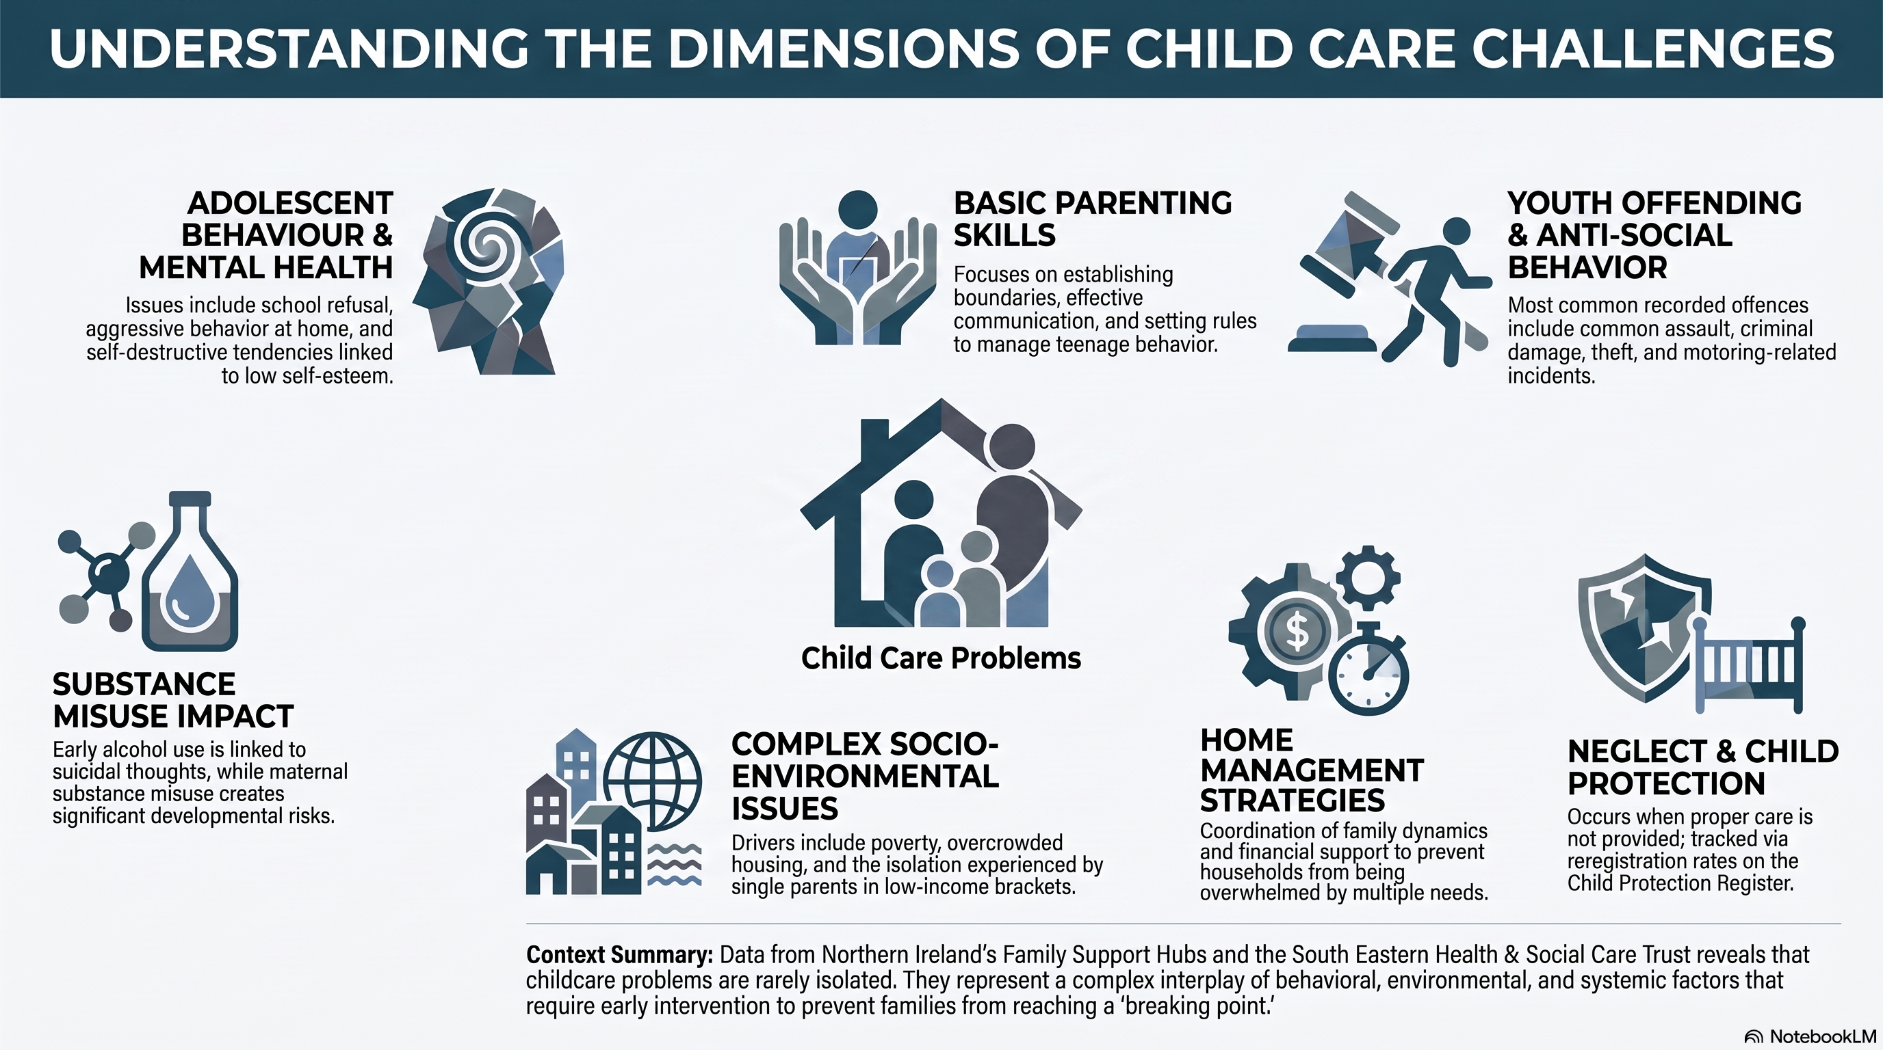
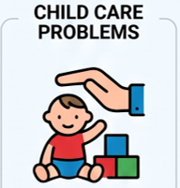
Key needs across the Trust
Parenting Skills
Adolescent & Adult Mental Health
Substance Misuse
Home Management Strategies
Youth anti-social behaviour
Socio-economic challenges
Notes:
Last 6 months the top reasons for referrals have been Child Care problems, DV and Risk Assessment. What does child care issues look like? – they can present as a number of different challenges – such as parenting capacity and basic parenting skills, adult and adolescent ill health, anit-social behaviour, substance misues, both with children and adults/parents and socio-economic complexities- which could be housing, poverty, isolation etc

Slide 8

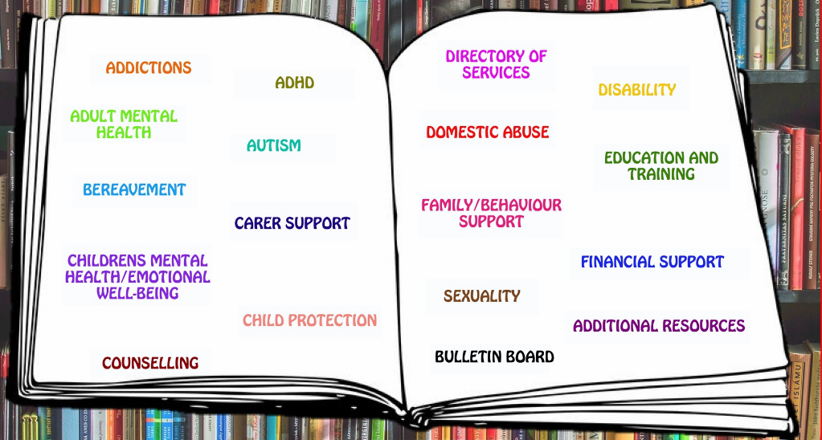
Our Early Help Journey at Gateway
Notes:
Within the Trust we are committed to working in partnership with our comm & vol collegues and organisations. In 2021, we received funding from the Q community to recruit an Early Help Co-Ordinator and establish an Early Help Team in Gateway. This was a great success an provided the type of early intervention work that we hope this EFFS could provide. We also developed an Early Help Knowledge Bank, which is a one-stop shop for all services and support available within the Trust localities, with information, referral forms, contact details etc at the touch of a button. This has been invaluable to our staff both in Gateway and in our Family Support Teams, and to date has been accessed and viewed over 5000 times. There is a great appetite within our service for families to receive support at the earliest intervention. But capacity and statutary work can make it difficult to provide.

Slide 9
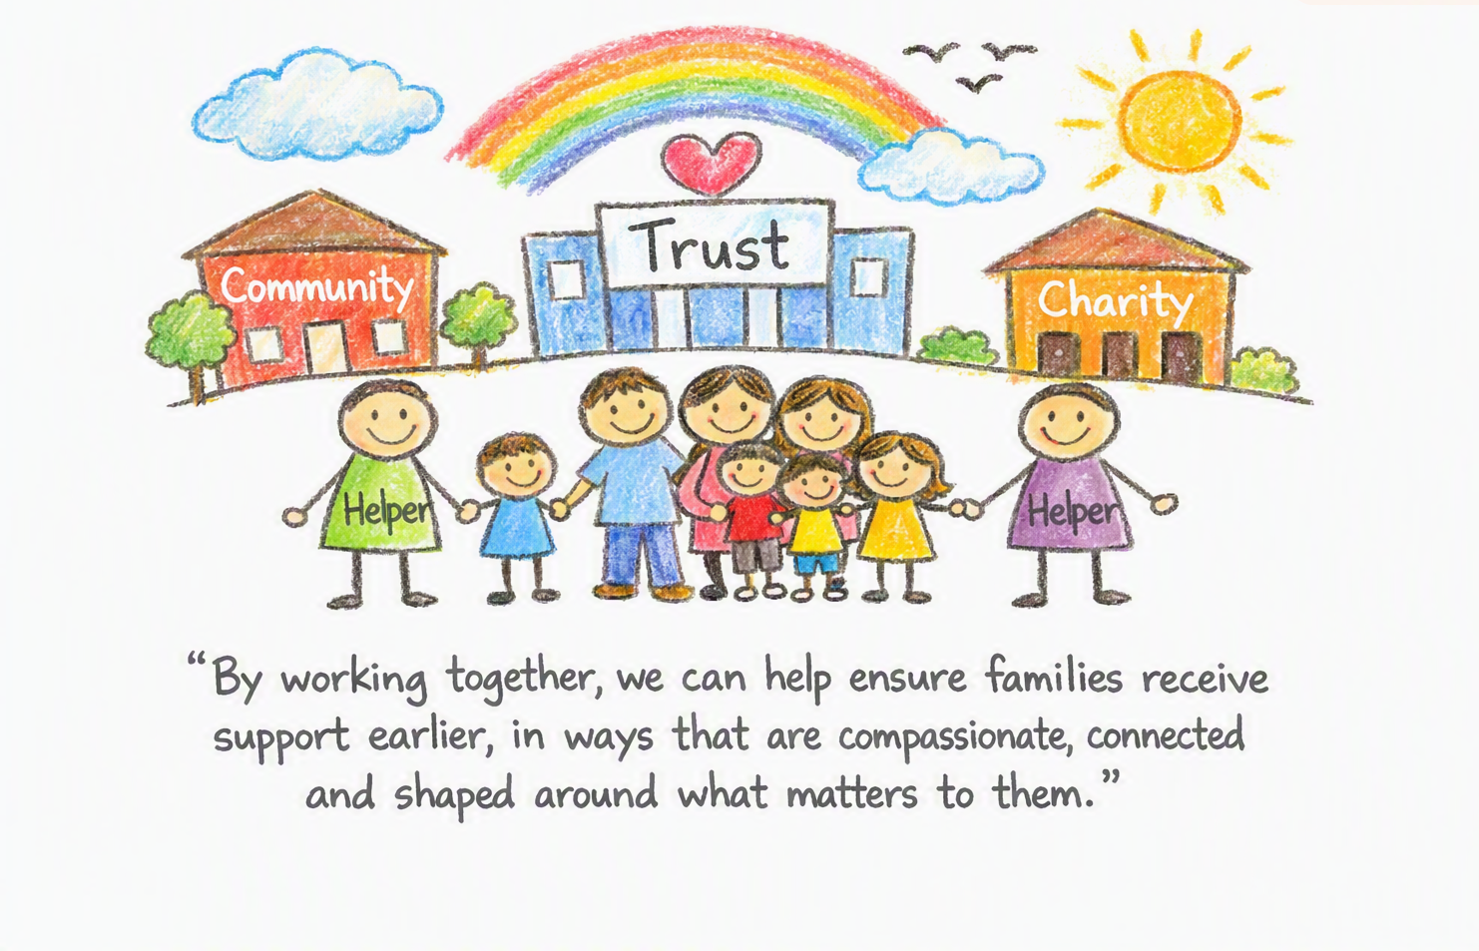
Thank you
Notes:
Kate Beggs- national director for national Lottery Communtiy Fund sums it all- “by working together, we can help ensure families received support earlier, in wats that are compassionate, connected and shapred around what matters to them”. We cant do this alone, family support is so much bigger then social services.

