Slide 1


WELCOME TO THE NHSCT ENGAGEMENT EVENT FOR THE
Enhanced Family
Support Service
Market engagement | Northern Health and Social Care Trust

Slide 2

NHSCT APPROACH: FAMILIES FIRST FRAMEWORK
NHSCT Approach to Working with Families
FAMILIES FIRST 5 PILLARS
OUR CORE BELIEFS
OUR SHARED WAY OF WORKING
Relationships first
1
1
Children thrive on connection
ONE
One way of working
Safety through collaboration
2
2
Families have strengths, even in crisis
ONE
One plan around the child
Strengths led and inclusive practice
Systems adapt to children,
not the other way around
ONE
One shared language
3
3
3
ONE
One expectation of quality
4
Wraparound community support
Relationships create safety and
change
4
Flexible and persistent support
5
5
Care is short, purposeful, and a last resort
Enhanced Family Support Service | Northern Health and Social Care Trust
3

Slide 3
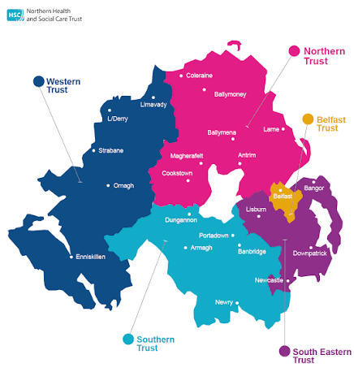
OUR GEOGRAPHICAL AREA
The largest Trust area in Northern Ireland
1,733
480,000
SQUARE MILES
PEOPLE SERVED
The largest of the 5 Trust areas
The resident population of the Trust area
13,000
4156
STAFF EMPLOYED
Children in Need (March 2026)
Across hospital and community services
403 (CPR) & 901 (LAC)
106,631
Children on Child Protection Register and Looked After Children(August 2026)
CHILDREN
Northern Trust area shown in pink
Highest under 18 population
.
Enhanced Family Support Service | Northern Health and Social Care Trust
4

Slide 4
OUR GEOGRAPHICAL AREA
Our Landscape- Urban vs Rural
Urban Deprivation:
Ballymena, Coleraine, Larne and Carrickfergus, largely driven by:
Income
Employment
Education
Poorer health outcomes
Rural deprivation:
Causeway Coast and Glens, Mid and East Antrim and parts Antrim and Newtownabbey:
Poorer access to services
Transport difficulties
Social isolation
Hidden Poverty
H
Enhanced Family Support Service | Northern Health and Social Care Trust
4

Slide 5
HOW REFERRALS FLOW
SPOE and Gateway teams
SPOE | Referral Gateway
Takes referrals from the entire Trust area
Team has a specific CWD practitioner and 2x DV workers
Northern Gateway
Central Gateway
South Eastern Gateway
Coleraine
Ballymoney
Kilrea
Garvagh
Portrush / Portstewart
Ballycastle
Cushendun / Cushendall
Ballymena South
Antrim
Mid Ulster area including Magherafelt & Cookstown
Ballymena North
Newtownabbey / Whiteabbey
Carrick
Larne
Ballyclare
Greenisland
Whitehead
Carnlough
Enhanced Family Support Service | Northern Health and Social Care Trust
5

Slide 6
REFERRAL ACTIVITY
Total referrals into SPOE and onward transfers to Gateway
9,066
Children referred into SPOE 2025/26
Highest numbers of referrals:
Domestic Violence
Family Support
Childcare concerns
75 %
Closed by SPOE in 2025/26
25 %
Transfers to locality in 2025/26
Transfers to GW locality Teams
Central – 37%
Northern - 30 %
SET – - 33%
Enhanced Family Support Service | Northern Health and Social Care Trust
6

Slide 7
WHAT PRACTITIONERS ARE ASSESSING
Emerging needs
1
2
Practical parenting support,
3
Emotional and behavioural support at a higher level than previously seen, in children as young as 3
Non-school attendance
4
5
6
Neurodiversity & those children who do not meet the criteria for Children with Disability Services
Mediation and contact/Parental Acrimony
Lower-level sexualised behaviour in children & Online Safety / Healthy Relationships
Alcohol and Substance use
(Adults & Young People)
Growing population of Ethnic Minority families
Domestic violence
Waiting lists for services are lengthy, resulting in families feeling they have nowhere else to turn.
7
8
9
Enhanced Family Support Service | Northern Health and Social Care Trust
10

Slide 8
Emerging Need for Enhanced Family Support
40 % of children who were closed following an I/A would have benefitted from EFSS
1
2
3
45 % of children closed without an I/A would have benefitted from EFSS
100 % of families who declined a service
Following an I/A would have benefitted from EFSS
6
4
5
60 % of children who were closed and referred to another service would have benefitted from EFSS
33 % of unallocated cases were suitable for EFSS and 40 % of unallocated cases within FSIT
Waiting lists for services are lengthy, resulting in families feeling they have nowhere else to turn.
Enhanced Family Support Service | Northern Health and Social Care Trust
10

Slide 9
DIP SAMPLE OF CHILDREN AND FAMILIES CASES
Analysis of unmet need and gaps in provision
Substance misuse, domestic abuse and parenting support are the three needs appearing most often in the dip sample.
Most cases carry more than one unmet need at the same time, which is why single-issue provision rarely resolves them.
Enhanced Family Support Service | Northern Health and Social Care Trust
11

Slide 10
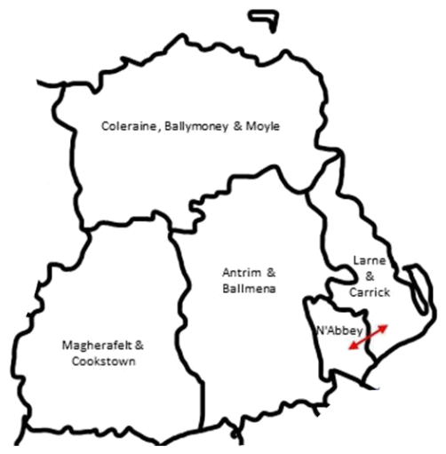
FAMILY SUPPORT HUBS AND UNMET NEEDS, NORTHERN AREA 2025/26
What are the gaps?
Coleraine, Ballymoney & Moyle
Antrim & Ballymena
Emotional and behavioural difficulty support for pre-school children
Emotional and behavioural difficulty support for primary school children
Counselling for children and young people
Emotional and behavioural difficulty support for pre-school children
Emotional and behavioural difficulty support for primary school children
Emotional support for children (bullying, separation etc)
School attendance
Magherafelt & Cookstown
Emotional and behavioural difficulty support for pre-school children
Emotional and behavioural difficulty support for primary school children
Newtownabbey, Larne & Carrick
Emotional and behavioural difficulty support for primary school children
Practical support e.g. furniture / appliances
One to one support for young people
Family Support Hub areas
Enhanced Family Support Service | Northern Health and Social Care Trust
12
Notes:
Neurodivergent children are coming more frequently as a CIN following the closure of local services such as Neurodiversity, lengthy waiting lists of 3-5 years, and parents voicing that they are less likely to engage with the recommended support of online podcasts - parents are clear they prefer hands on / visible in person learning / training.
Emotional behaviour in younger children of late is becoming more and more significant - this is now even more prevalent in the younger age groups, from as early as 3 years old some parents are reporting. It seems that parents are struggling to know how to manage and intervene. Families are not as close knit and have less support at times. These families typically feel great support in services like Safer Families etc. There is also a clear causal link between parents' ability to manage behaviours / behavioural issues and school attendance, given this is usually due to school refusal.
Behavioural is the main concern coming through, with parents feeling unable to safely manage their child's behaviours, being worn down and having limited guidance - closely linked to behavioural issues with young people who have a diagnosis / are on the waiting list for ASD.
Addictions - there is a clear pathway for parents / family members with addictions issues via CAT when addiction is ongoing. However, parents are trying to self-manage and reduce whilst awaiting an appointment or a referral to be made, and at this point are then experiencing relapse. An intervention / support with a more immediate response at this point is crucial as motivation levels are very high. In some cases, even if the family member has remained abstinent the referral to CAT is declined and they are then passed on to Extern for motivational support, adding to this delay for intervention.

Slide 11

THE VOICE OF FAMILIES
What our families need
1
Visible, hands on practical support in their home when they need it
2
Services who can help them understand why the support is important for their children, e.g. SLT, SEN
3
Training or learning in person, where they feel able to ask questions
4
Responsive and flexible services without waiting lists
Families are asking for support that is visible, practical and available when they need it — not another waiting list.
5
Services for parents like addictions support, counselling or mediation that build their capacity to parent in the long term
6
Community Networks and Supports
Enhanced Family Support Service | Northern Health and Social Care Trust
13

Slide 12
Thank you
Questions and discussion
Enhanced Family Support Service | Market engagement | Northern Health and Social Care Trust

