Slide 1

Enhanced Family Support Service Grant Programme Webinar

Slide 2
Webinar Agenda
Overview of:
Together for Families
Enhanced Family Support Service
Application process/expectations

Slide 3
Jacinta Linden Co-Director Together for Families.
Email: togetherforfamilies@health-ni.gov.uk
FAO: Jacinta

Slide 4
Programme vision
To create a regionally consistent, locally responsive system of enhanced family support that enables children, young people and families to access the right help, at the right time, in the right place — preventing escalation, strengthening resilience, and improving long-term outcomes.

Slide 5
A new model for Family Support
Developed from extensive research
Built by the partners of the Family Support workstream , Social Care Reform
Informed by Professor Ray Jones review
Informed by TNL Reaching Out Supporting Families programme
Total Investment £59.2 million
£29.2 Million from the Public Sector transformation fund
£30 million from the National Lottery Community Fund
Notes:
site visits, quantitative analysis and extensive engagement with families, children practitioner's and professionals across NI and further afield

Slide 6
Evidence
Over 4260 children in care in NI
+ 47% over 10 years
+ 26% increase in children in care over 5 years
Over 110,000 children growing up in poverty
Care experienced young people 8.85% more at risk of death by suicide
Source: pubmed.ncbi.gov/37821223. NI departmental data March 2026. Poverty figures JRF 2025 after Housing Costs

Slide 7
The need to transform
Current System
Enhanced Support
Fragmented support
Time-limited interventions
Service boundaries
Short term funding
Staff shortages
Seamless service
Locally rooted
Relational
Whole-family approach
Flexible intensity of support
Strengths based

Slide 8
Together for Families
Challenge
Rising demands
Growing complexity of family need
Sustained pressure on services
Escalation of children entering care
Insufficient holistic provision

Slide 9
Together for Families
Response
Shift the focus from crisis to;
Right Help
Right Time
Right Place
= Better Outcomes
Through transformation

Slide 10
Our ambition
Together for Families seeks delivery partners who see themselves not solely as grant recipients, but as active contributors to system transformation

Slide 11
Natasha Duddy Programme Manager
Together for Families;
Email: togetherforfamilies@health-ni.gov.uk
FAO: Natasha

Slide 12
How EFSS fits within the wider TfF programme
The Enhanced Family Support Service is a central element of this transformation. Supported through the £30 million National Lottery Community Fund investment.
EFSS will establish fifteen locality-based Support Services aligned to Gateway teams to address a critical gap in the current family support landscape.
Enabling children and families to access timely, skilled and relationship-based support within their own communities

Slide 13





A Relational, Tiered, Neighbourhood-based,
Whole-System Family Support Service
Regional Partnership Board and Five Local Partnership Panels
Gateway
Progressive/Universal Services
Family support Hubs
Strengthened Family Support & Administrative capability
across Hubs in Northern Ireland
Community-based supports
Ante-natal Care
VCSE-provided
Enhanced Family Support Services
Multi-Disciplinary Service specialising in:
Youth work
Social Work
Practical Family Support
Emotional Health
Neurodiversity
Domestic Abuse
Addiction
Co-parenting
Education worker
Statutory Social Work Intervention Team
Health Visiting
Targeted
Sure Start
HSC Trust-based
Intensive Family Support Services
Aligned with Trust Services/ Family Centres
Early Years
Education
Primary Care MDTs
Other universal Services including progressive universal services
Referrals from all Agencies
Family Support Inter-Agency Open List Decision-Making Panel
Strengths-based and systemic
ACE-aware
Infant Mental
Health-focused
Trauma-
informed
Evidence-
Informed
Relationship- Based
Compassionate
Partnership-
Driven/Cross-
Sectoral
Connected
and Seamless
Underpinning Principles

Slide 14
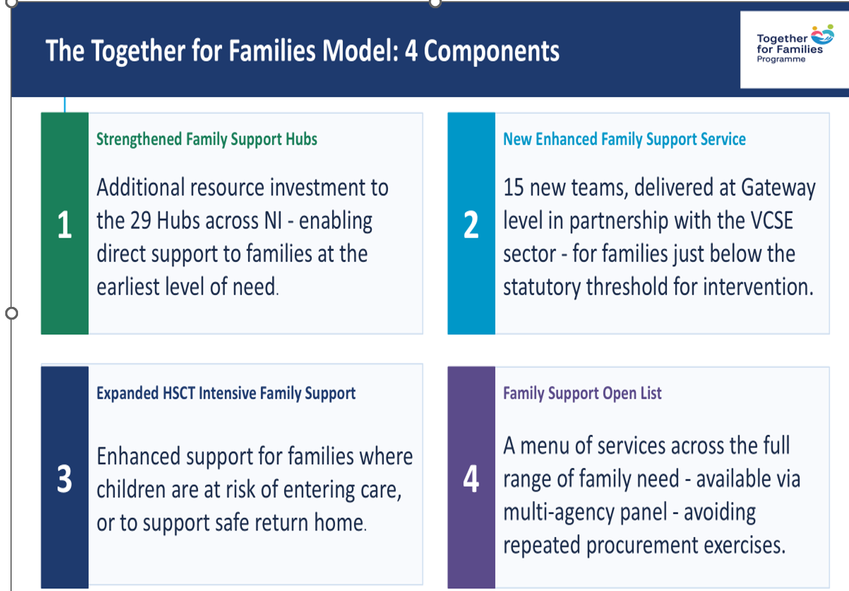
Enhanced Family Support Services

Slide 15
Some families we hope to help may be
Experiencing emerging or increasing complexity
Navigating poor mental Health and Trauma
Needing support with neurodiversity/ disability
Needs rarely arrive one at a time.
Struggling with relationships, domestic violence and hidden harm
Affected by Addiction

Slide 16
Enhanced Family Support Services
More Responsive
More Relational
More Sustained
More Flexible
More Connected
More holistic

Slide 17
Regional consistency with Local Flexibility
Regional Consistency
Local need will drive local design
Quality
Safeguarding
Outcomes
Evaluation
Workforce
Partnerships
Expertise
Community delivery

Slide 18
Gillian Irvine Funding Manager with the National Lottery
Email: togetherforfamilies@health-ni.gov.uk
FAO: Gillian

Slide 19
Strong Partnership requires ….
Shared purpose Complementary expertise
Clear roles
Shared accountability Better support for families

Slide 20
Partnership Applications welcome from VCSE organisations that:
Are locally rooted
Experience of managing grants of comparable complexity;
Evidence of delivering family support at scale and at a higher level of need;
Demonstrable robust governance & appropriate financial management systems;
Evidence safeguarding compliance and governance;
Comply with all Guidance, monitoring, evaluation, engagement reporting and assurance requirements.
Notes:
Final eligibility & assessment criteria will be confirmed within the formal grant documentation.
Talk about the engagement and support contract here
Need to highlight locality awareness and understanding of locality specific data
Need to work collaboratively with all relevant stakeholders

Slide 21
Collaboration expectations ?
We expect VCSE partnerships to work collaboratively with relevant statutory agencies and community-based providers to ensure the holistic needs of families are met.

Slide 22
Indicative Timeline
Webinar – August 2026
Market Engagement – August 2026
Launch – September 2026
Application Window – September–October 2026
Assessment November
Decisions December 2026
Mobilisation – January–March 2027
Services start by 01 April 2027

Slide 23
Start with your locality, not your organisation
Who are the families?
What does the evidence tell us?
What’s already working?
Where are the gaps?
Who needs to be around the table?
What would families say they need?
What have local stakeholders said?

Slide 24
What will strong applications demonstrate?
NEED — Are you clear on What is needed locally?
PARTNERSHIP — Why this combination?
PRACTICE — What will families experience?
DELIVERY Can you make it happen?
IMPACT — What difference will it make?
VALUE — Is the investment proportionate?
Collaboration at locality level

Slide 25

What could success look like?
Families get meaningful help earlier.
Families don’t have to reach crisis before receiving significant support.
Communities have greater capacity to respond.
VCSE and statutory services work as one connected system.

Slide 26
This is an opportunity to design support around families, not services; around partnerships, not organisations; and around early intervention, not crisis

Slide 27
TNL Community fund will shortly publish detail of an overarching evaluation opportunity to capture learning emanating from the entire TfF programme.
The delivery programme & evaluation will be further supported by an overarching Wraparound tender funded by the National lottery.
Successful participants and their partners will form an integral part of these valuable opportunities to capture, learn and share outcomes, practice and learning

Slide 28
Thank you and wrap up
Together for Families | Enhanced Family Support Service

