Slide 1



Together for Families
- Delivering an Enhanced Family Support Service for Belfast
Belfast Trust
Children’s Community Gateway Service
Notes:
Intro slide
1

Slide 2
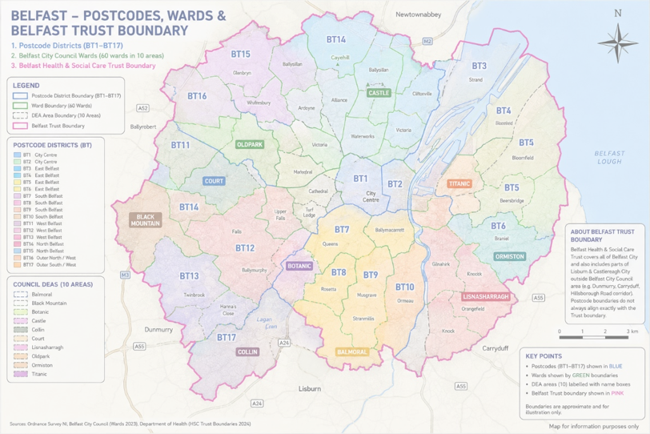

Slide 3

The Belfast Context
Demand and Complexity
Belfast has @76,704 children and young people with significant levels of deprivation and complex need.
Belfast - CYPSP consultation - area experiencing significant poverty-related pressures affecting children and families.
11,000–19,000 are affected by poverty
Mental Health - Belfast above the Northern Ireland rate for self-harm hospital admissions among children and young people.
Disability and Neurodiversity - Belfast highest rate of children receiving Disability Living Allowance.
Education - 21% of Belfast post-primary pupils attend school less than 85% of the time.
Belfast has the highest primary school absenteeism levels in Northern Ireland.
Family Safety - Belfast records the highest level of domestic abuse motivated crime in Northern Ireland.
Notes:
Belfast carries some of the highest levels of demand, complexity and social inequality across Northern Ireland, More families are living with complexity, disability, neurodiversity and mental health challenges that require coordinated early intervention. making it a critical location for early intervention and family support investment.
3

Slide 4
What Children, Young People and Parents Told Us
Better support for mental health
More support for additional needs
Trusted adults in schools
Safe spaces and social connections
Easier access to support
Less fragmented services
Earlier intervention
Support for school anxiety
Earlier access
Coordinated support
Single plan
Named worker
Community-based solutions for School disruption and school anxiety were identified by children, young people and parents as key priorities.

Slide 5
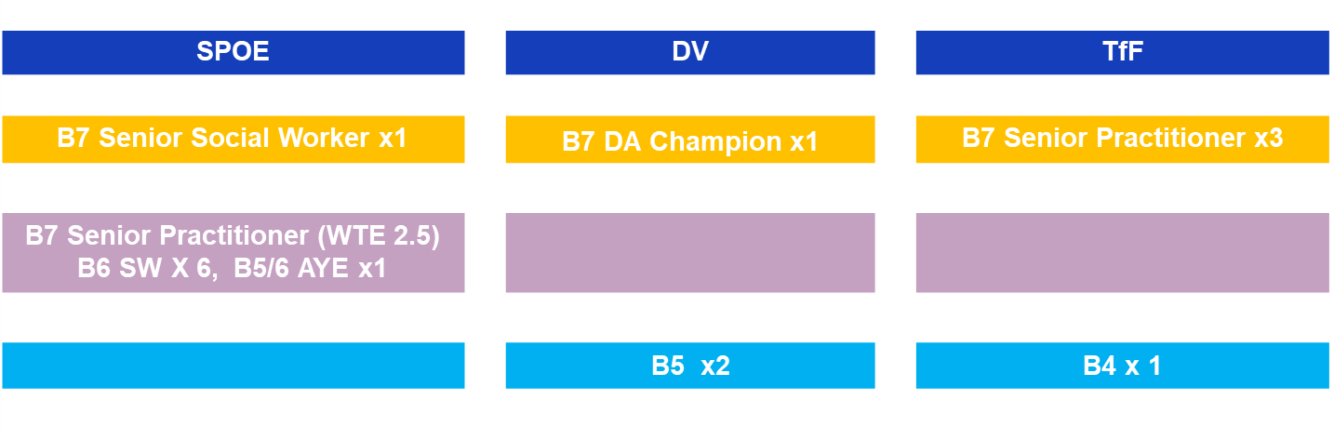

Gateway Service
B8B Children’s Services Manager
Karen McCall
B8a Principal Social Worker
Sharon Kerr / David McIlmunn
SPOE
ASSESSMENT
Team 1
ASSESSMENT
Team 2
ASSESSMENT
Team 3
B7 x 6.5 (7)
B6 x 7
B7 x3 (2.5)
B6 x5
B7 x3
B6 x5
B7 x3
B6 x5

Slide 6
W What Gateway Tells us is telling us.
Belfast had 7,005 children in need referred in 2024/25.
5.3 per 1,000 Belfast children on the Child Protection Register.
15.3 per 1,000 Belfast children are Looked After Children, the highest rate in Northern Ireland.
This is substantially above the NI average of 9.6 per 1,000.

Slide 7
What Gateway tells us
Concerns
Domestic Violence 57%
Mental Health 41%
Substance Misuse 30%
Child Behaviour 22%
Neglect 17%
Activity
120–180 Gateway contacts each day
Only 10% become referrals
40% signposted/closed/no action
21% waitlisted
55% of referrals are known families
Gaps
Repeat referrals and recurring need
Long waits for specialist support
Limited therapeutic provision
Growing waitlists
Escalation before support available

Slide 8
What Gateway tells us.
Family Support Hub referrals increased 53%
Demand driven by deprivation, mental health and domestic abuse
Demand is not simply increasing. Family needs are becoming more complex, while many families fall below statutory thresholds but above universal provision.
Earlier family support is essential if more children are to remain safely within their communities and family networks.

Slide 9
The Enhanced Family Support Service is specifically designed to support these families.
Enhanced Family Support is not a standalone service. It is a mechanism for integrating statutory, community and voluntary sector support around family need. Children's Services Co-operation Act (NI) 2015 CYPSP collaborative leadership model
Gateway Demand, Unmet Need and Partnership Opportunities
Community & Voluntary Sector Engagement
BHSCT Enhanced Family Support Service
Family Support Hubs
Locality Planning Groups
Community and Voluntary Sector delivery

Slide 10
The Missing Middle
Where Needs Escalate before Help can be accessed.
A group of families -
whose needs exceed universal provision.
Who require more than signposting.
Who fall below statutory thresholds.
Who often experience repeated referrals and escalating difficulties.
With long Waits for Specialist Supports
Notes:
The Missing Middle
10

Slide 11


Enhanced Service
Alignment with the Dynamic Framework
Commissioned, flexible interventions
The proposed model should draw on a menu of supports, enabling a responsive offer rather than a fixed single programme.
Family support
Mediation
Youth engagement
D
domestic Abuse Recovery
Mental health and wellbeing help
Specialist substance misuse
Broader tier of provision to meet unmet need
8
Notes:
[Sources]
Enhanced Service Dip Sample Final.docx, lines 26-28
11

Slide 12
What We Need From Partners"
Enhanced Family Support Response
Parenting programmes
Earlier neurodiversity support
Family navigation and advocacy
Parenting and behavioural support
Improved community capacity
School avoidance interventions
Emotional wellbeing provision
Domestic abuse recovery services
Family mediation
Youth engagement activity
Targeted support for poverty and housing stress
Flexible outreach
Trauma informed practice
Moderate complexity family work
Strong outcomes reporting
Early intervention capacity
Protective Parenting
Behaviour Management

Slide 13
Why Belfast Needs Enhanced Family Support Services
to intervene earlier, prevent escalation and strengthen families before statutory intervention becomes necessary.
Build family resilience through Trauma-informed practice and interventions.
provide the missing layer of early intervention identified by the CYPSP, Family Support Hubs, Children's Social Care Reform and Gateway services.
Notes:
Hoe the ET will make a difference.
13

Slide 14
Belfast Vision
for
Together for Families
Relationship Based Practice
Whole Family Support
Practical & Therapeutic Help
Multi-Agency Co-Ordination
Early Intervention
Right support, right time
Reduce repeat referrals
Improve family resilience
Prevent statutory escalation
Our Shared Vision
One Family, One Plan
Single coordinated family plan
Named lead worker
Community and voluntary delivery
Outcome focused support
Shift Away from
- Waiting for crisis
- Escalating concerns
- Multiple Referrals
- Repeat Gateway Presentations
Shift Towards
- Earlier Interventions
- Community Based Support
- Whole Family Working
- One Family –One Plan
- Better Outcomes

Slide 15
Operating position within the wider pathway
Universal services
Enhanced Service
Statutory social work
Available community and universal supports
Structured early help, targeted support and coordinated family assistance
High-level family support, child protection or statutory assessment where necessary
REPORTING LINE
SPOE / Enhanced Teams Structure
Leadership and operational alignment
Karen McCall
CSM
David McIlmunnn / Sharon Kerr
PSW SPOE
BAND 7
BAND 7
BAND 7
Enhanced Team 1
Enhanced Team 2
Enhanced Team 3
15

