Slide 1


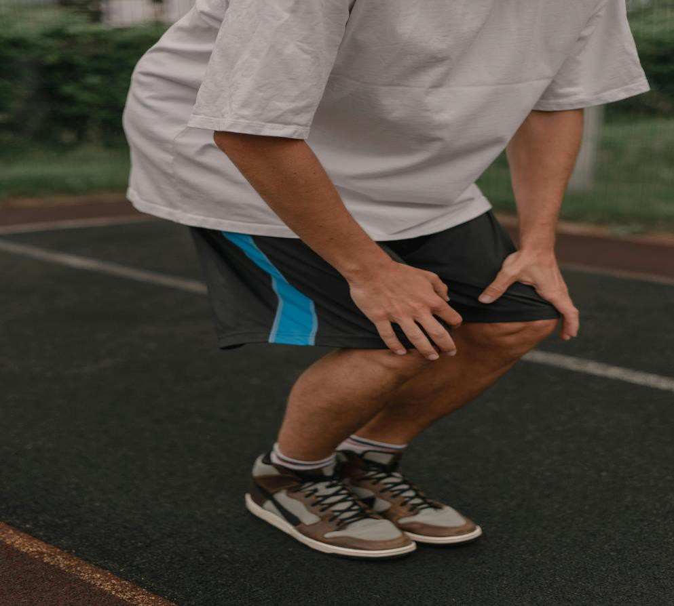



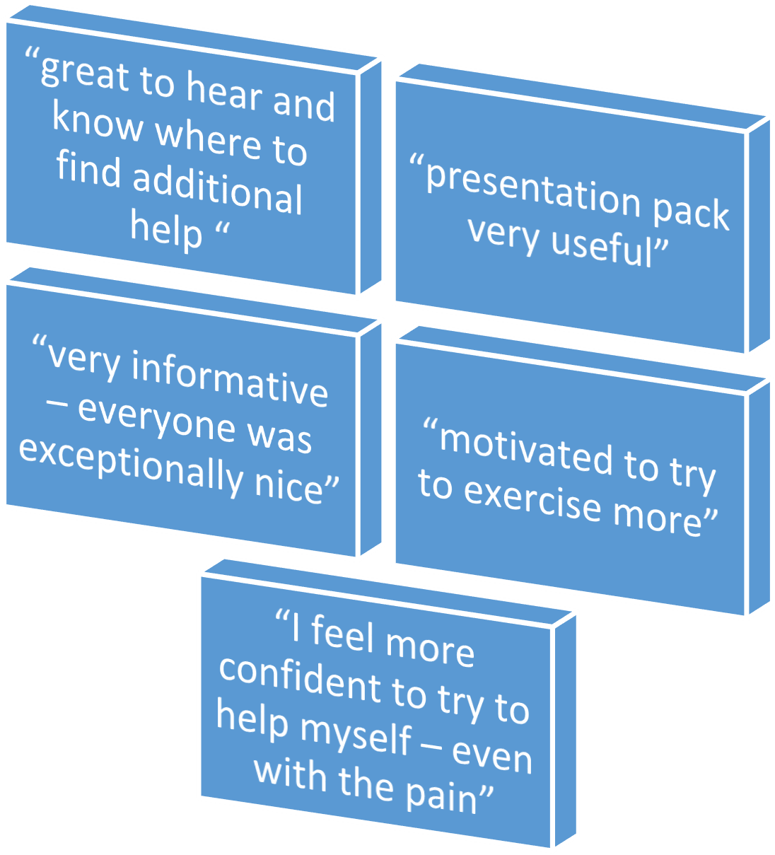

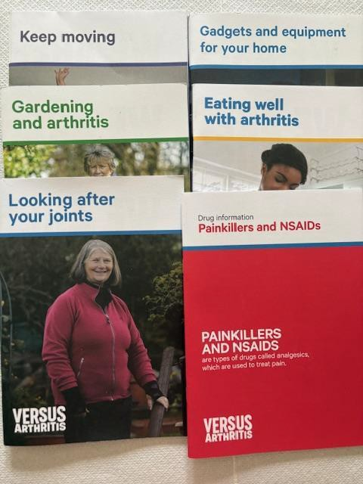
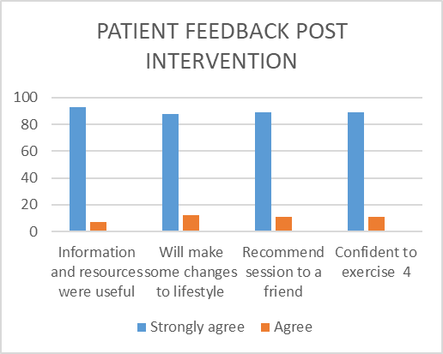








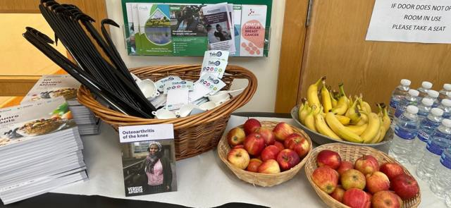

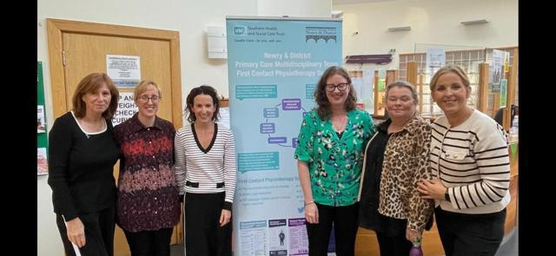
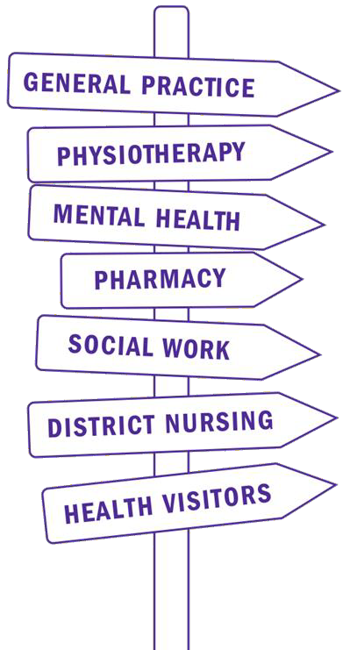
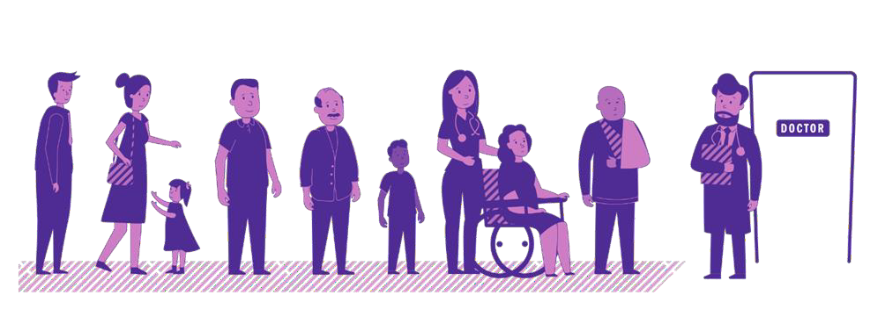
AIM
WELL WHILE WAITING
First Contact Physiotherapy Service
TO IMPROVE HEALTH LITERACY AND EMPOWERMENT OF PATIENTS WAITING FOR KNEE OSTEOARTHRITIS INTERVENTION
EVIDENCING THE NEED FOR IMPROVEMENT
BACKGROUND
Severe Osteoarthritis in the knee joint can result in significant pain, loss of function and decline in
workplace productivity.
Regional Orthopaedic waiting times are at record
times, current data reporting 6282 patients waiting on Total Knee Replacements (TKR) up to five years.
Evidence to suggest that patients deteriorate with regards to function, mobility, strength, mood and quality of life, increased co-morbidities and diminished post-operative recovery.
Patients in Northern Ireland (NI) are prescribed more opioid and anti-depressant prescriptions
compared with age matched populations and long waiting lists increase pressure on Primary Care
resources.
METHODOLOGY
  First Contact Physiotherapy Practitioners (FCPP) engaged with
colleagues in SHSCT Orthopaedics to evaluate and identify waiting times, criteria for urgent/routine surgeries and consider service
development strategies within secondary care.
  NICE guidance (2022) for management of people with Knee OA adhered to in relation to best practice.
  Inclusion/exclusion criteria for patients in GP practices were established.
  Patients with Knee OA referred to Orthopaedics for consideration of TKR were identified (Vision search 2021-2024).
  The results were quality assured and all patients were offered an appointment at a ‘Well While Waiting’ session.
  FCPPS engaged with Multidisciplinary Team Social Workers and
representative from Versus Arthritis to co-produce a resource pack for all attendees.
OUTCOMES
80 patients were invited and 30 attended the 1.5 hour session which included education on physical activity, diet, pain medication, pain management, lifestyle changes, local opportunities for physical activity and voluntary/community services.
93% of participants strongly agreed that information and resources shared were useful and easy to follow.
85% strongly agreed that they were likely to make some of the lifestyle changes recommended.
89% would recommend the session to a friend and 89% felt confident to exercise after this session.
Post operative outcomes
following TKR are limited by clinical frailty. Increased frailty
can increase the risk of mortality, morbidity and post operative
complications, longer hospital stay and more expensive
community social care cost.
Patients on a pre operative list longer than 6 months are at risk of deteriorating joint pain and
physical function in relation to wait time.
Urgent action is required to minimise deterioration of joint function, quality of life and mental health for patients waiting for orthopaedic surgery. Patient centred support services including exercise, diet and pain management programs are needed to improve care .
Multi discpilnary
team
Local community and voluntary groups
Service Users
Stakeholders Engaged
Secondary Care services
GPs
Versus arthritis
NEXT STEPS
Engagement with Versus Arthritis has led to a 12
week Pain Management course in Banbridge. Further ‘WWW’ courses are planned to target other GP
populations on Orthopaedic lists. We have engaged with the Trust Orthopaedic service to share learning.
Future areas may include engaging with the Trust promoting wellbeing division to develop capacity through community development to improve
signposting and support for Physical activity in
voluntary and community sectors for Patients to self- care while on lengthy waiting lists.
CONCLUSION
This ‘WWW’ session has positively impacted those patients who are currently waiting on intervention for knee OA. Patients felt more confident and empowered to manage their health whilst waiting. They valued the specific knowledge gained on various aspects of care. The response to the intervention highlights a need for better management of patients on lengthy waiting lists. Uptake may have been improved with a social media campaign or advertising within Practice.
Project Team: SHSCT Newry and Mourne District FCPs Banbridge Group Surgery
Contact Information: gemma.o’donnell@gp.hscni.net

