Slide 1



West Belfast Primary Care Multidisciplinary Teams Service
A joint partnership between BHSCT & West Belfast GP Federation
Dr Aine Harley, Chair West Belfast GP Federation and Michelle Toland Programme Manager Primary Care MDTs, BHSCT
West Belfast Primary Care Multi-disciplinary Team

Slide 2
Introduction
Current pressures across the healthcare system in Northern Ireland (NI) are unprecedented. Within Primary Care, demands upon our General Medical Services (GMS) are pushing GP Practices to breaking point. With increasing practice contract handbacks there has been a 10% decrease in the number of GP practices in NI in the past 10 years.
The regional development of new Primary Care Multidisciplinary Teams (PC MDTs) is a central element of ‘Health and Wellbeing 2026: Delivering Together’ for Department of Health (DoH) in NI. It has been identified as a key factor to stabilising and strengthening Primary Care Services.
The PC MDT Programme has been established to transform the planning and delivery of Primary care services by:
Better meeting existing demand for primary care services;
Providing a platform for service reform –supporting the shift of care into primary and community settings; and
Boosting capability and capacity for early intervention, prevention and focus on wellbeing.

Slide 3
Background - West Belfast Primary Care MDT
Partnership Working
West Belfast (WB) PC MDT is a partnership between WB GP Federation and Belfast Health and Social Care Trust (BHSCT) funded by DoH.
First Contact Staff
First Contact Physiotherapy (FCP), Mental Health (MH) and Social Work (SW) staff
Holistic Care
Holistic approach to physical, mental and social wellbeing. Focus of prevention and early intervention across the team.
FC staff co-located in GP practices embedded within the existing practice teams.
Providing Enhanced Primary Care Services
Strong emphasis on partnership working with community and voluntary sector organisations

Slide 4
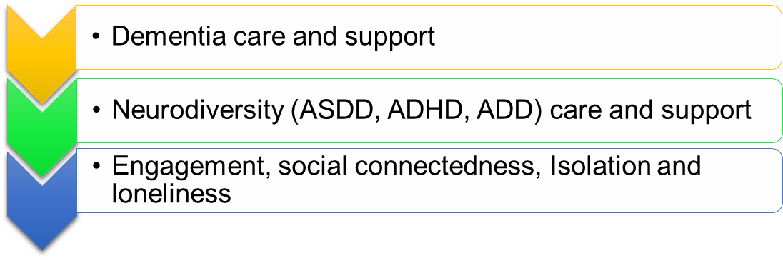
Background cont:
In addition to staff funding, the DoH NI provides WB PC MDT with annual Seed funding for the purpose of building capacity in the local community and/or enhancing services provided by the Community & Voluntary(C&V) Sector.
The Primary Care Social Work service oversees the allocation of this funding on behalf of the WB GP Federation working together with PC MDT professional colleagues and local community organisations
All Seed money projects are designed in partnership between the Primary Care MDT, C&V organisations and Service Users.
All projects are planned with an outcomes based approach to ensure optimum delivery of project objectives.
Projects address unmet local need in the local community. Current projects include the following key themes:

Slide 5
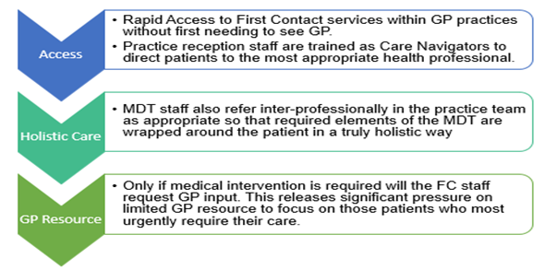
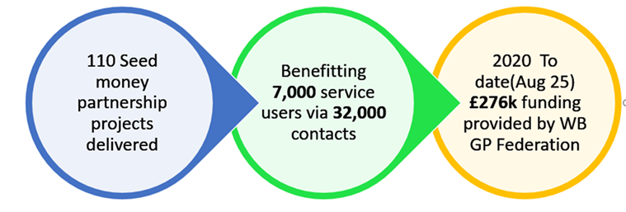
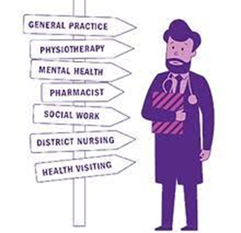

West Belfast Primary Care MDT Service Activity – 2024/25 Full year reporting period – High Level Summary & First Contact Professions Activity
Service Delivery Summary
Community Development Delivery Summary 2020/25
GP Practice Based Service Activity Summary
Since implementation in 2019/20-2024/25,
WB PC MDT First Contact services - MSK Physiotherapy, Social Work and Mental Health
have delivered:
>171,000
patient consultations
In GP practice
Low Onward Referral rates to
Secondary Care 2024/25
84 % of patient referrals managed within primary care

Slide 6

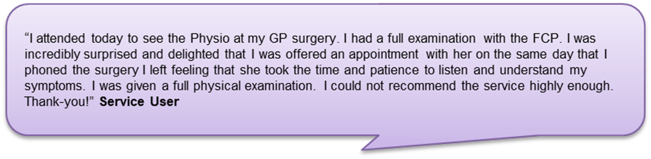
Patient/Service user and GP Feedback
GP feedback –SPPG regional survey
Regional SPPG 10,000 voices Primary Care MDT patient experience survey
303 survey responses received from across all 17 GP Federation areas in NI
50 patient responses from West Belfast Primary Care MDT area.
89% of responses from current MDT practice GPs Strongly Agreeing/Agreeing that MDTs have improved the quality of patient care
94% GPs Strongly Agreeing/Agreeing that MDTs improved patient access
80% GPs strongly agreed/agreed that MDTs uncovered an unmet need
72% GPs Strongly agreed/agreed that the introduction of MDTs to their practice had changed the utilisation of their time in a positive way including increased time for complex medical patients
97% GPs in a current MDT practice would encourage their peers to seek an MDT for their
practice.
95% non-MDT practice GPs indicated that their practice would benefit from an MDT
Regional results summary:
831 responses patients, relatives and carers
97% reported experience of services as positive or strongly positive
81% were satisfied or very satisfied with time to access an appointment
86% satisfied or very satisfied with tie spent at appointment
81% satisfied or very satisfied with their progress and number of appointments offered
I am very happy with this Mental Health service and they have helped me significantly. I had some similar issues approximately 6 years ago and was provided with none of the support and help. This time I hope to get ahead of things, the support, advice and understanding of the team has been very very helpful.
We met with the MDT Social Worker in my GP surgery. They showed a great amount of patience and care for myself and my family. They pointed us in the right direction to obtain a very much needed care package that meant I could stay at home. They also provided options to connect with other people which people, which helped with loneliness and isolation”

Slide 7
Conclusion
The West Belfast Primary Care Multidisciplinary Team has significantly strengthened local healthcare delivery by embedding First Contact Practitioners within GP practices, enabling rapid access to holistic care and reducing reliance on secondary services.
Since its implementation, over 171,000 consultations have been delivered, releasing vital GP capacity and improving patient outcomes.
Community development projects funded through Seed Money have further enhanced service reach by addressing unmet needs in partnership with local organisations.
High levels of patient and GP satisfaction—97% and 94% respectively—underscore the model’s success in improving access, quality, and responsiveness.
The Primary Care MDT approach represents a sustainable, collaborative solution to the growing pressures in primary care.

