Slide 1

Federation Sentinel Plus Project
Overview post project completion and Presentation of Poster at PCRS conference

Slide 2
BACKGROUND
ABC Council was 208 out of 217 in highest rate of respiratory related deaths and hospital admissions in the UK.
Sentinel Plus Aim – A Federation wide QI project to help reduce SABA overuse and improve patient outcomes.
Improve asthma patient outcomes by identifying SABA overuse, holistically reviewing asthma patients and commencing guideline directed Maintenance and Reliever Therapy (MART) in appropriate patients.

Slide 3
Sentinel Plus Project
In the federation 16 of 22 practices signed up to the project
920 Patients were reviewed (of 6167 total pts coded as Asthmatic the highest risk patients were invited for review)
Patient reviews were carried out by Clinical Interface Pharmacists

Slide 4
METHOD
From June 2024 to March 2025 Interface Clinical Services analysed routinely collected NHS data, formed a baseline report and conducted targeted asthma reviews aligned with SENTINEL Plus in 16 GP practices within the Armagh and Dungannon Federation.
This was coupled with asthma management educational sessions and access to the SENTINEL Plus website resource being made available to all clinicians within the federation.

Slide 5
METHOD
The approach allowed the project to be facilitated and enacted with minimal impact on surgery workload.
A Formulary was drawn up by GPP Lead Kerri McCann for interface pharmacists to follow on selection of inhaler devices.

Slide 6
BASELINE FIGURES PRE- REVIEW
Baseline characteristics of registered asthma patients (N=6,167) | N (%)
Had an asthma review in past 12 months | 3,324 (54.0)
Assessment of inhaler technique in past 12 months | 2,648 (43.0)
≤3 SABA prescribed in past 12 months | 3,571 (42.0)
≥3 SABA prescribed in past 12 months | 2,596 (42.1)

Slide 7
RESULTS
Total of 920 patient reviews were undertaken. Of these reviewed patients:
660 (72%) patients had their short acting bronchodilator SABA or short acting muscarinic antagonist (SAMA) stopped
740 (80%) patients commenced on MART (668 new initiations).

Slide 8
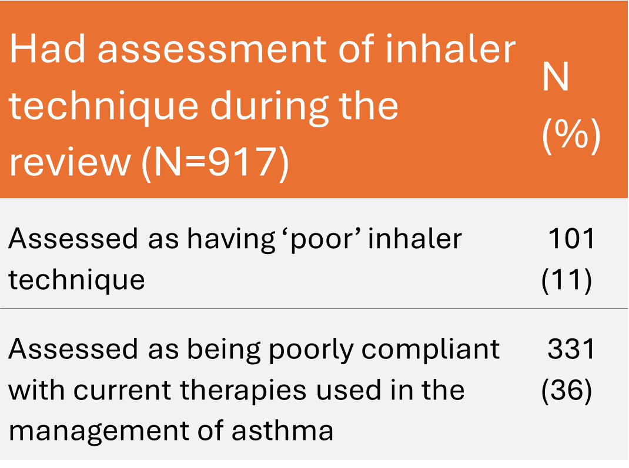
RESULTS REVIEW
BASELINE FIGURES PRE- REVIEW

Slide 9
RESULTS (continued)
919 of reviewed patients (99%) received advice on worsening asthma control and provision of a personalised asthma action plan.
56 out of 107 (52%) patients who smoke expressed wanting to stop smoking and were signposted/referred for smoking cessation service.
917 (99%) patients had their inhaler checked.

Slide 10
Pre Assessment vs Post Review

Slide 11
Pre Assessment vs Post Review

Slide 12
Pre Assessment vs Post Review

Slide 13
Conclusion
The Project resulted in improved asthma guideline directed care with SABA only reliever therapy prescribing being reduced and MART uptake increased in appropriate patients.
An approach, which in November 2024, was consolidated with the update of BTS, NICE, SIGN³ joint asthma guideline. Education along with the creation of a collaborative framework has facilitated an interdisciplinary approach towards enhanced asthma care.

Slide 14
Conclusion
Although initial consults and review undertaken by Interface. The project involved a federation wide interdisciplinary approach
Holistic reviews of patients undertaken.
Follow up of patients by normal practice processes.

Slide 15
PCRS Abstract submission
An abstract was submitted to the PCRS entitled:
“Improving asthma outcomes by following guideline directed care with SENTINEL Plus in the Armagh and Dungannon Federation”

Slide 16
PCRS Conference
The Federation submitted a poster presentation at the PCRS conference in conjunction with AZ Sentinel Plus.
The Poster was presented by representatives of the federation to PCRS delegates.

Slide 17



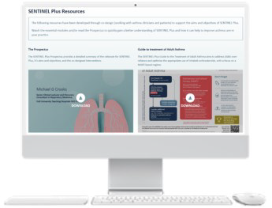




Improving asthma outcomes by following guideline directed care with the SENTINEL Plus programme in the Armagh/Dungannon Federation¹
Cleary D_{1,} Hughes B_{1,} McCann K_{1,} O’Reilly-Smyth A_{2,} Stevenson N₂
Armagh and Dungannon GP Federation¹. AstraZeneca, Medical and Scientific Affairs, Biopharmaceuticals Medical, London, United Kingdom²
Introduction
What is SENTINEL Plus?
SENTINEL Plus is a quality improvement package that aims to improve outcomes for asthma patients and reduce the environmental impact of asthma treatment by identifying and addressing SABA over-use. SENTINEL Plus utilises a co-designed intervention, developed during the SENTINEL Project.¹
Results
In 2023, the respiratory index data from Asthma and Lung UK ranked Armagh Banbridge Craigavon council area as 208 of 217 in terms of highest respiratory rate of deaths and emergency admissions². Short Acting Beta Agonist (SABA) monotherapy over reliance continues to negatively impact asthma patients and the environment. To address this, the Armagh/Dungannon GP Federation worked collaboratively with AstraZeneca utilising SENTINEL plus, a co-designed quality improvement package, in conjunction with Interface Clinical Services to improve asthma patient outcomes.
Total of 920 patient reviews were undertaken. Of these reviewed patients:
660 (72%) patients had their short acting bronchodilator SABA or short acting muscarinic antagonist (SAMA) stopped (Figure 3)
740 (80%) patients commenced on MART (668 new initiations). (Figure 3)
919 of reviewed patients (99%) received advice on worsening asthma control and provision of a personalised asthma action plan
56 out of 107 (52%) patients who smoke expressed wanting to stop smoking and were signposted/referred for smoking cessation service.
917 (99%) patients had their inhaler checked (Table 2)
Other prescribing changes are displayed in Figure 4.
Aim
Improve asthma patient outcomes by identifying SABA overuse, holistically reviewing asthma patients and commencing guideline directed Maintenance and Reliever Therapy (MART) in appropriate patients.
Methods
From June 2024 to March 2025 Interface Clinical Services analysed routinely collected NHS data, formed a baseline report and conducted targeted asthma reviews aligned with SENTINEL Plus in 16 GP practices within the Armagh and Dungannon Federation. This was coupled with asthma management educational sessions and access to the SENTINEL Plus website resource being made available to all clinicians within the federation.
Table 2 Inhaler assessment technique findings
Had assessment of inhaler technique during the review (N=917) | N (%)
Assessed as having ‘poor’ inhaler technique | 101 (11)
Assessed as being poorly compliant with current therapies used in the management of asthma | 331 (36)
Table 1 Baseline characteristics of asthma patients
Describes baseline characteristics of registered asthma patients in 16 practices.
Baseline characteristics of registered asthma patients (N=6,167) | N (%)
Had an asthma review in past 12 months | 3,324 (54.0)
Assessment of inhaler technique in past 12 months | 2,648 (43.0)
≤3 SABA prescribed in past 12 months | 3,571 (42.0)
≥3 SABA prescribed in past 12 months | 2,596 (42.1)
Conclusions
The Joint working between the Armagh Dungannon GP Federation and AstraZeneca resulted in improved asthma guideline directed care with SABA only reliever therapy prescribing being reduced and MART uptake increased in appropriate patients. An approach, which in November 2024, was consolidated with the update of BTS, NICE, SIGN³ joint asthma guideline. Education along with the creation of a collaborative framework has facilitated an interdisciplinary approach towards enhanced asthma care.
Figure 1 Routinely collected NHS data was obtained in 16 of 22 GP Practices within the Armagh/Dungannon Federation, Northern Ireland
Figure 2 Participating practice characteristics and record of oral corticosteroid issues, asthma attack episodes and hospital admissions due to asthma
Registered asthma patients= 6,167
≥2 OCS, ≥2 asthma attacks, or ≥1 asthma admission in 12 months
=653
Number of practices =16
≥1 OCS, ≥1 asthma attacks in 12 months
= 829
Figure 3 MART and SABA/SAMA prescribing changes before and after SENTINEL PLUS patient review
Figure 4 Prescribing changes before and after SENTINEL PLUS patient review
Before review
After review
SABA/
SAMA usage unknown
* The ICS/LABA figure includes not only ICS/LABA but also add-on therapies
References
Crowther L, Pearson M, Cummings H, Crooks MG. Towards codesign in respiratory care: development of an implementation-ready intervention to improve guideline-adherent adult asthma care across primary and secondary care settings (The SENTINEL Project). BMJ Open Respiratory Research. 2022 Feb 1;9(1):e001155.
Asthma & Lung UK- Respiratory Index. https://public.tableau.com/app/profile/asthmaandlunguk/viz/Respiratoryindexvisualisations/Respiratoryindex Accessed April 2025
NICE, BTS and SIGN, 2024. Asthma: diagnosis, monitoring and chronic asthma management (NICE guideline NG245). [online] Available at: https://www.nice.org.uk/guidance/ng245 [Accessed 10 Apr.2025].
Supported by
Presented at the Event Title, Location Name, 00 Month Year

Slide 18
END

