Slide 1
overview: what is patient voice?
Case studies /Stories of Change with Partners
Medical students hear from people living with chronic pain (versusarthritis.org)
Stories of change: Partnering with patients at Ulster University, Northern Ireland (versusarthritis.org)
Stories of change: The waiting rheum project (versusarthritis.org)
‘Patient Voice’ is a key part of Versus Arthritis' Advancing MSK SKILLs Programme – ensuring the unique experiences and perspectives of people living with MSK conditions and persistent pain directly influence the training and development of students and HCPs.
Delivered across 2 elements:
Education & training
Service & Quality Improvement Initiatives
In Partnership with:
Universities, Post Grad Educators
Health & Social Care Trusts, Health Boards, relevant specialties
Method:
Online or face to face
Notes:
Anna
The Patient Voice offer was established in response to demand from educational partners in 2020, initially on the basis of restricted access for their students to patient interaction due to COVID, and more broadly due to the shift in onus by educators to prioritise, value and empathise with the lived experience of patients from the outset of HCP careers, right through to post graduate and practicing levels.
Volunteers (existing and newly recruited) were also passionate about improving the future and current levels of HCP understanding and empathy with their conditions in order to ultimately improve outcomes for all.
An example of this in education & training would be our sessions co designed and delivered with QUB Medicine year 5s, whereby volunteers deliver a mock consultation format with groups of students, via zoom, based on a GP appointment interaction – the focus is not ascertaining a diagnosis, but more importantly allowing the volunteer to convey the holistic impact of their condition on their lives – health, relationships, work, future etc, and critically what has been or would valuable to them in HCP interactions. This is just one example of a format, and as detailed in the slide, we have worked with such a range of educational disciplines according to the learning outcomes of their courses and significance of lived experience to inform their practice.
The PV role has also grown to support service and quality improvement initiatives within HSCTs, boards and regional groups, which I’ll expand upon in the next slide
At least 3 stories of change have been published on our website on the back of Patient Voice in both its educational and service improvement capacity.
Education & Training : Patient Voice interaction with healthcare professionals, to improve their understanding and empathy with what it is like to live with an MSK condition and/or chronic pain
Service & Quality Improvement Patient Voice involvement in Health Service Design/Improvement, Service User testing, Patient Information initiatives, curriculum development
Case studies /Stories of Change with Partners
Medical students hear from people living with chronic pain (versusarthritis.org)
Stories of change: Partnering with patients at Ulster University, Northern Ireland (versusarthritis.org)
Stories of change: The waiting rheum project (versusarthritis.org)

Slide 2
PV Examples – education element

Slide 3

"The Queen's medical graduate is a caring and compassionate doctor who is a critical thinker, problem solver and reflective practitioner with excellent clinical skills who values, above all else, service to patients."
Our ‘Patients as Partners’ make a valuable contribution to the education of medical students, through their participation in the selection of medical students to the programme, teaching sessions, as well as assessments.

Slide 4
Year 5
Year 1
Year 2
Year 3
Year 4
FAMILY MEDICINE
Family Attachment
5 sessions inc. home visits
FAMILY MEDICINE
General Practice Experience
5 sessions
GENERAL PRACTICE
ATTACHMENT
12 sessions
GENERAL PRACTICE
LONGITUDINAL CLERKSHIP
4 x 2 weeks
PREPARATION FOR PRACTICE
Primary and preventative care
7 weeks
General Practice across the QUB Medical School Curriculum 2025/2026

Slide 5
Learning objectives and competencies
Assessing all types of chronic pain (chronic primary pain, chronic secondary pain, or both)
Person-centred assessment
Thinking about possible causes for pain
Talking about pain – how this affects life and how life affects pain
Providing advice and information
Developing a care and support plan
Flare-ups
Managing chronic primary pain
Non-pharmacological (esp. pain management programmes- Versus arthritis)
and benefits/risks of pharmacological management
Assessment and Management using the biopsychological model
Communication skills: shared-decision making, compassionate care
Professional skills: respect, empathy, person-centredness, resilience/emotional regulation

Slide 6
feedback

Slide 7
100% OF DELEGATES who gave feedback Recommended PATIENT VOICE

Slide 8
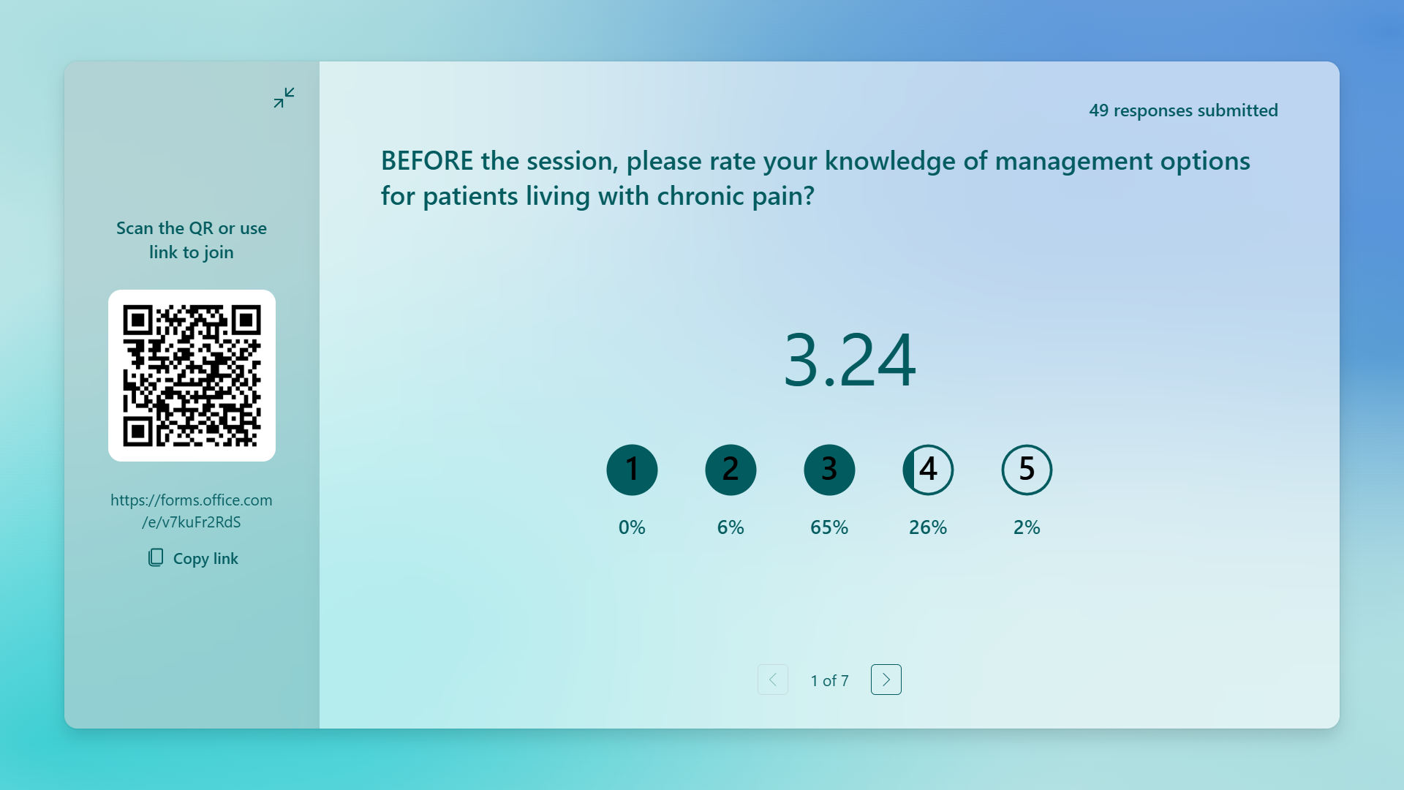
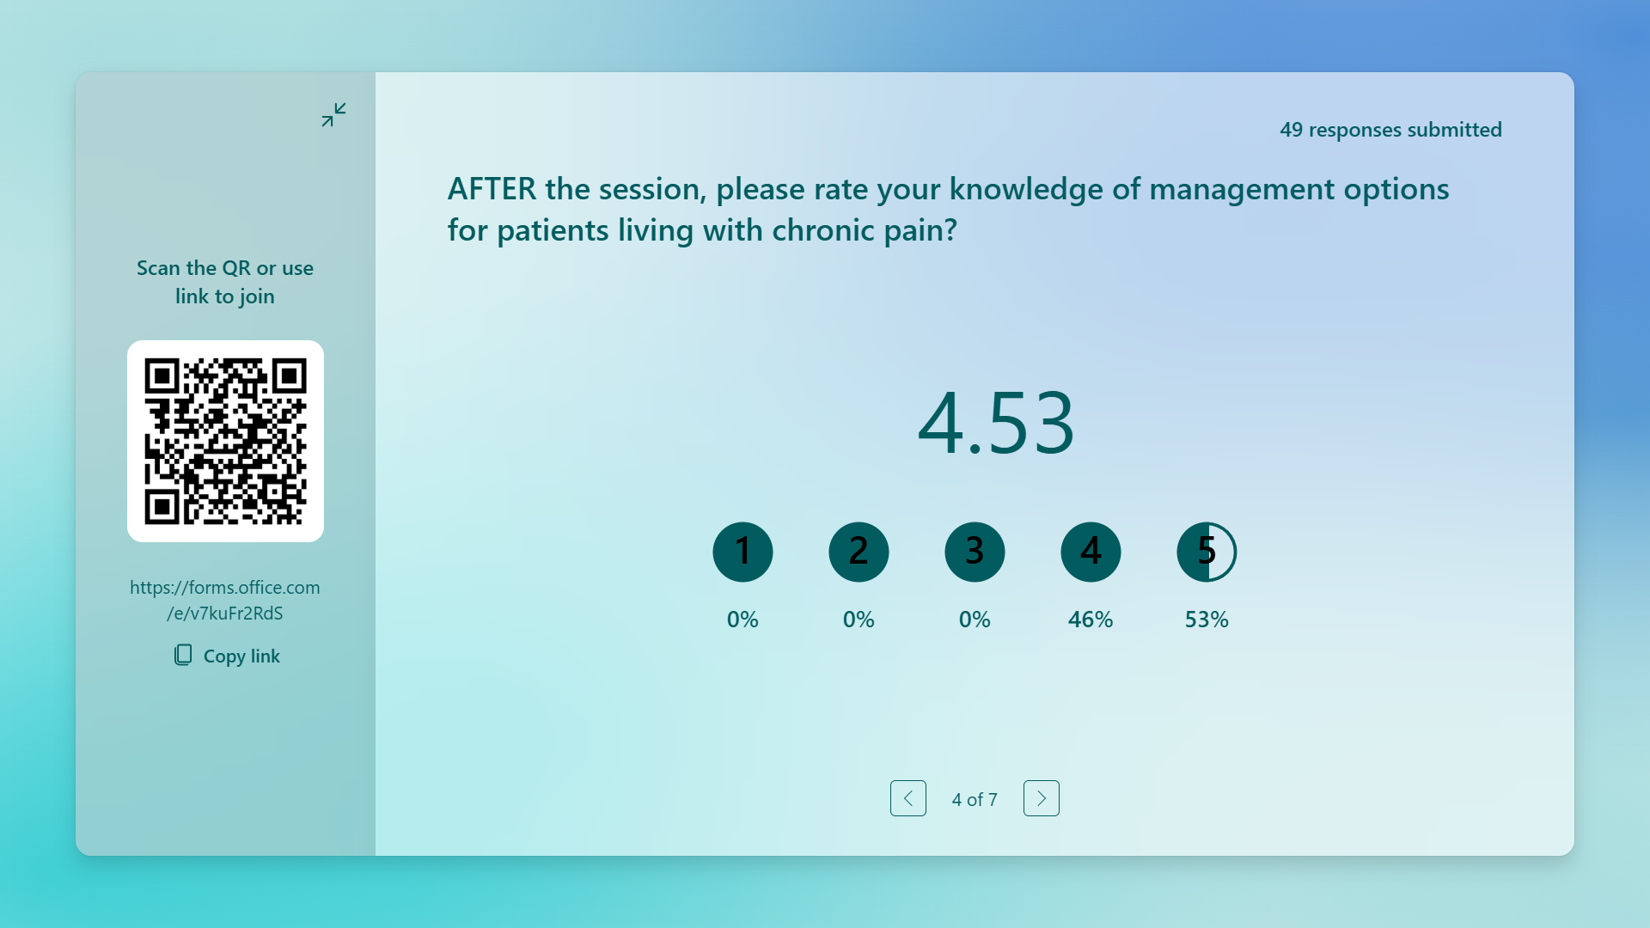
QUB Med Ed Student Feedback

Slide 9

Versus arthritis provided a very useful forum for the patient to meet others in similar situations, to exchange stories and how they each cope with their chronic conditions.
I think I learnt how debilitating a long-term illness like rheumatoid arthritis can be. People underestimate inflammatory arthritis and assume it is a “sore joint”, but it is much deeper than that and a life changing diagnosis.
Really good to hear how a chronic condition had affected the patient, not just physically but socially and emotionally as well.
Good to hear what she thought we should know as medical professionals

Slide 10

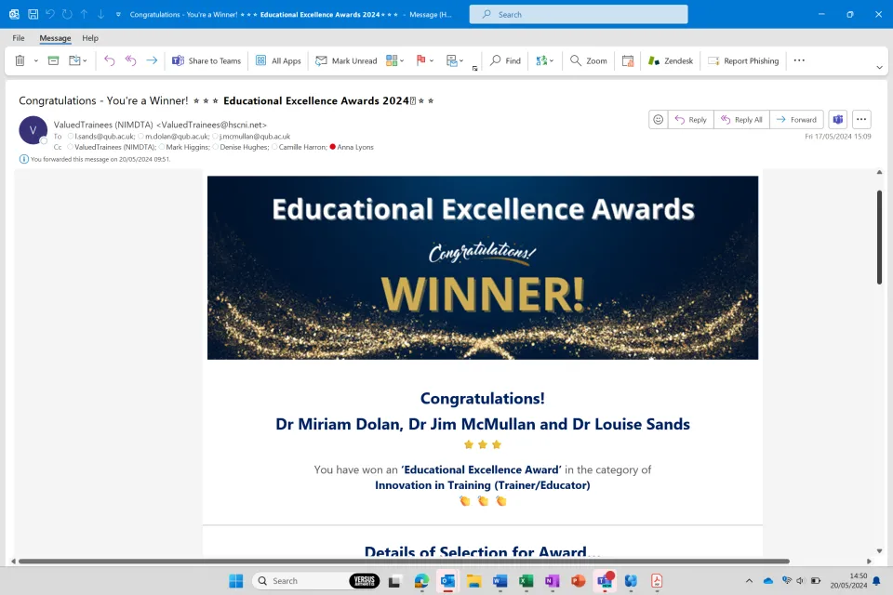
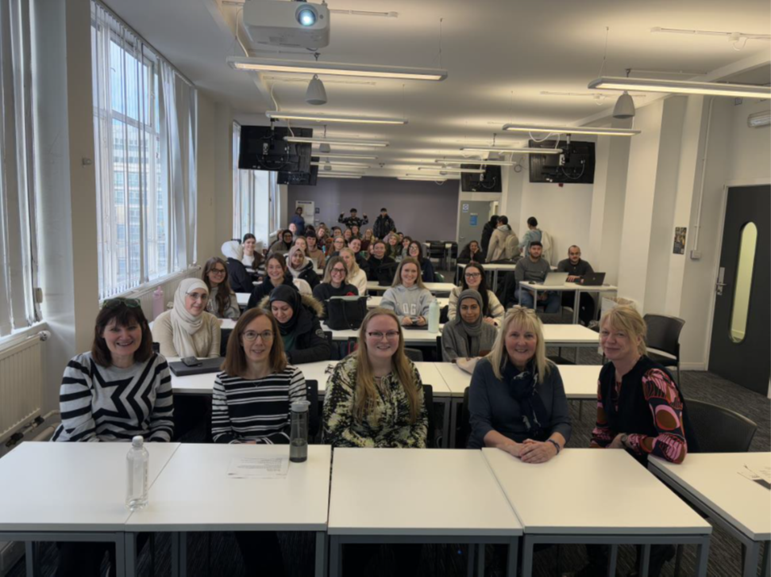
PARTNER FEEDBACK -EDUCATION
Just to let you know, the feedback from our students was overwhelmingly positive in relation to the online sessions…. in their module reflections, the volunteer sessions were consistently the aspect of the module which they enjoyed the most, and found the most beneficial.
They enjoyed not only being able to practice their communication skills for the first time, but found it most enlightening to hear directly from people living with various conditions, and getting to understand their experiences.
It really has been invaluable. Please let me know if the volunteers had any specific feedback for us.
Sinead George, Lecturer in Physiotherapy Ulster University
Successfully nominated our Patient Voice partners at QUB for NI Medical and Dental Training Agency (responsible for the the post-grad training of HCPs in NI) 'Educational Excellence Awards' in the category of 'Innovation in Training’.
Celebrating their collaboration with us in to bring lived experience to the fore in their Year 5 Chronic Pain teaching - showcasing the 'health service improvement' and educational role of the amazing Patient Voice volunteers and the trust they put in their winning facilitators!
I had the privilege of facilitating the pharmacy class within which Susan shared her experience of having rheumatoid arthritis. Her honesty and storytelling skills were impressive, and it was clear the students were fully engaged when she spoke (which can be a rare occurrence). In addition to speaking to the class, Susan walked round the different groups and spoke with the students, answering their questions and sharing stories of her experience. She was confident and I could tell the students enjoyed speaking with her. Considering the positive engagement on the day and the excellent feedback, I am certain Susan’s volunteering strengthened the pharmacy students understanding of the realities of living with rheumatoid arthritis and taking the medication, deepened their empathy, and made them aware of everything they could do to support people with rheumatoid arthritis. “ Dr Natalie Weir, Lecturer / Community Pharmacist, Strathclyde Institute of Pharmacy and Biomedical Science
The students were really engaged and asked some very thoughtful questions.
Please pass on our thanks to all the patient voice volunteers who helped this year, and please do forward any feedback they would like to share.
Thanks again for working with us to deliver these sessions this year!
Best wishes,
Carole
Dr. Carole Parsons | Senior Lecturer in Pharmacy Practice QUB

Slide 11
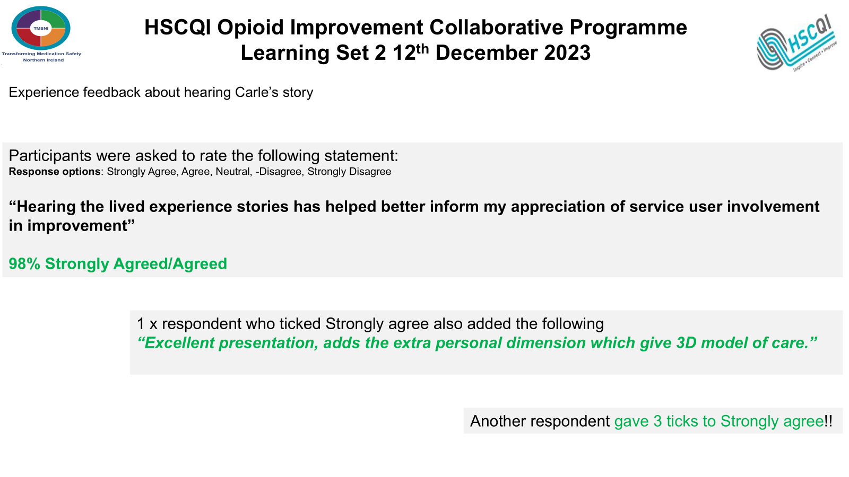
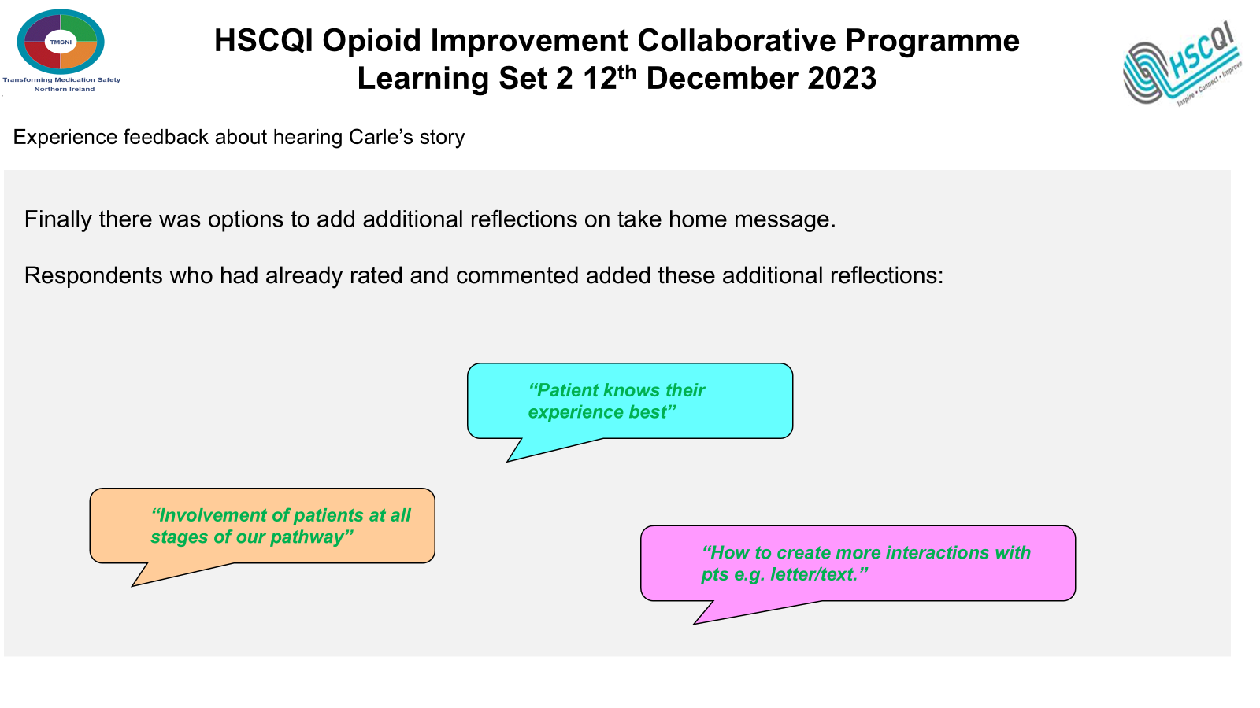
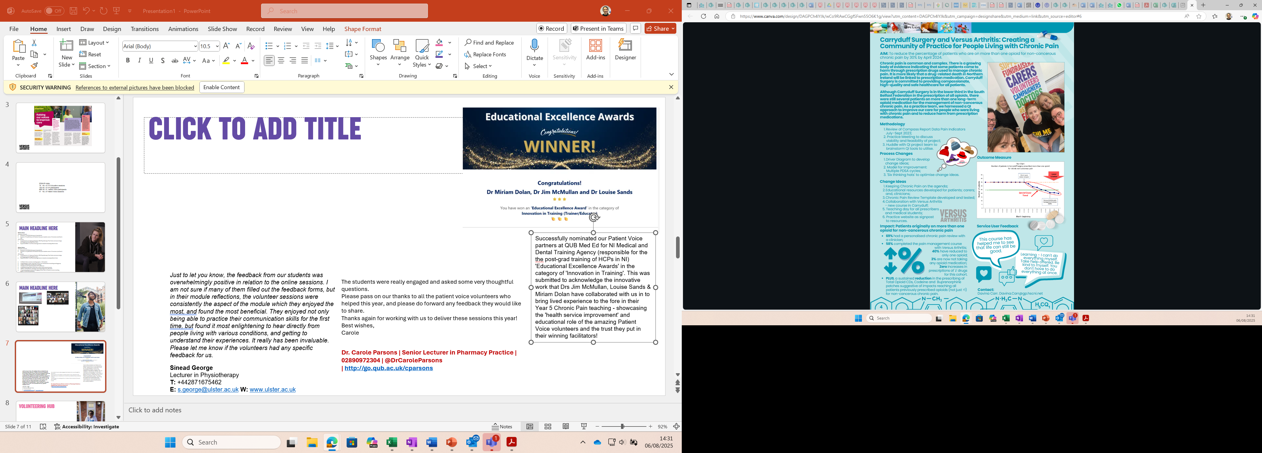
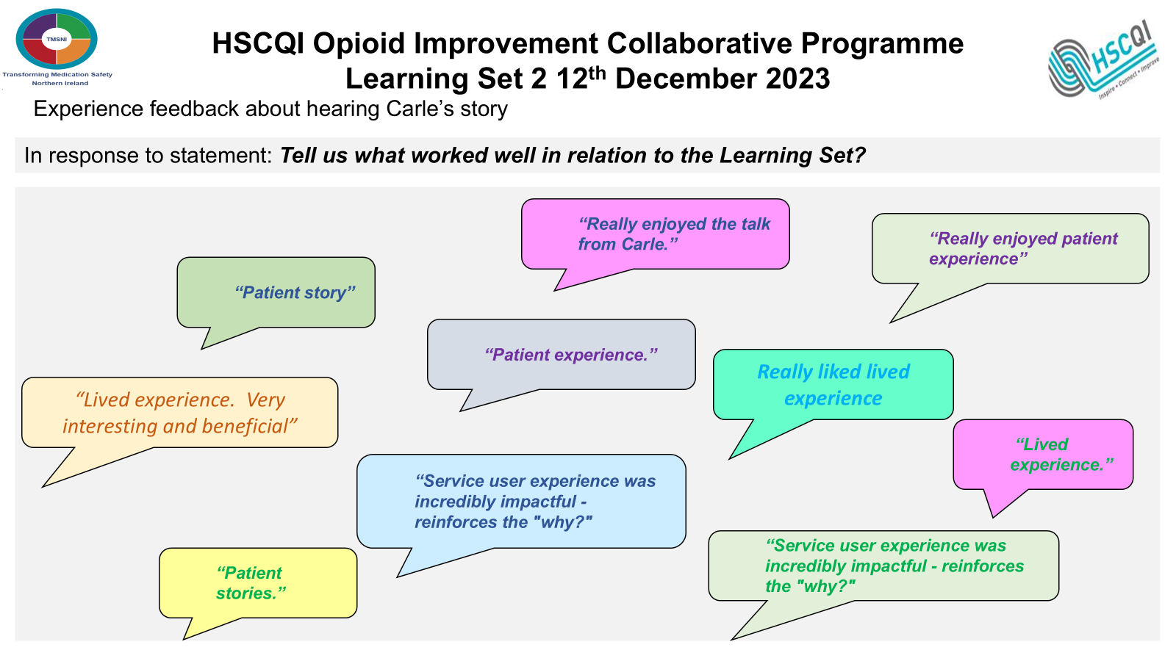
PARTNER FEEDBACK –Quality/SERVICE IMPROVE

Slide 12
reach

Slide 13
2024-25 totals (NI & Scot)
No. of PV (QI/Service Improve element) sessions: 41
No. of PV (QI/Service Improve element) participants: 494
No. of PV (Education element) session participants: 936
No. of PV (Education element) sessions: 72

