Slide 1
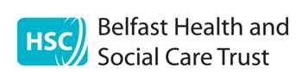


Individual Placement & Support (IPS)

Slide 2
Individual Placement & Support
Evidenced based model of supported employment.
Implemented worldwide.
Currently in operation in the Belfast Trust in partnership with Action Mental Health.

Slide 3
IPS Philosophy
Anyone is capable of undertaking competitive work in the community if the right kind of job and work environment can be found – job match.
No relationship between employment outcomes and diagnosis, severity of diagnosis does not impact on success.
The right support is provided dependent on the client.
Motivation is the driving force for success.

Slide 4
8 Principles of IPS
Competitive paid employment
Zero exclusion criteria
Individual job preferences
Rapid job search
Employment Specialist integrated within the mental health team
Employer engagement
Time unlimited support

Slide 5
IPS Process
Referral received from keyworker, consultant or psychologist
Joint meeting with service user, ES and OT/keyworker
Service explained – different roles of professionals
Vocational profile and job search begin
OT assessments and intervention commence as needed
Key worker remains involved
On-going support from ES and OT for Client and employer

Slide 6
Role of Employment Specialist
Vocational Profiling
CV development and job applications
Job search
Interview skills training
Disclosure support
Employer contact
Link to benefits advice

Slide 7
OT as Vocational Champion
Clinical knowledge of mental health and function
Specific OT assessments and interventions
Knowledge of service user needs following assessment
Evidence based approach to employment
Link to the multidisciplinary team weekly MDT
Awareness of Employment Specialist role, training
Support with positive risk taking
Ensure work is kept on the agenda

Slide 8
Responsibility of Healthcare professionals
Ask about work history
Make work a realistic outcome
Include it in treatment plans
Focus on strengths
Seek support of OT and/or employment specialists
Ask the work question

Slide 9
Current Update
Total service users involved in the programme
Data from 01/01/2021 – 31/12/2024
Age Range | Male | Female | Total
18-24 | 13 | 5 | 18
25-49 | 40 | 17 | 57
50-54 | 2 | 5 | 7
55+ | 3 | 2 | 5
Total | 58 | 29 | 87

Slide 10
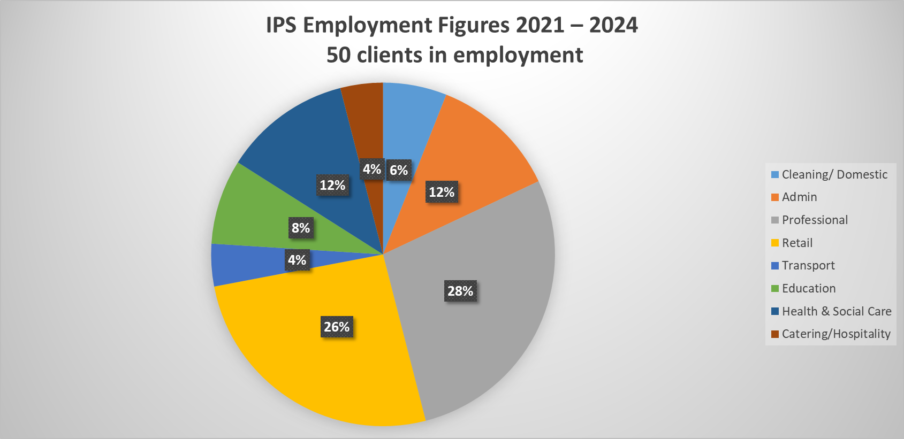
Current Update

Slide 11
Current Update

Slide 12
IPS Clinics
To assist with access to the IPS service, staff are facilitating a monthly drop in clinic:
Teams: North 1 and North 2
Day: Last Wednesday of the month
Time: 1pm – 2pm
Location: Old See House, Resource Room

Slide 13
Referral Process
Referral form will be circulated via your team leader.
Referrals to forwarded to your Employment Specialist or OT.
Reviewed at allocations meeting.
Joint appointment will be arranged.
Keyworkers must remain involved as employment specialists are not clinically trained.

Slide 14
Referrals without a keyworker
Occasionally service users who are referred, do not currently have a keyworker in the team. To access IPS both service users and Employment Specialists need a clinical point of contact as Employment Specialists have no clinical background.
Options for this include:
Allocation of Keyworker for duration of involvement
Contact through Recovery Clinic
Team lead as named professional

Slide 15
IPS Summary
What is IPS? Supported employment service facilitated by BHSCT and AMH.
Who is it for? Service users connected to any of the CMHT, EIT or CRT who are looking to obtain paid employment.
When should I refer? As soon as service users identifies they want paid work.
How to refer? Referral form to OT or employment specialist.
Why? Everyone deserves the opportunity to obtain productive roles if this is their goal.

Slide 16
If not IPS, then what?
Action mental health provide other services which may be more suitable for some service users in relation to employment.
New Horizons – supports adults experiencing mental ill health who are interested in progressing in education, training or employment.
SkillSET – a disability employment support programme which supports adults with a range of disabilities to build their skills through education/training and access to the workplace, volunteering or further education.
Workable – provides support to retain employment by giving 1:1 support, advice and assistance for making reasonable adjustments to the workplace, training and support to both service user and employer.
Please contact OT or employment specialists for more information.

Slide 17
Contact details for IPS
Belfast HSCT
Donna McElduff, OT Early Intervention Team: donna.mcelduff@belfasttrust.hscni.net
Esther McNeill, OT North 2 Integrated Team: esther.mceneill@belfasttrust.hscni.net
Ciara Duffy, OT South CMHT: ciara.duffy@belfasttrust.hscni.net
Employment Specialists, AMH
North 1 & 2, EIT- Francesco Petronio: fpetronio@amh.org.uk
South, West & CRT Barbara Blair: bablair@amh.org.uk
East – Megan Killen mkillen@amh.org.uk

Slide 18
Any questions?
Thank you for listening

