Slide 1

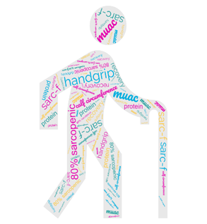
Turning the Searchlight on Sarcopenia and Frailty
Muscle wastage/ loss
Co-occurrence of frailty, sarcopenia, malnutrition
Optimise rehab and Impact
Notes:
Hello, my name is Debbie McGugan. Thank you for having me here to briefly overview our teams QI project. It is entitled “Turning the searchlight on sarcopenia and frailty and this took place initially at Dalriada community hospital”.
Firstly, lets define what sarcopenia is. It is the term used for muscle wastage or muscle loss **
Muscle loss can occur as a result of ageing, it can be disease related, as a consequence of physical inactivity or bed rest or accelerated by malnutrition or over-nutrition (referred to as sarcopenic obesity).
So why did we want to search for sarcopenia and frailty within community hospital rehabilitation?
A better understanding of their prevalence is important because sarcopenia is a key component of frailty, and both impact functionality and rehabilitation outcomes.
From the research available, we know that these conditions, along with malnutrition, are prevalent amongst older patients. They can co-occur and are all potentially reversible. **
However, the links between frailty, sarcopenia and nutrition are often not well comprehended.
From the dietetic perspective, meeting dietary energy and protein requirements are needed to optimise rehab and to have impact.**
Meeting individuals requirements can help prevent muscle loss (sarcopenia) and potentially rebuild it, along with resistance exercise.
It is now well established that protein loads should be spread throughout the day to optimise muscle health.
Meeting nutritional requirements is also necessary for the prevention of frailty progression, as-well as it’s reversal and reversal of malnutrition risk.

Slide 2

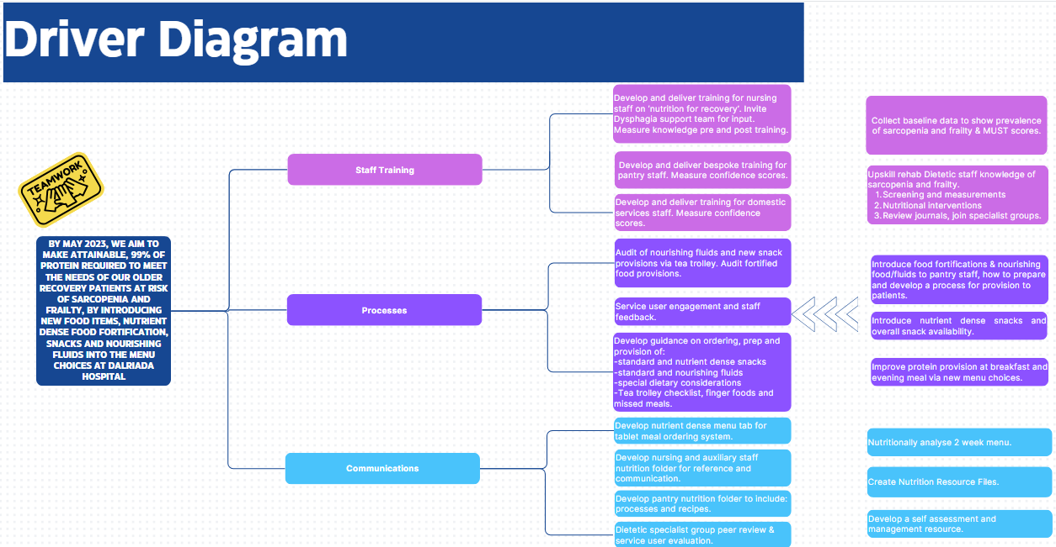
Driver Diagram
Notes:
This is our project driver diagram and it is useful to highlight what we did. I want to highlight just a few of the steps we took.
Firstly, we collected baseline data to understand the prevalence of sarcopenia and frailty on the community hospital wards along with Malnutrition screening scores calculated on admission.
We nutritionally analysed the 2 week community hospital menu and compared that with 15 ward patients’ individual nutritional requirements.
We engaged and listened to community hospital staff and our patients and subsequently provided targeted ‘nutrition for recovery awareness training’ for ward staff, with the help of our Dysphagia support team.
We delivered bespoke training on food fortification, prep of new nutrient dense fluids and foods to pantry staff and awareness training for our domestic services staff.
Including our ward patients views throughout, we developed and implemented a new nutrient dense menu tab on the catering ordering system.
Ultimately through further agreement on processes and development of resources we fulfilled our aim of:
Aim: By May 2023, we aim to make attainable 99% of protein required to meet the needs of older recovery patients at risk of sarcopenia and frailty, by introducing new food items, nutrient dense food fortification, snacks and nourishing fluids into menu choices within Dalriada Hospital.

Slide 3
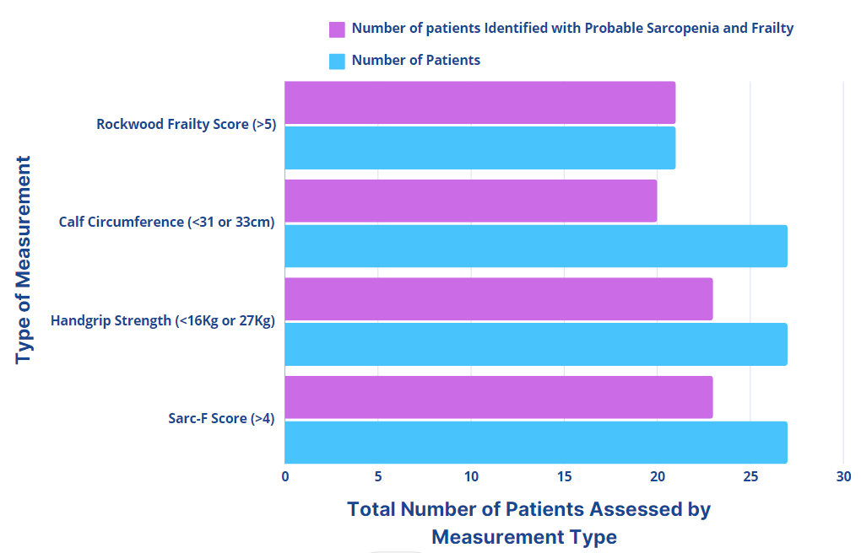
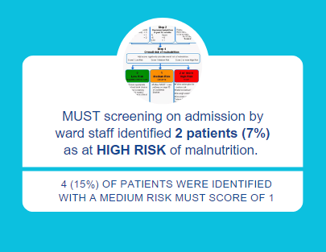
Sarcopenia and Frailty Measurements Taken With Older People Admitted to Community Hospital
Notes:
This chart shows the baseline measurement results taken from older patients admitted to community hospital wards for rehab.
Validated assessment tools were used to measure frailty score and identify malnutrition risk along with the use of European consensus guidance on measures to identify probable sarcopenia.
Our data showed that 21/21 (100%) patients were living with frailty.
20/27 (74%) had a calf circumference below the female or male cut offs of 31 or 33cm for probable sarcopenia.
23/27, 85% had hand grip measurements below the cut offs of 16 or 27Kg for probable sarcopenia and 85% also had a SARC-F sarcopenia screening score above 4, which suggests a high risk of sarcopenia.
***MUST malnutrition screening scores, as calculated on admission by nursing staff, identified only 2 patients (7%) with a MUST score <2 , at high risk of malnutrition requiring dietetic intervention. 4 (15%) of patients were identified as at medium risk with a MUST score of <1, with no dietetic referral.
That gives a total of 22% identified as at malnutrition risk vs 85% identified with probable sarcopenia and 100% of those assessed as living with frailty.
This data suggests a high prevalence of and overlap between probable sarcopenia and frailty within community hospital. The 22% overlap with malnutrition is lower than expected when compared to literature, where a (42%) overlap between sarcopenia and risk of malnutrition has been found in hospitalised older adults. This could be due to differences in malnutrition screening tools used and repeated malnutrition screening during admissions.
by Ligthart-Melis, Luiking YC, Kakourou A et al ^{(3).}

Slide 4
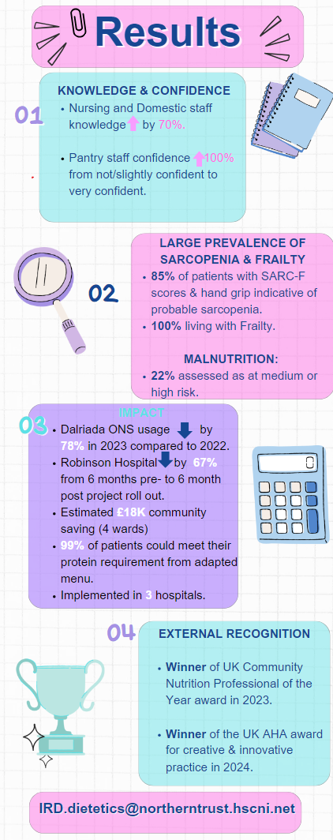
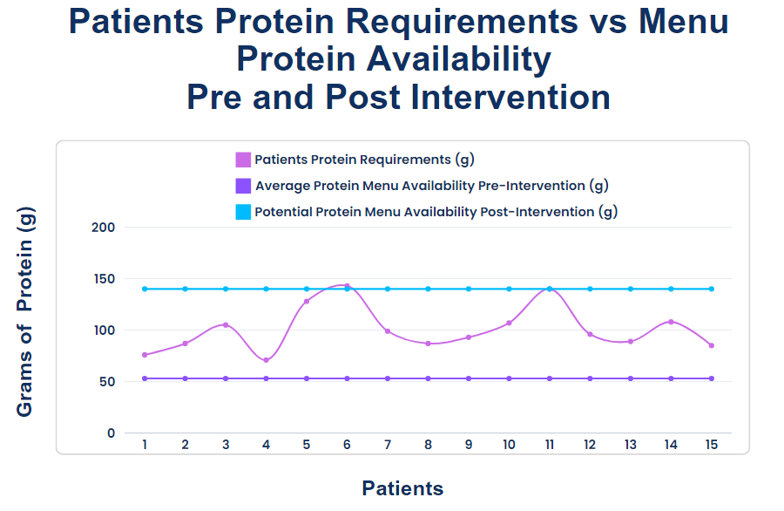
Results
Notes:
In terms of Results: This graph relates to protein and it shows that we achieved our aim of making attainable 99% of protein required to meet the needs of older rehab patients.
The bottom purple line shows the amount of protein available from the average daily Dalriada hospital menu before our project intervention. This figure was derived from analysing the 2 week menu and taking an average of the protein available from the combinations of the 2 menu options at each mealtime. In other words, more or less protein would be available depending on the combination of items chosen at meals, but this is the average. But remember, this is also based on everything being eaten!
For context, current UK menu guidance suggests that menus should have the ability to provide ~92g protein/day.
The pink wavy line shows 15 ward patients individual protein requirements, as calculated by our team. It is worth mentioning that typically our older wardrehab patients protein requirements are around 1.2-1.5g/Kg/BW. Some malnourished or acutely unwell patients can require 2g/Kg/BW.
The top blue line is the maximum amount of protein that could be made available with food fortifications and nutrient dense choices after this project was implemented.
****Other results include the improved knowledge and confidence of ward nursing, domestic and pantry staff following engagement and bespoke training.
We did gain knowledge on the large prevalence of sarcopenia and frailty and used this knowledge to inform our steps as the project progressed.
To meet patients requirements, ONS can be prescribed. This projects impact on prescribed Oral Nutritional Supplement usage was measured with a huge 78% reduction in Dalriada in 2023 compared to the previous year.
At roll out to the Robinson Hospital, a 67% reduction in ONS usage was calculated when comparing 6 months pre and post roll out of the project.
There can be crude estimates of cost savings based on these ONS reductions alone in the community.
Scale and spread of this project has occurred with this project now implemented in 3 Trust community hospitals and it is under pilot in one acute ward.
Another huge result for the team was receiving external recognition through winning 2 UK awards, the most recent earlier this year at the UK AHA awards where we won the creative and innovative practice award in London.

Slide 5
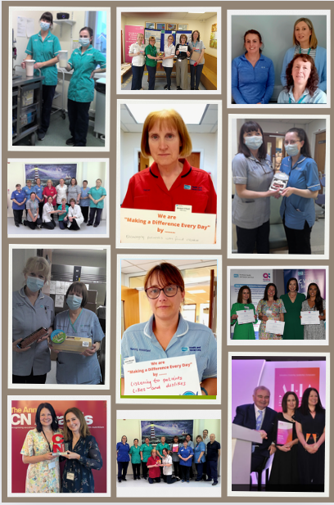
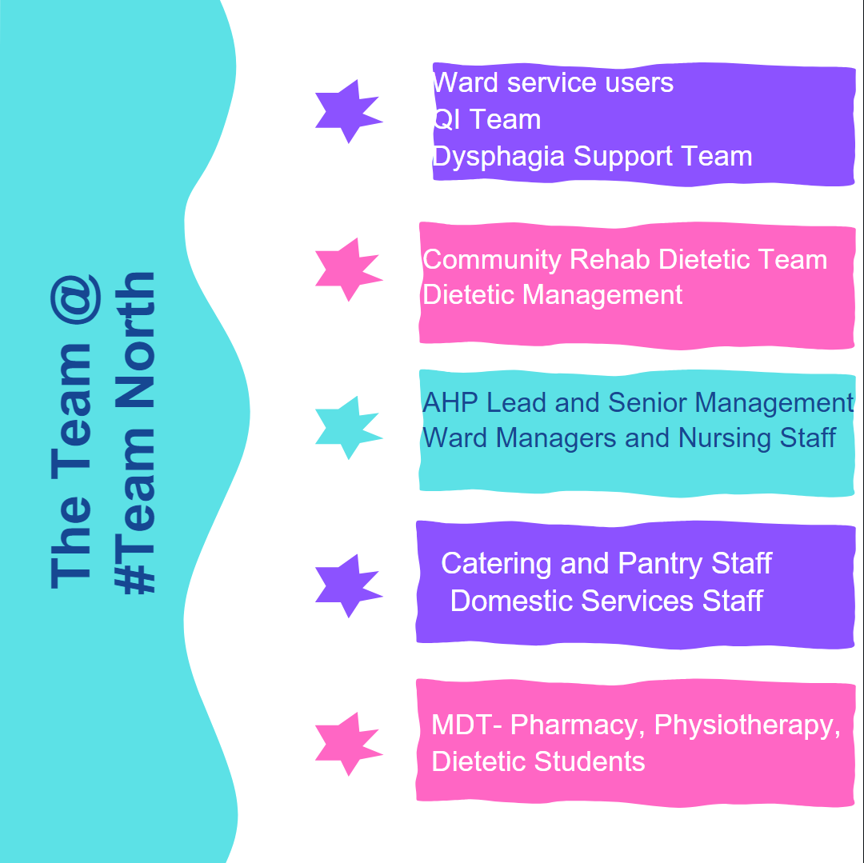
Acknowledgements
Notes:
This final slide is to acknowledge and thank all those people who made this project possible and a success. Some of the team and award successes are displayed in the photos.
Thanks to our QI team, our service users, our past dietetic students and all our dedicated Team North colleagues..
Their willingness, commitment and focus on ‘what mattered’ helped us collectively achieve improvement and realise our project aim.
We are also grateful to work with the remarkable individuals who provide opportunities, open doors and are always there to support, and encourage along the way.
Thank you to everyone and thanks for listening.
2.) Alfonso J Cruz-Jentoft, Gülistan Bahat, Jürgen Bauer et al. Sarcopenia: revised European consensus on definition and diagnosis, Age and Ageing, 2019; 48: 16-31
3.) Ligthart-Melis, Luiking YC, Kakourou A et al. Frailty, Sarcopenia, and Malnutrition Frequently (Co-)occur in Hospitalized Older Adults: A Systematic Review and Meta-analysis. Journal of the American Medical Directors Association, 21 Apr 2020, 21(9):1216-1228

