Slide 1




‘Getting to the Gut of the Problem’
The Impact of Dietetics in a Gastroenterology Ambulatory Hub Service
Christine McColgan
Advanced Practice Gastroenterology Dietitian
Ulster Hospital
Acknowledgements
Jennifer Addley, Consultant Gastroenterologist
Gemma Morgan, Specialist Dietitian
Adele Nichol, Advanced Practice Gastroenterology Dietitian
Noelle Power, Team Lead for Gastroenterology & Surgical Dietetic Service
Leanne McWha, Gastroenterology Specialist Nurse
Notes:
Hi everyone, for those who don’t know me I’m Christine McColgan one of the Gastroenterology Dietitians at the Ulster Hospital. Today I’m going to present to you my work around the impact of a a dietetic service in a Gastro ambulatory hub.
1

Slide 2

Overview of the project
Aim: Assess the impact of dietetic services within a Gastroenterology ambulatory hub setting over 2 years.
Method: Impact was assessed via quantitative and qualitative methods;
patient feedback questionnaires
dietetic outcome measures
Both methods contributed to evaluating
patient outcomes and service outcomes.
Notes:
My project sought to look at the impact of dietetic services within a gastro ambulatory hub over 2 years.
Methodology included both quantitative and qualitative approaches using patient feedback questionnaires and dietetic outcome measures.
Combined these helped me evaluate service and patient outcomes.
Here is a snapshot of the dietetic outcomes measures we used in the SET which are based on the British Dietetic Association model and process taking into account many aspects of a patients dietetic care for example looking at anthropometry, biochemistry, clinical symptoms, their diet, environment, behaviour, social aspects. Every patient would have a dietetic diagnosis, goas set and a plan on assessment. On review these outcomes would be reviewed and progress was monitored and documented using the following criteria; achieved, partially achieved, or not achieved to aid and determine if further dietetic input is required.
This form is provided to all patients attending any clinics in the GI hub and the patient is able to provide feedback on how their service went for example specifically dietetically ‘did the service improve their QoL through improved ability to manage your diet’ did you benefit from the MDT approach, confidence to self manage your condition’ in addition there is free text boxes for patients to provide more in-depth feedback.
2

Slide 3
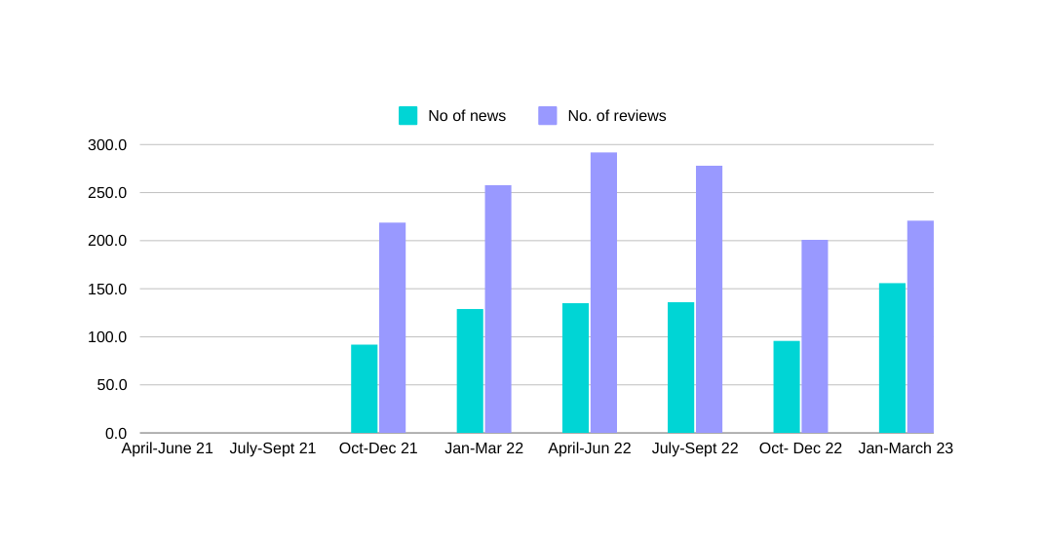
Results
In 2021/22;
~25-30% of hub referrals required dietetic input.
100% of patients required condition related diet advice
63% required nutritional support
70% required bowel function advice
In 2022/23;
~20-25% of hub referrals required dietetic input
75% of patients reported an improved ability to manage their diet.
94% of patients found a benefit from a MDT approach.
Overall 100% of users (n= 245) would recommend this service.
Notes:
Firstly here the graph demonstrates the number of patients seen by dietetics within the hub in a 2year period- you can see missing data for the first two quarters this is simply due to data wasn’t collated until Oct 2021 – influenced by a number of factors including COVID.
This data includes dietetic input which is face to face as well as virtual
You can see an upward trend of news and reviews this can be relatable to the fact the service as initially piloted to some GPs in SET then broaden across all localities in the SET and also dietetics being more well known and integrated to the MDT to access during clinics.
You can see a dip in Oct-Dec 2022 simply related to AL and reduced referrals during the holiday period.
A high number of reviews can be attributed to many factors such as checking progress 1-2 weeks post consult or completing a review looking at ONS preferences/compliance with diet advice.
Above is only a snapshot of different dietetic outcomes addressed with patients but these were selected to demonstrate the majority of focus of consults and what was achieved. Out of the 700 new and reviews seen in 2021/22 dietetic outcomes were 100% achieved for those requiring condition related diet advice, nutrition support and advice to improve their bowel function. This also occurred with similar figures in 2022/23 but in addition from the service user feedback questionnaires 75% of 245 patients surveyed reported an improved ability to manage their diet and 94% found a benefit from an MDT approach and 100% of patients would recommend the service to other users.
3

Slide 4




Results
Between October 2021-Sept 2022;
6 patients had their enteral feeding care
managed in the hub which;
Avoided admission
Saved 207 bed days
~ £72,450 cost saving
‘Never been to a more productive
appointment,
meeting the consultant, dietitian and
getting bloods done all under the
same roof and
decisions regarding ongoing care being made
at the same time collectively.
The service was amazing’
‘Dietetic treatment
has
changed my life,
my quality
of life has
never been better’
Ultimately life
saving!!
I can’t thank you all
enough
at the Gastro hub
Notes:
These patients were a mix of IBD pre op optimisation for surgery, nutritional optimisation before hip surgery, liver disease work up to improve nutritional status before transplant assessment, UGI cancer patients. These patients had a NGT placed in the hub or before discharge and ongoing management was via the hub under close care and monitoring of the consultant, dietitian and Gastro specialist nurse. It was estimated during this period it saved 207 bed days and over £72,000. taking at look at this a bit more closely these patients were deemed ambulatory suitable (not applicable in all cases) managed by the consultant and MDT and also this service enable the patient, family and medical team to monitor progress closer and adapt quicker in comparison to solely community based management. It enabled a more manageable approach for the patient and their family with reassurance of regular contact as appropriate.
4

Slide 5

Conclusion
These results demonstrate the value a Dietitian can add to a MDT rapid access service;
Improved clinical outcomes and patient experience
Admission avoidance - saved bed days & associated costs.
Further research is needed to understand
the potential impact of Dietitians working in other ambulatory care clinics.
the additional benefit of Dietitians with supplementary prescribing rights can have on service, MDT and patient outcomes in this setting.
Need to explore new methods of data collection with implementation of ENCOMPASS digital patient record.
Notes:
So to conclude
These results demonstrate the value a Dietitian can add to a MDT rapid access service.
Improved clinical outcomes and patient experience
Admission avoidance - saved bed days and associated costs.
Further research is needed to understand the potential impact of dietitians working in other ambulatory care clinics.
Further research is needed to understand the additional benefits Dietitians with supplementary prescribing rights can have on service, MDT and patient outcomes in this setting.
Need to explore new methods of data collection with implementation of ENCOMPASS.
Limiations
Like all projects mines was no expectation and had limitations. I acknowledge it is likely a lot of patient who were seen by dietetics didn’t not complete questionnaires – simply due to a lot of patient not aware at the start of their consult that they may need to see me therefore hand their feedback form in prior to the assessment. As highlighted earlier – data gap in 20/21. reporter bias can be an issue particularly when determining if a dietetic outcome was met or not.
But ultimately this project has demonstrated when a Dietitian is fully embedded in the ambulatory service it can improve patient-centred care for several patient groups; enhance learning for staff around diet and nutrition; and contribute to more efficient working and cost savings.
5

