Slide 1


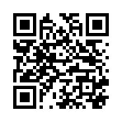
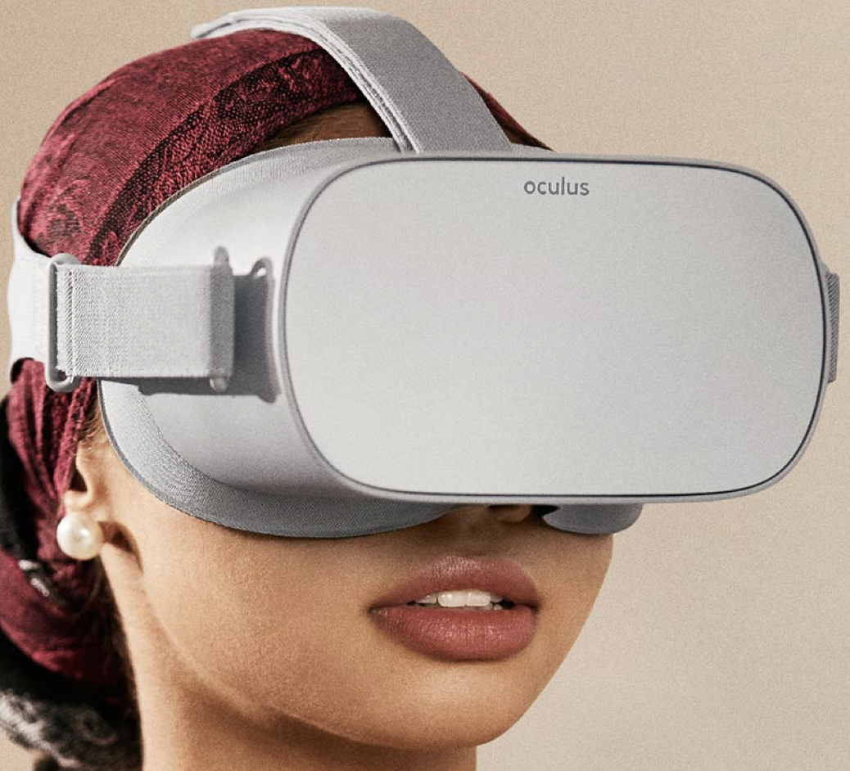
Speech and Language Therapists perspectives of Virtual Reality as a clinical tool for autism: a cross-sectional survey
Jodie Mills
Speech and Language Therapist | PhD Researcher
Notes:
Hello, today I'm going to present research about speech and language therapists perspectvies of VR as a clinical tool for autism.
My name is Jodie, I'm a SLT and PhD researcher and this research was completed as part of my masters

Slide 2

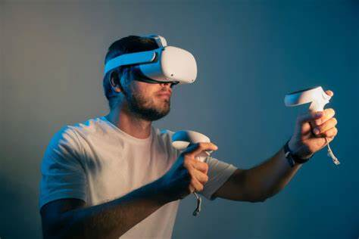
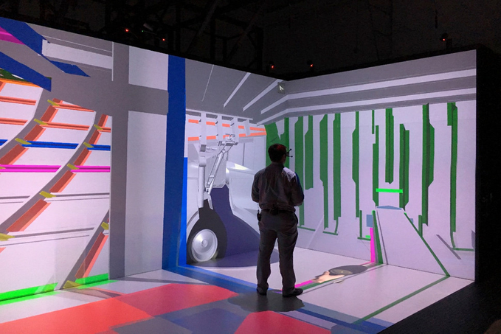



VIRTUAL REALITY
Virtual Reality (VR) uses artificial tactile, visual, and auditory feedback to digitally replicate real world scenarios [1]
Advantages for autism
Drawbacks for autism
Head Mounted Display (HMD)
Computer Automated Virtual Environments (CAVE)
Notes:
VR can be a HMD which is the most popular, a Computer automated virtual display, which I have seen most in special schools and sometimes even on a laptop.
The main point of VR is to achieve immersion in the virtual environment - the feeling of actually being in the virtual environment and forgetting about everything around you in the real world.
When we think about VR in relation to autism it has advantages and disadvantages
Advantages:
- Capitalizes on visual strengths
- Safe, controlled and customizable practice environments
- This has led to further research suggesting VR-based interventions may be effective for improving socials skills and generalisation, enhancing emotional recognition, reducing anxiety and facilitating sensory integration [3,4]. Indeed, research has demonstrated a moderate evidence base for VR with the autistic population [5].
- George et al. (2023) [6] demonstrated that a VR reality intervention for young autistic adults effectively improved their social and communication skills, and this group preferred the VR intervention in comparison to traditional methods.
Drawbacks:
- Difficult to know how sense of motion in HMD may interact with sensory needs
- Needs to be viewed with a critical lens. Most studies target social skills training and sensory integration - which are deficit based interventions that want to reduce and normalise autistic social behaviours
- This can potential increase the risk of masking, negative mental health outcomes and trauma
- As an many SLTs working in autism and moving towards neuro-affirming practice which seeks to support autistic identity through strength based approaches - it is difficult to know if VR is even an acceptable tool

Slide 3




VIRTUAL REALITY IN SLT
Used in TBI
Vaezipour et al. 2023; Brassel et al. 2023
Potential for communication disability
Bryant et al. 2020
Potential for skill generalisation
Could support several communication goals
Bailey et al. 2022
Evidence requires development
Preliminary evidence base in autism
‘which VR technologies work for whom, in which contexts’
Notes:
Key papers have established a preliminary evidence base for VR as an intervention for autistic children in the SLT field:
(1) Vaezipour et al and Brassel et al have used and created VR tools as a rehabilitation tool for people with TBI. They indicated that while attitudes were positive, perceptions of a lack of evidence, a need for training and guidelines, side effects and workplace limitations acted as barriers to adopting the technology
(1) Bryant et al’s (2020) [15] literature review provided initial support for the use of immersive VR for ‘communication disability’ and autism, in SLT and indicated there is some potential for every day, functional communication skills developed in VR worlds to transfer into real-world interactions. However, they suggested that technological complexities may act as a barrier to individuals with co-morbid intellectual disabilities, and that VR may create ethical and safety issues that should be considered carefully,
(2) Bailey et al’s (2022) [16] systematic review suggested that VR could support several social communication goals for autistic children and those with an intellectual disability. However, results varied greatly, included research with low quality methodology and outcomes were inconsistent across VR technologies.
Evidence underpinning effective and affirming VR interventions in autism requires further development.
Overall, shows that VR implementation in SLT practice is still in the early stages, and therefore it is difficult to determine “which [VR] technologies work for whom, in which contexts,” how VR supports SLT tasks and objectives, and the support they require

Slide 4




The current study
The current study
Aim
To explore Speech and Language Therapists’ knowledge and attitudes towards immersive virtual reality (VR) as a clinical tool for autistic children.
Objectives
What knowledge do SLTs have about VR?
What are SLT attitudes towards using VR as an intervention for autistic children?
What do SLTs need to support the implementation of VR for autistic children in an SLT setting
Notes:
In this work, we explore Speech and Language Therapists’ knowledge and attitudes towards the use of Virtual Reality for autistic children.
We sought to answer 3 questions with SLTs practicing in the autism field:
(1) What knowledge do SLTs have about VR?
(2) What are SLT attitudes towards using VR as an intervention for autistic children? and
(3) What do SLTs need to support the implementation of VR in clinical practice?
With this research, I aimed to create a basis for future research, co-design, and implementation of VR for autistic children in an SLT setting.

Slide 5

Online cross-sectional survey with speech and language therapists working with autistic children in the UK
The current study
Method
Survey
23 questions overall
60 responses with 53 complete
48 women / 4 men = SLT gendered employment
? representive of SLTs working in autism
demographic data collected but not analysed
Notes:
23 questions overall - likert scales, open ended questions, single and multiple choice questions
60 responses - 53 complete
Recruitment across professional social media
No data on the number of SLTs working with autistic children in the UK - so difficult to know if 53 responses is representative of this population - and its acknowledged this may be a limitation

Slide 6
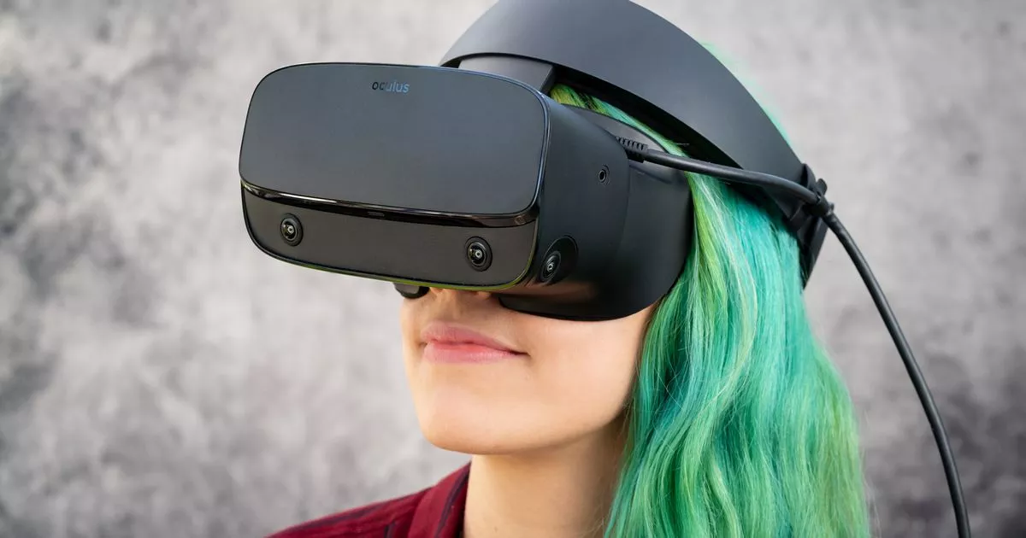




RESULTS
92%
49/53
had not used VR with autistic children in SLT
7.5%
4/53
had used VR in SLT
1.8%
1/53
had used VR in SLT with autistic children

Slide 7




RESULTS
What knowledge do SLTs have about VR?
Mixed self reported knowledge
“My own knowledge is my main limitation.”
Around half knew that VR describes desktop VR, CAVE and HMD’s
Majority of SLTs were aware of VR, but had not used it

Slide 8




RESULTS
What are SLT attitudes towards using VR as an intervention for autistic children?
“I would be worried about social scenarios created by neurotypical people to intervene in helping autistic people practice skills that don’t come instinctively.”
“I think that it would support practicing areas such as self-advocacy and perspective taking in a more dynamic way.”
SLT users were positive about VR
+++ uncertainty
80% of non users would use VR in the future
20% would not use VR in the future
Notes:
Positive and negative attitudes towards VR from SLTs who had not used VR, with uncertainty about autism specific considerations for VR. Those who had negative attitudes, strongly disagreed with the intervention.
The SLTs who had used VR or specifically with autism were generally very positive.
80% of SLTs who had not used would use in the future. Reasons included: innovation in practice, motivational nature of the technology, potential therapeutic impact.
20% would not and reasons included: VR may not be supportive of neuro-affirming principles, concerns about sensory issues and ethical concerns and dissociation

Slide 9
RESULTS
What are SLT attitudes towards using VR as an intervention for autistic children?
Softwear
Research / evidence base
Adverse side effects
Barriers
Support and budget
General
Autism specific
Neuro-affirming status
Trend of uncertainty
Instructions / guidelines
Selecting and screening for VR
Notes:
SLTs were also asked to outline their reasons for not using VR and the quotes are taken from these
Many of these barriers are reflective of barriers noted in research and the technology acceptance model
30% of SLTs who had not used VR thought it was neuro-affirming, 14% did not and most just didn't know

Slide 10
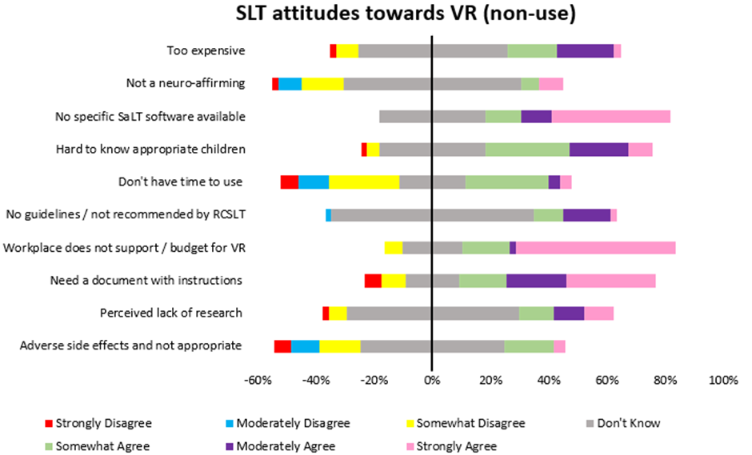
RESULTS

Slide 11
Results
Results
What do SLTs need to support the implementation of VR for autistic children in an SLT setting
Future Research:
Effectiveness
Clear outcomes for communication and generalisation
Compare with NHS therapy
Increased evidence base
“having the knowledge to make an informed decision.”
VR roadshow
Education from VR specialists
Funding
Research overview
Practiced based learning with peer support
“I personally would need a VR road show for autism where you can see what it can do, get to try it and talk with experts and other SLTs using it.”
Training and education
Manual
VR user guide and set up
Frequently asked questions
Trouble shooting guide
Example therapy activities
83%
A manual from “procurement to discharge”
Notes:
The 49 SLTs who had not used VR were asked what they needed to support future research. Key themes emerged including: an increased evidence base, workplace support and training and education. Many SLTs did not answer in full sentences, and this reflects the fragmented quotations used (Figure 4).
An improved evidence base for VR as an SLT tool for autistic children was required and “having the knowledge to make an informed decision,” was a priority for many. An improved evidence base was also required to provide a more solid foundation for business cases for employers: “I don't know enough about the applications of it within SLT, i.e. in Assessment & therapy. I would need to know this and have a strong enough evidence base before I could even approach my NHS employers to try and build a business case to support them purchasing it.” Furthermore, SLTs suggested future research should demonstrate clear quantitative evidence showing the effectiveness and efficacy of VR, clear and replicable outcomes measures for communication and generalisation domains, and comparison of VR with standard SLT therapy.
Training and education were also identified as a theme across the data. 83% of SLTs felt they would benefit from training, to include an overview of VR technology and guidelines for use. SLTs suggested a demonstration day, best described by one participant: “I personally would need a VR road show for autism where you can see what it can do, get to try it and talk with experts and other SLTs using it.” SLTs wanted this to include education from specialists about the VR headsets available and appraisal of these, information on how to apply funding, an overview of research and practice-based learning opportunities with peer support.
SLTs also reported that they needed a VR manual from VR “procurement to [therapy] discharge.” This would include: a VR user guide and set up, example therapy ideas and a frequently asked questions guide for troubleshooting and difficulties.
Although there are guidelines for using extended reality (XR) with autistic children, and may provide a foundational base for clinicians working with autistic children, they should be critically appraised on a case by case basis. It may be that future research modifies these guidelines using participatory methods and co-design with autistic children, parents and SLTs to ensure that tools are neuro-affirmative.

Slide 12
Summary
Summary
Mixed general knowledge, which was poor in relation to autism applications
Positive and negative attitudes, where uncertainty dominated and barriers were noted
SLTs need an improved neuro-affirming evidence base, guidelines and training
Knowledge
Attitudes
Support Needs

Slide 13
Limitations
Limitations
Demographic variables
Online and self selective
Is the sample representative?
Explore age, location and clinical experience and adoption
Include digital skills questionnaire
Replicate with a larger sample size

Slide 14




Implications
Implications
Increased evidence + available training = potential employer support and integration into practice
Increased support from employers and funding
Could overcome general and autism barriers to usage and could increase knowledge
SLT VR education and training programme recommendations
Strengthens neuro-affirming evidence base and knowledge surrounding autism specific applications
Neuro-affirming research - including participatory approaches with autistic children, parents and clinicians
Notes:
Patient specific facilitators and barriers to VR SLT interventions should be identified (e.g., sensory differences, epilepsy, victimization, dissociation, intellectual disability and gender) and external features of VR that contribute to effective SLT interventions. Given the link between epilepsy and autism, and the lack of evidence regarding seizure risk with HMD’s, side effects are a pertinent area for exploration. Although the risks of HMD’s are reportedly low for autistic children [12], it is necessary to establish safety protocols, such as maximum exposure time and treatment intensity required for generalisation, to ensure tolerance and comfort. Limiting exposure times may also help reduce the possibility of autistic children dissociating from reality and real social interactions [15].
The neuro-affirming stance of VR was a key issue in this research. Future research should ensure VR research in autism is rooted in strength-based philosophies, given much of the current evidence base for autistic children prioritises technology-based interventions for social skills and social cognition training [33]. This paper reiterates the need to think beyond a social skills approach, considering other linguistic, educational, and pragmatic domains within the SLT remit. This reflects the systemic change to autism management observed in the SLT literature and current practice standards [8]. Furthermore, it may be that a priority setting exercise for neuro-affirmative SLTs would uncover pressing areas for research, which could guide future neuro-affirmative VR research.
SLT specific software for autism should be designed using participatory research approaches [34] to ensure VR applications are neuro-affirmative, rooted in autistic and family priorities, and contribute to evidence-based practice in socially and ecologically valid ways [35]. Frameworks such as Design Thinking [36] may facilitate future research allowing this topic to become more define and to create new ideas to solve barriers to implementation in practice. Feasibility of VR as a clinical SLT tool may follow [37]. Additional research should compare outcomes from VR and traditional SLT clinical tools, enabling a cost benefit analysis for the benefit of clinical decision-making.
Suggestions for development include VR applications that facilitate perspective changing and VR as an educational tool.
Finally, an education and training programme may be developed for SLTs, regarding VR as a clinical tool for use with autistic children. Key themes are outlined, but I don't have time to discuss these fully within todays time limits. Future research should explore how a SLT specific VR training package impacts knowledge and attitudes towards VR as a clinical tool for autism and impacts adoption of VR into clinical practice. First-hand experience of and engagement with VR, may allow SLTs to consider how it may be used with autistic children and for SLT goals. This may also inform future research questions regarding implementation: dosage, minimum and maximum immersion time, and protocols for use, which contribute towards evidence-based guidelines for VR.

Slide 15

Contact details

Slide 16
Neuro-affirming approach to autism
Neuro-affirming approach to autism
What does that mean?
Strength based
Accepts differences and does not seek to change
Focus on environmental adaptions and self-advocacy
As neuro-typical resources may not capitalise on autistic strengths, alternative tools for therapy should be explored
Notes:
Support for autistic identity through strength based environment first approaches that promote adaptions [9]. Seeks to remove environmental and societal barriers imposed by neurotypical standards and facilitate self advocacy.

