Slide 1


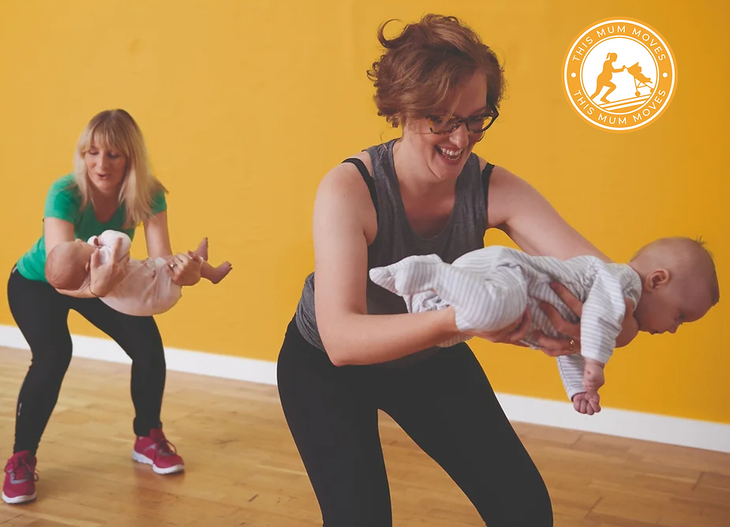
Pushing physical activity up the agenda
Main Aim: Embed a whole system approach to the promotion physical activity within ante & post-natal care pathways.
Working in partnership with Midwifery & Physiotherapy AHP colleagues in Southern Trust.
Clare Drummy: Physical Activity Lead, Annette Kearney: Physiotherapist, Gemma Winter: Antenatal Education Coordinator.

Slide 2
Pushing physical activity up the agenda – This Mum Moves!
The plan:
Map physical activity provision
Map physical activity resources
Physical activity campaigns
Map & source physical activity training
Devise & initiate survey & consultation sessions
Map & devise physical activity messaging
Map key stakeholders & partners

Slide 3
What we found…
Gaps in provision & training
Lack of resources
Lack of consistent messaging
Lack of campaigns & messaging
Lack of physical activity training to support staff
What does physical activity mean to you?
86% of ante & post-natal mums report physical activity means exercise & sport!
Barriers to physical activity
Work
Time
What would support you to be active?
Campaigns
Promote the benefits
56% of ante & post-natal mums are aware of the physical activity guidelines for health.
Safety concerns
Childcare
Lack of motivation
Education & Awareness
Targeted provision
Resources to support
Health professional advice and support
Lack of PA knowledge & awareness
Family commitments

Slide 4

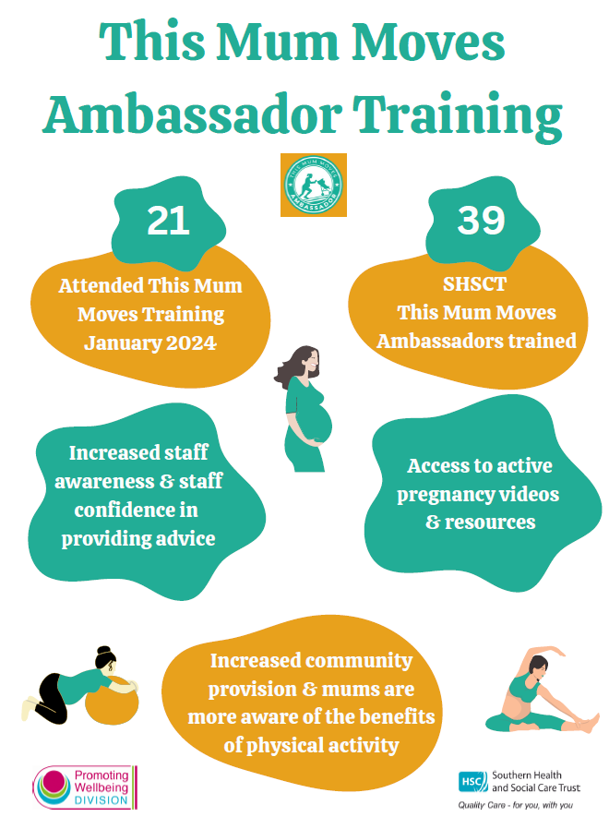
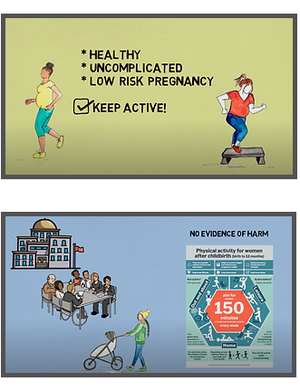
What we did….
Build capacity in workforce
Physical activity questionnaire
Physical activity resources
Targeted provision

Slide 5
Update on current This Mum Moves work…
Co-production & design of targeted campaign This Mum Moves
Reframe physical activity definitions, benefits & awareness
Physical activity resources being developed to support This Mum Moves
Implement findings of Get Active Questionnaire
Updating provision and signposting opportunities
Key providers to be added to steering group
Designing a resource toolkit to support mums to be active
Raising awareness of how physical activity is safe for ante & post natal mums
Coordinated approach to language & terminology

