Slide 1
AHP R&I CONFERENCE 2024
Out Of Hospital Cardiac Arrest (OHCA) Masterclass
Northern Ireland Ambulance Service
Paul Corns, Emma Boylan, Simon Fell, Neil Sinclair & Julia Wolfe

Slide 2

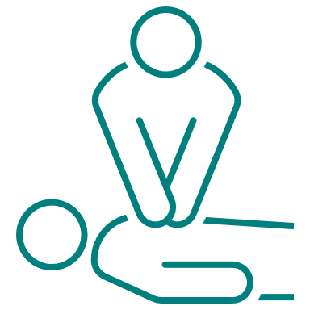
THE CHALLENGE AND THE CONTEXT
OHCA in NI – 2023
n = 2771
Notes:
NIAS were activated to 2771 OHCA in 2023 – approximately 36% (1136) of which received CPR from our attending crews or from bystanders before NIAS arrived.
The question we were posed was, how do we increase survival from OHCA in Northern Ireland?
Ultimately the solution is system wide and must take a population health approach. However, CPR and basic life support should be promoted across the whole of NI – community and schools, ambulance services, acute Trusts. This is a population health approach to the survival of people from OHCA.
NIAS have taken several initiatives, one of which is investing in new education innovations targeting OHCA survival.
The education team within NIAS decided to take a different, innovative, approach to the education of OHCA. We developed and an OHCA masterclass education day and delivered this to around 900 NIAS staff from March to December 2023.

Slide 3




HOW DID WE INNOVATE?
Notes:
CPR is challenging, CPR in out of hospital settings is as difficult as it gets.
Flash teams are formed to deal with a stressful, uncontrolled, medical emergency.
People often become task focused to cope with this, and this often leads to reduced individual and team performance
We moved the focus of education from the individual tasks, that research has recently demonstrated to have limited impact on outcomes, towards a focus on how we can best perform the core fundamentals of high-quality CPR and the elements in the chain of survival.
high-quality CPR does not happen without a high functioning team.
The teamwork starts in the community, with bystanders, community responders and public access defibrillators. It moves through the call takers, control room professionals, into the pre-hospital clinical teams and then into definitive care in acute hospitals.

Slide 4




WHAT DID WE DO?
Notes:
Removed hierarchy – no uniform, no epaulettes, deconstructed the way teams are formed in OHCA and targeted the learning on clear communication and how this feeds good leadership and teamwork.
The education was learner centred – centred on being meaningful to them and their practice, not on organizational outcomes or tick boxing.
Discussion based workshops – leadership. Teamwork, communication and key clinical interventions
Combat the challenge of flash teams by focusing on understanding the unique human factor aspects of OHCA, and non-technical skills that will enhance all of the relevant clinical skills
Communities of practice developed with all feedback peer-led.
We introduced a whole team approach – where we included all grades of NIAS staff, including our non-emergency patient care services staff, who often either witness cardiac arrest or are called to support emergency crews.
Changed practice based on recent research and evidence – for example, removed intubation and introduced vector change defibrillation (ref**)

Slide 5



WHAT WAS THE IMPACT?
Self reported ‘confidence in CPR performance’
(n=656)
35% increase in survival to 30 days
Pre-event
78.2%
Post-event
97.8%
Notes:
Some select quantitative data from the post-event survey included a significant increase in self-reported confidence in overall CPR performance.
Qualitative comments were overwhelmingly positive and highlighted how the innovative education modality really helped the participants view the learning with new perspectives.
35% increase in survival to 30 days in 2023 compared with 2022.
5.53% (n=66) to 7.48% (n = 89)

Slide 6



HOW DO WE KEEP PROGRESSING?
Notes:
NIAS education team have a 5-year plan for OHCA improvement
Promote OHCA research and innovation in your setting
Collaborate with NIAS or other partners who are researching or innovating OHCA practice, share resources, share data and .
Take the message into your communities – promote community CPR, public access defibs, access to CPR education in schools and local communities.

