Slide 1
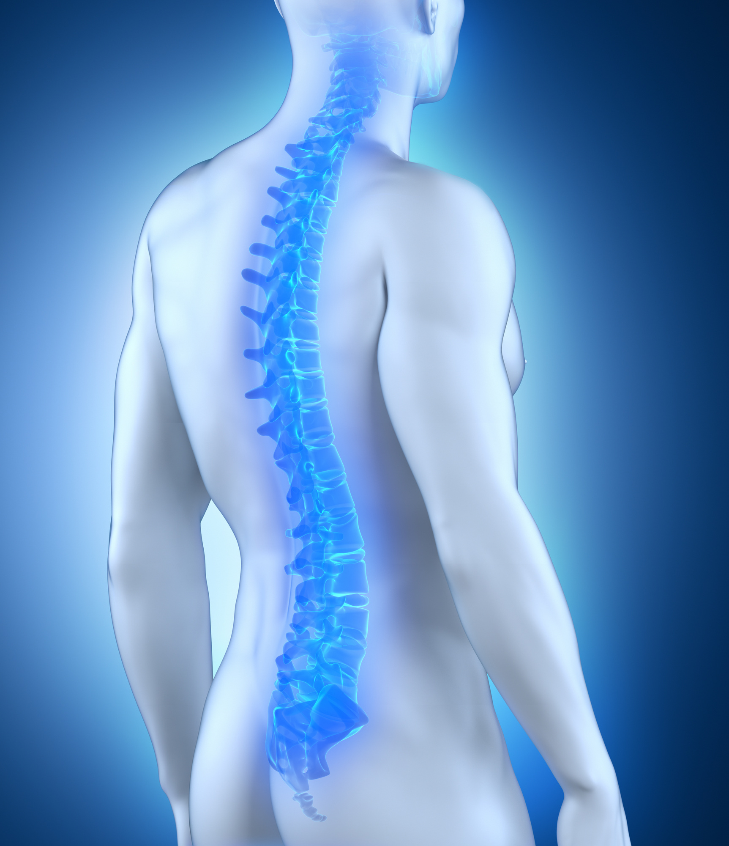


Optimising Referrals to a New Inflammatory Back Pain Clinic through Enhanced Collaboration across Physiotherapy Services
Niamh Kennedy Advanced Practice Physiotherapist
Royal Victoria Hospital

Slide 2

Aims
Develop new inflammatory back pain clinic
Optimise referrals to the clinic
Collaborate across
physiotherapy services

Slide 3





Background
New post and opportunity to be involved in clinic | Physiotherapy involvement in clinic | Long waiting lists in rheumatology | Difficulty triaging referrals | Diagnosis challenges

Slide 4
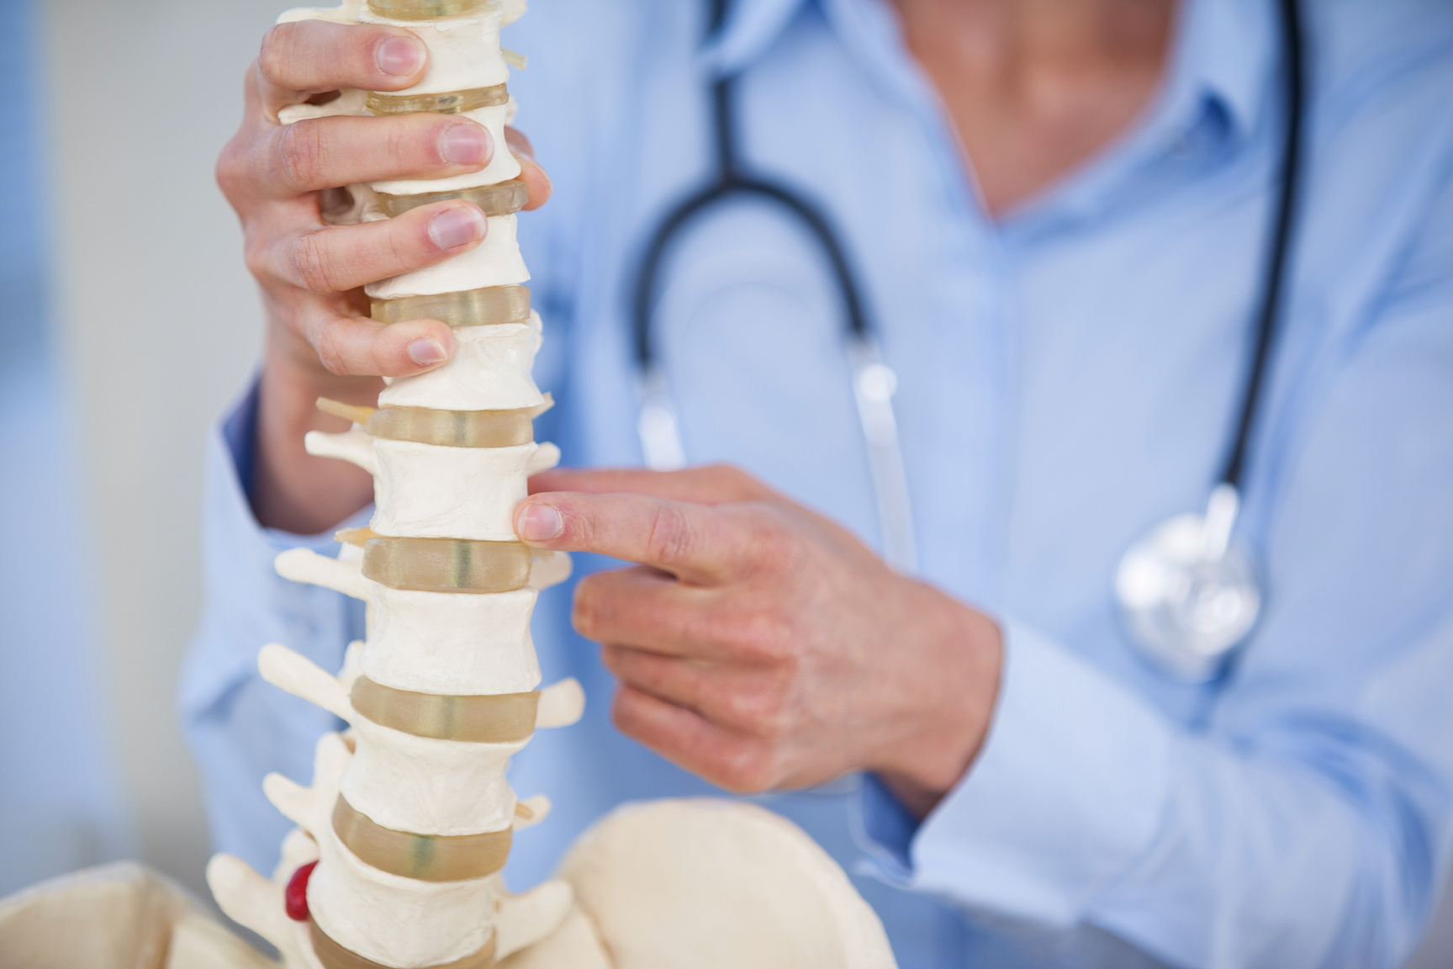

Why is this clinic important?
Axial spondyloarthritis is a progressive inflammatory arthritis primarily affecting the spine and sacroiliac joints
Diagnosis relies upon recognition of inflammatory back pain (IBP) and referral to a specialised rheumatology clinic
Prompt diagnosis and early intervention to control inflammation is crucial
The Belfast Trust average time to diagnosis is 8 years

Slide 5

Barriers to diagnosis
No definitive radiographic or laboratory tests
Signs and symptoms overlap with other (more common) causes of back pain
Limited awareness among public and healthcare professionals re clinical features
Barriers to diagnosis

Slide 6

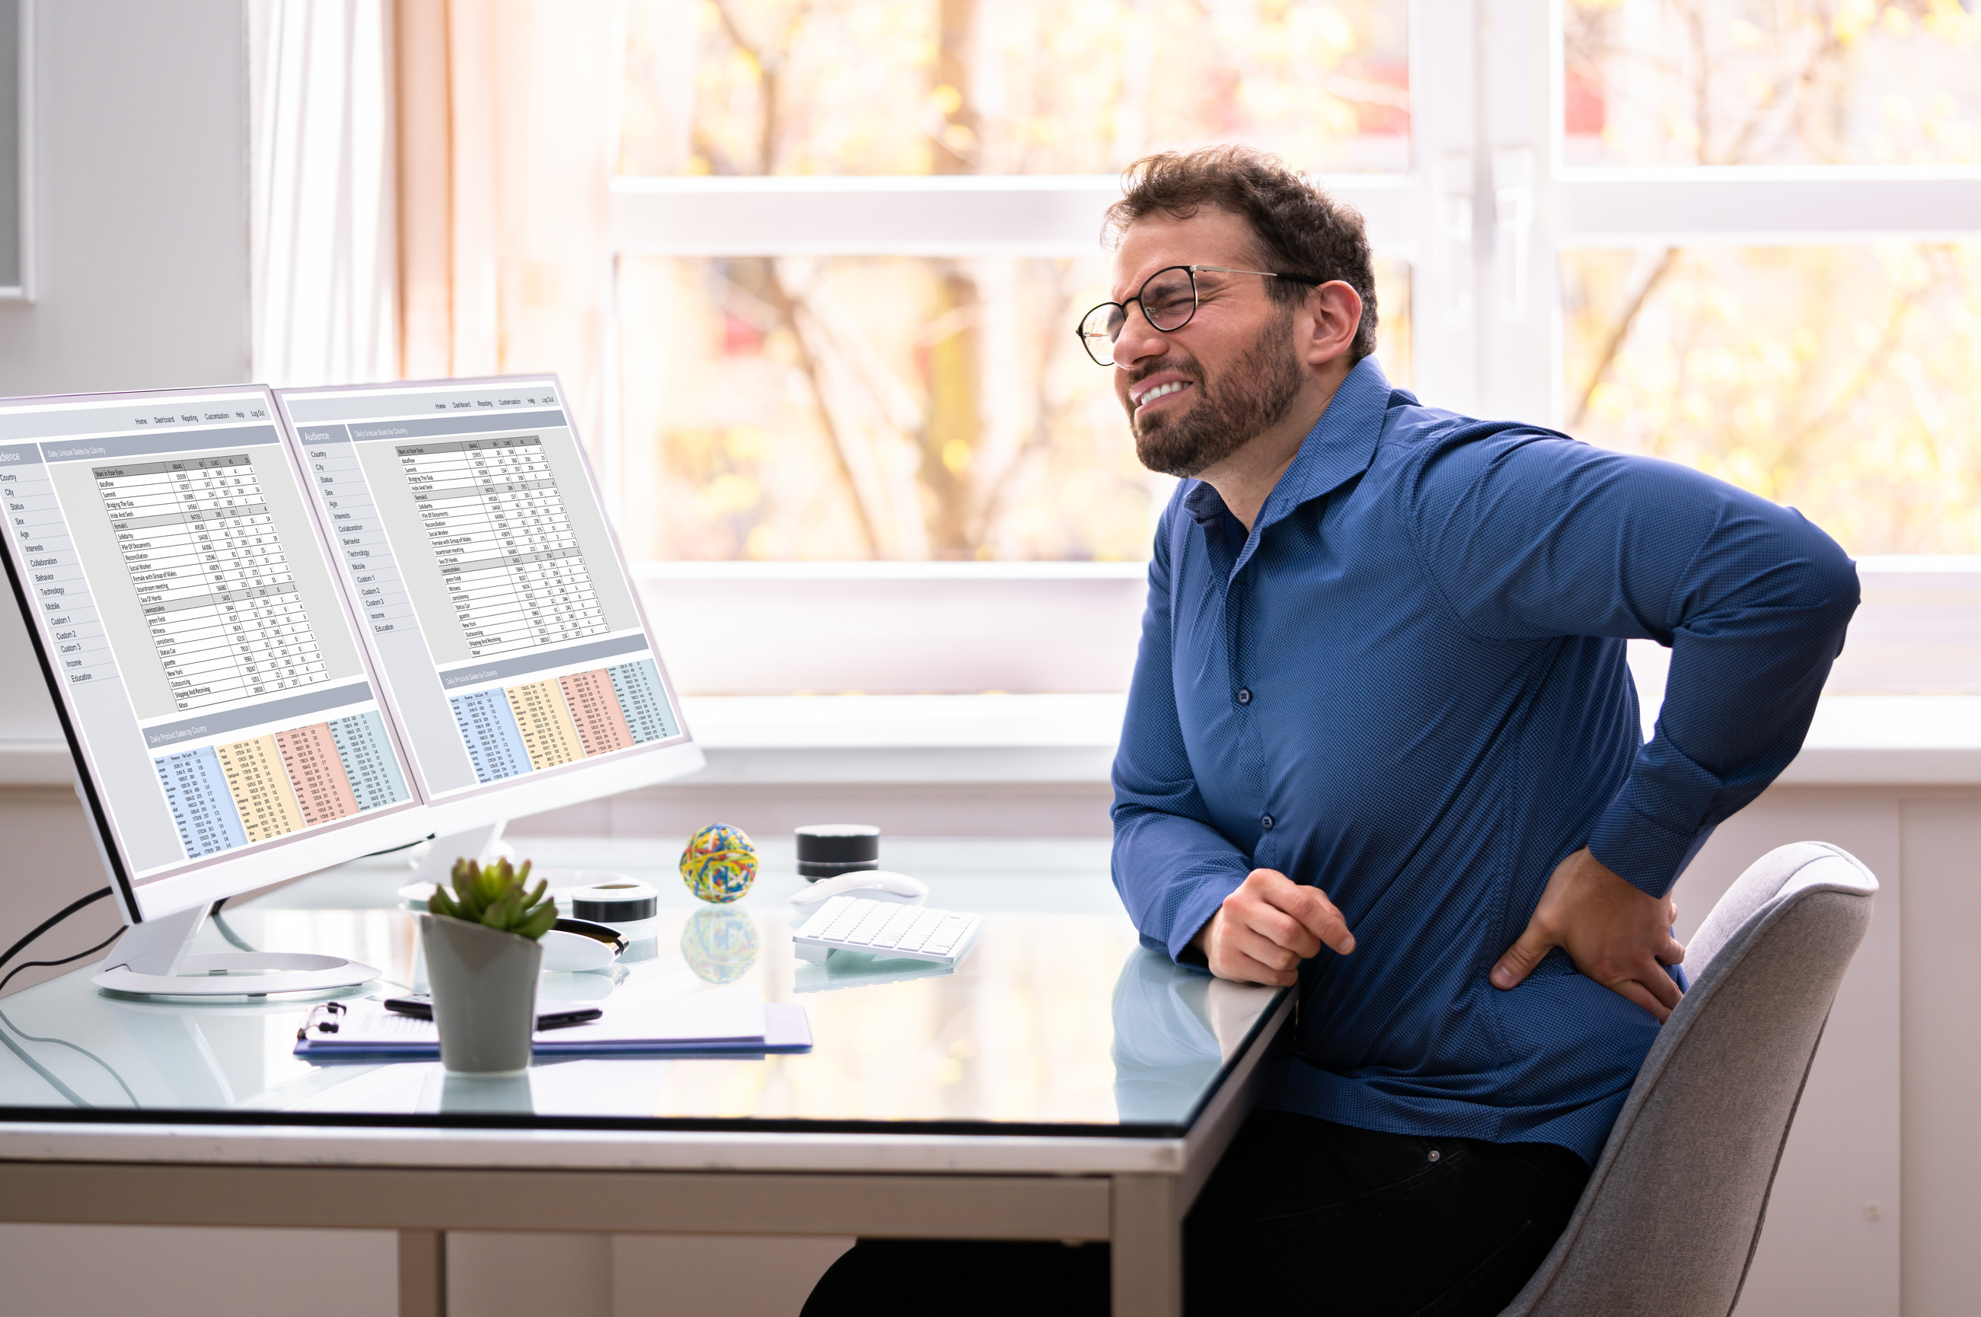
Delayed diagnosis
treatment efficacy
symptoms
Mental health impact
disease activity
quality of life
Economic impact
activity levels

Slide 7

Aim of the project
Investigate the impact of collaboration across physiotherapy services on referrals to a new inflammatory back pain clinic

Slide 8





Objectives
Increase awareness of and communication about IBP
Develop the Advanced Practice Physiotherapy role
Mobilise resources by working
with external organisations
Develop a streamlined referral pathway

Slide 9




Methods
Education
sessions
Communication
channels
Create
pathway
Service user
feedback

Slide 10

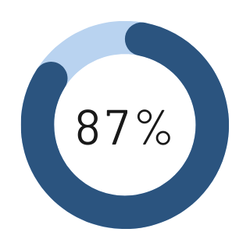
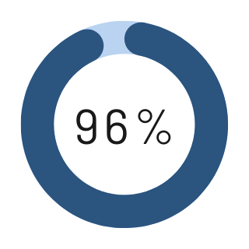

Face to face workshop feedback (n=25)
Highly likely (≥8/10) to recommend workshop to a colleague
Extremely confident (≥4/5) in applying knowledge to own practice
Rated ≥4/5 for increasing understanding of the topic

Slide 11


GPNI Webinar
167 primary care professionals
Overall session | 9/10
Speakers | 4.7/5
Relevance | 4.7/5
Would recommend to others | 90%

Slide 12

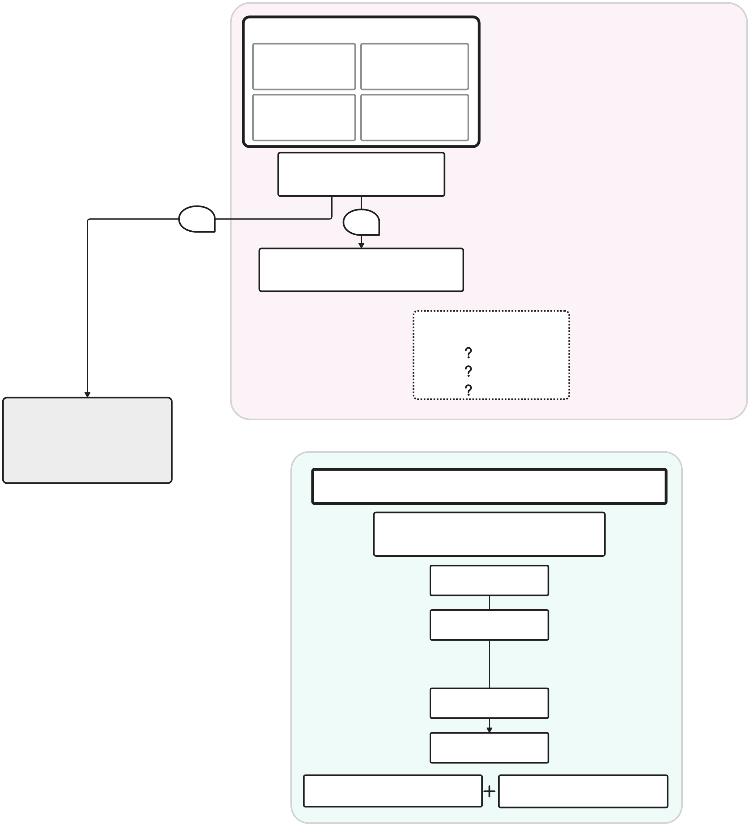
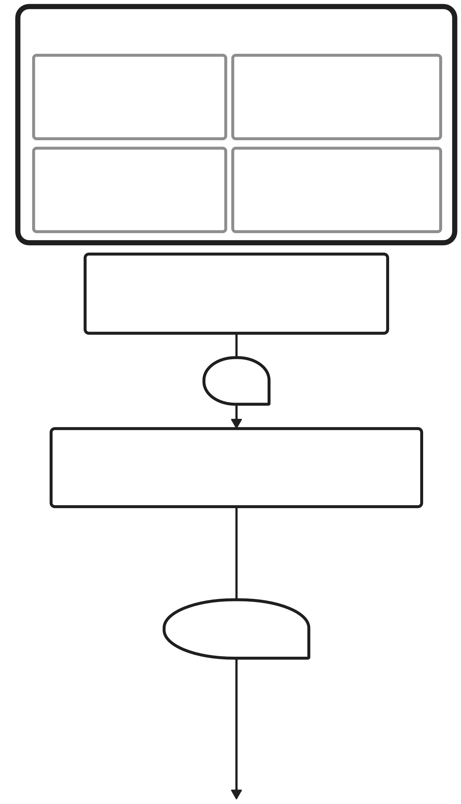
Pilot Inflammatory Back Pain Pathway
Patient with back pain
Back pain assessment:
Identified in secondary care
GP or First Contact Physio
Musculoskeletal Physiotherapy
Dermatology
Gastroenterology
Orthopaedic ICATS
Emergency Department
Ophthalmology
Other specialties
Signs and symptoms of inflammatory back pain?
Signs and symptoms of inflammatory back pain?
No
Yes
Yes
Improbable
Screen using SPADE tool
Screen using local measures
Diagnostic investigations?
(Depending on scope of practice)
Probable
Imaging
Criteria met
Bloods
HLA B27
Patient remains on local non-inflammatory back pain pathways
Inflammatory Back Pain Clinic
Co-located Rheumatologist and Advanced Practice Physiotherapist
Investigate
Advice and signposting
No
Confirm diagnosis
Yes
Educate
Initiate treatment
Pharmacological management
Physiotherapy
Axial SpA Long-term Management

Slide 13

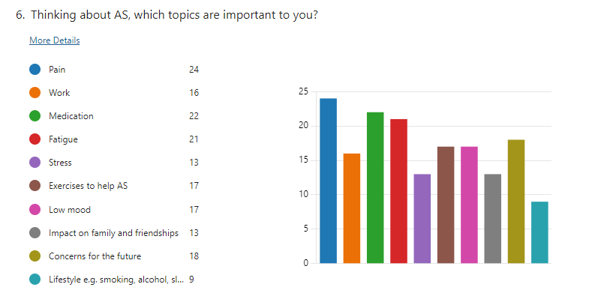

Service user questionnaire
Have your say- what matters to you
?
Dear Service User,
Our Rheumatology Physiotherapy Team is hoping to improve its service for people with Axial Spondyloarthropathy / Ankylosing Spondylitis (AS).
Each person with AS will have a different experience. We would like to know your views and experiences from the time of your diagnosis onwards. Your feedback will tell us what is important to you. It will influence how we can make your
experience better.
We would really appreciate if you could take a few minutes to complete the attached
questionnaire.
OR Please scan the QR code below if you would prefer to fill out an online questionnaire.
What you tell us is anonymous and taking part is voluntary.
Please do not write your name or anything else that may identify you on this questionnaire.
Kindest regards, The Rheumatology Physiotherapy Team

Slide 14
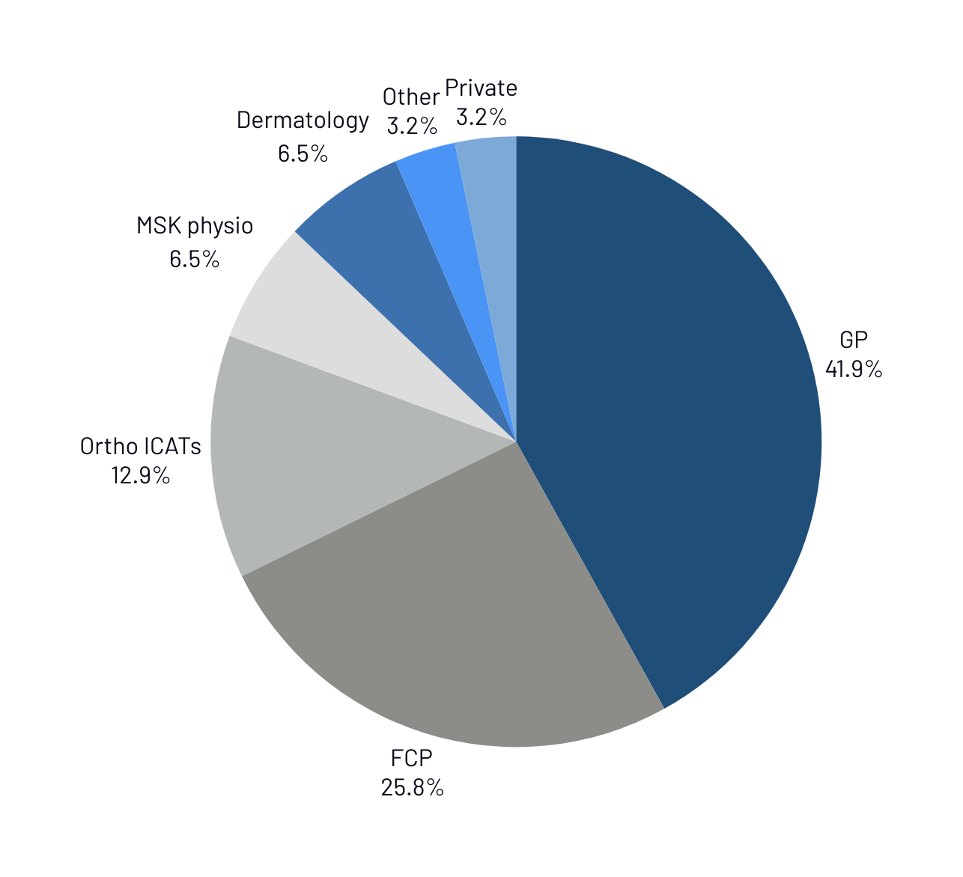
First 6 clinics
Results indicate that physiotherapy collaboration was effective
45% of referrals came from physiotherapists

Slide 15

Referrals from physiotherapists
Referrals from
Physiotherapists
Appropriate referral rate
100%
Confirmed diagnosis rate
29%

Slide 16


Time to Assessment
Average 57 days
Referral from physiotherapist
Assessment at clinic
The new pathway facilitated prompt triage of referrals from physiotherapists.

Slide 17

IMPACT
Impact
Improved networks and collaboration
Rapid effective improvement for patients
Increased awareness of axial SpA
Standardised effective referral pathway

Slide 18









Conclusions
This joint clinic exemplifies collaborative patient-centred care
Cross service
co-operation in physiotherapy reduces the burden of ax SpA
Physiotherapists enhance the effectiveness of referral pathways
Specialist referral pathways can shape population health outcomes

