Slide 1



Claire Hallowell
Aidan McDonnell
NIAS Complex Case Team
Northern Ireland Ambulance Service Complex Case Team and the BRC ‘INTERACT’ Pilot

Slide 2


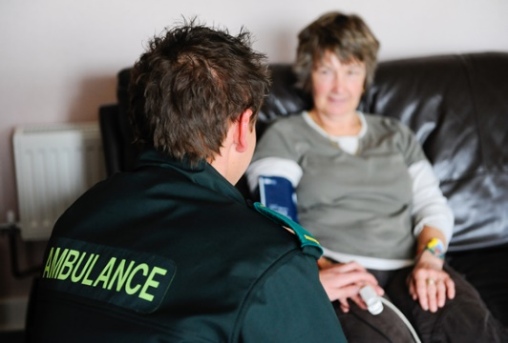

Background…
National Definition of a Frequent Caller
“Anyone over 18 years of age who calls ‘999’ 5 or more times in a month”

Slide 3




Establishing the project…
Application and Governance Stage
Establishing a Referral Pathway and Staff Recruitment

Slide 4
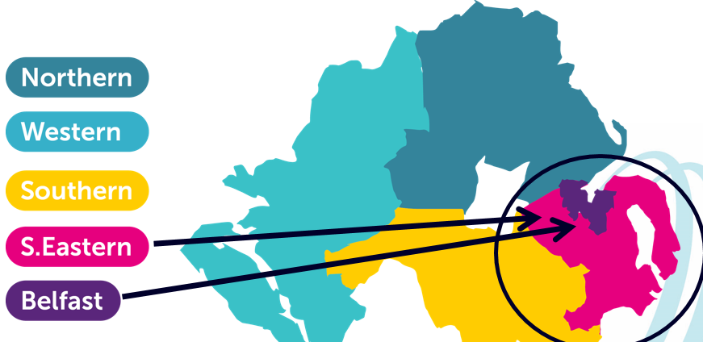
How it worked…
4 Members of staff – Belfast and SE Divisions
Accepting referrals from CCT
Identify gaps in services that may be exacerbating use of emergency services
Demonstrate reductions in use of NIAS, PSNI, unscheduled care and primary care

Slide 5
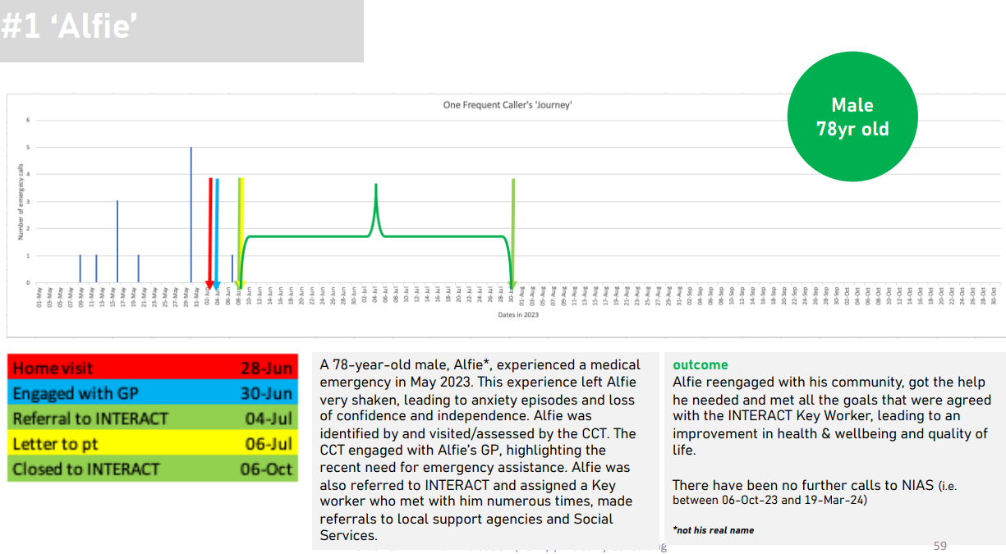
Results…

Slide 6
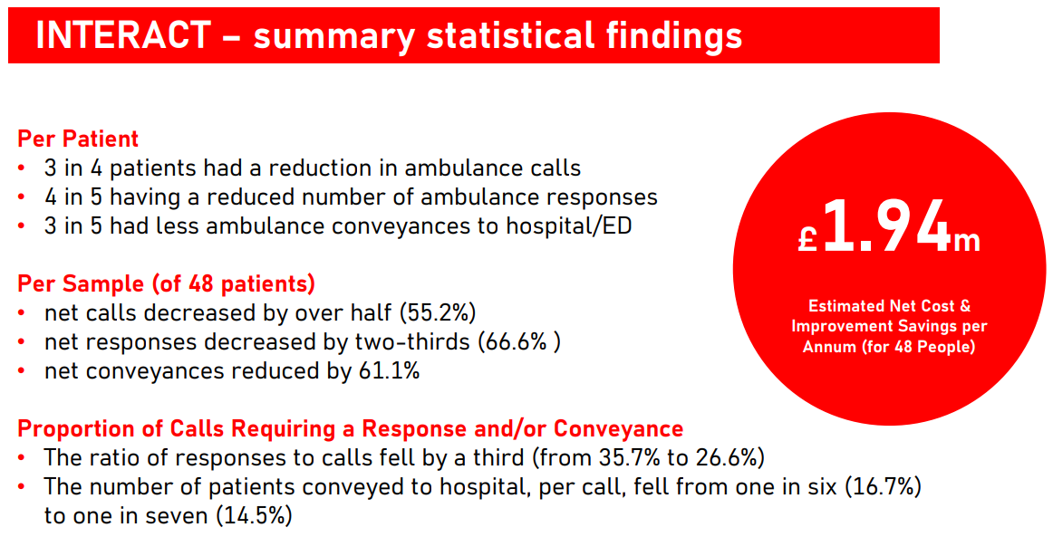
Summary

