Slide 1

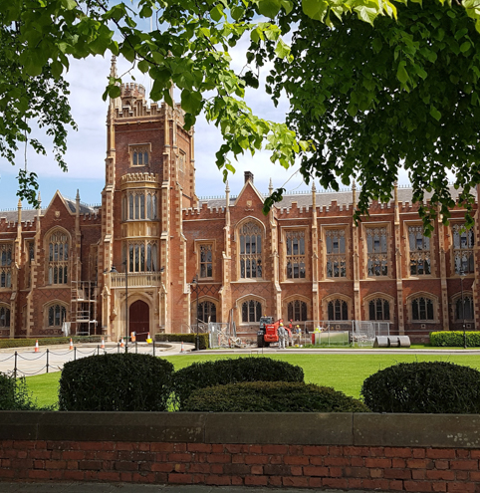


The MusiCARER Project: developing the evidence base for music therapy to support carers pre- and post-bereavement
Northern Ireland AHP Research & Innovation Conference
11th September, 2024
Dr Lisa Graham-Wisener, Reader in Health Psychology, Queen’s University Belfast
l.graham-wisener@qub.ac.uk

Slide 2
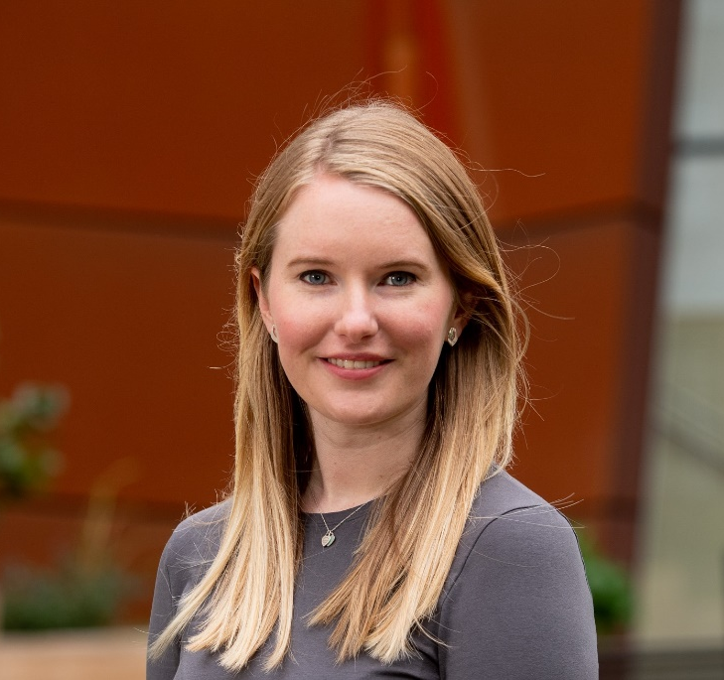
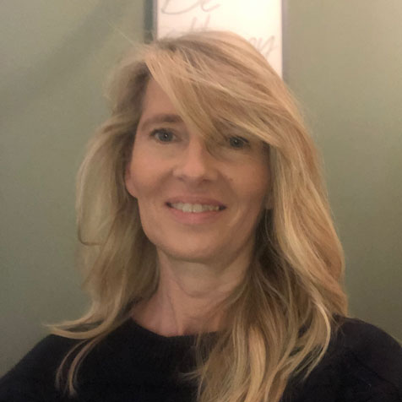
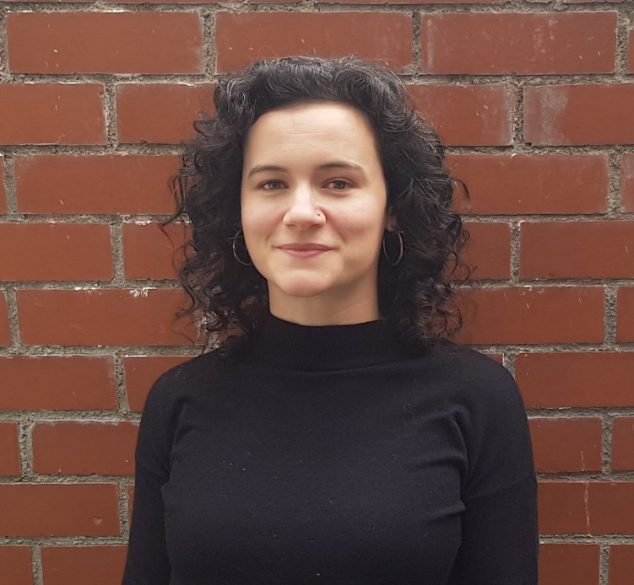


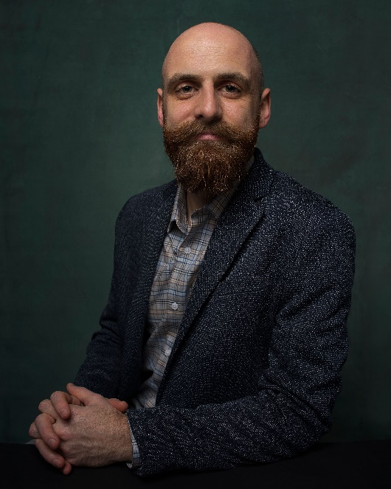
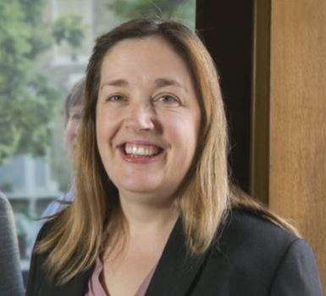

“Innovation happens when disciplines collide”
PPI Panel
Dr Angela McCullagh
Lorna Roche
Marcella O’Sullivan
Dr Lisa Graham-Wisener
Dr Tracey McConnell
Dr Katie Gillespie
Prof Audrey Roulston
Daniel Thomas
Dr Noah Potvin
Jenny Kirkwood
Dr Cara Ghiglieri

Slide 3
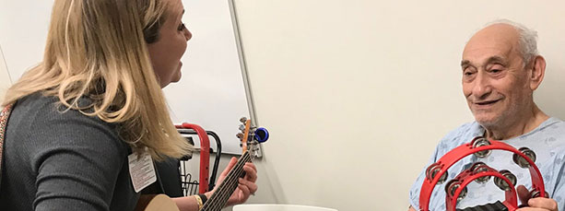
What is music therapy?
Music therapy is defined as the reflexive process of using music and sound by a professionally trained music therapist to cultivate therapeutic relationships and facilitate clinical interventions that promote optimal health, including physical, emotional, spiritual, and psychological wellbeing (Bruscia, 2014)

Slide 4
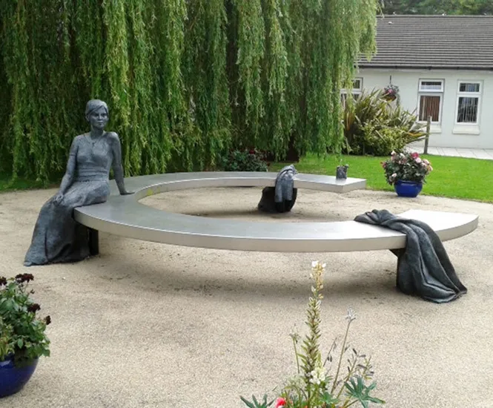
Music Therapy in Palliative & End-of-life Care
‘To be human is to be creative’
The creative impulse is fundamental to the experience of being human…
‘Acute medicine and art(s) walk hand in hand, day and night […]. The first saves lives, the second nudges our spirit, allowing us to know what it is to be human, to know ourselves, others.’
(Gilly Angell, UCL hospitals)
(All-Party Parliamentary Group on Arts, Health and Wellbeing Inquiry Report – “Creative Health: The Arts for Health and Wellbeing” published July 2017)

Slide 5


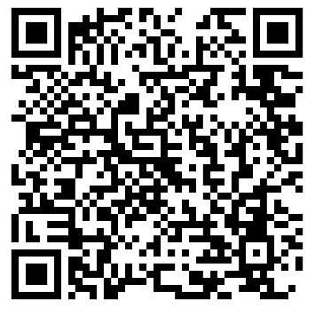
How do you eat an elephant? One bite at a time
Small grant funding- Music Therapy Charity, approx. £17k.
Funding used to employ a part-time research fellow.
Project focused on building capacity for high-quality research on the role of music therapy to support informal carers pre- and post-bereavement.
QR Code- scan for study webpage

Slide 6
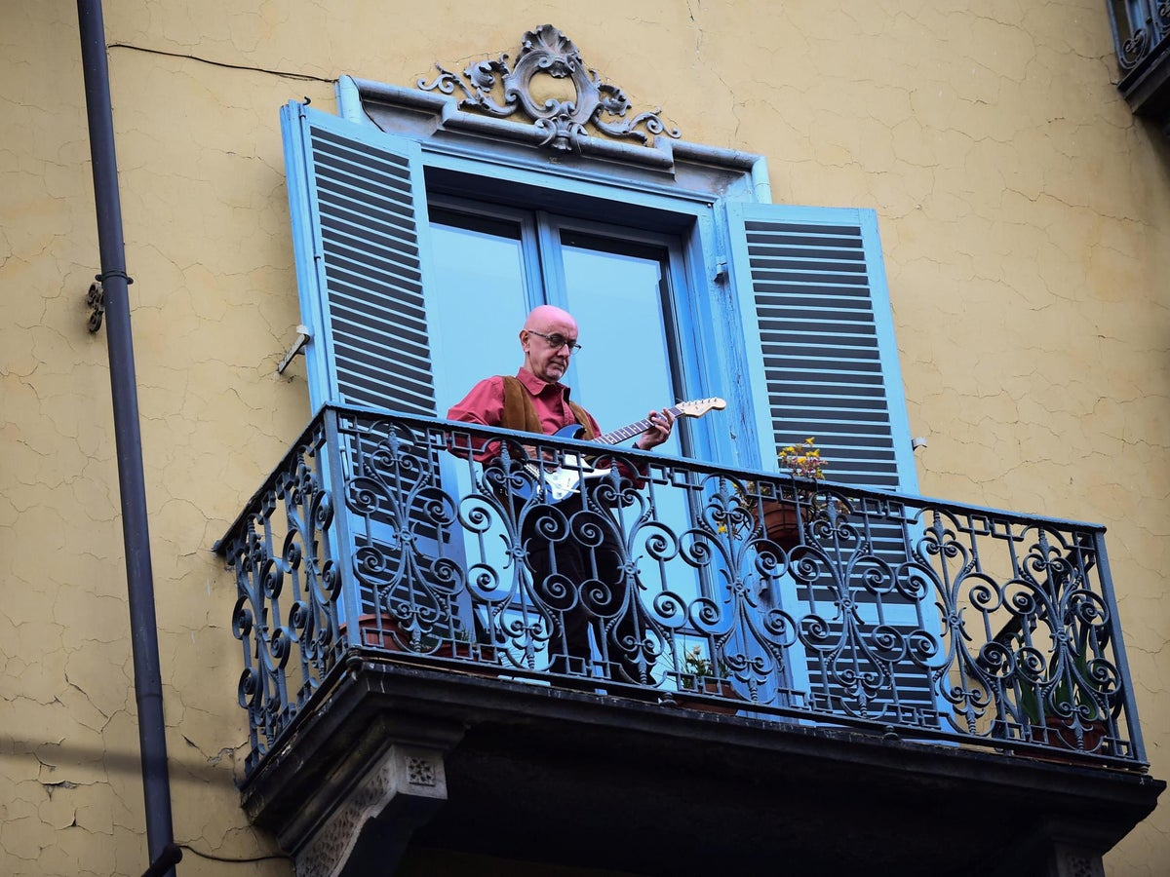

Music as universal Let me go, Gary Barlow Wake me up when September ends, Green Day The living years, Mike + The Mechanics Fire and rain, James Taylor

Slide 7
Music Therapy & Bereavement Support
International guidelines advocate for a public health approach to bereavement support. A core outcome set for evaluating bereavement interventions includes ability to cope with grief and quality of life and mental wellbeing as the key outcomes to measure (Harrop et al, 2020)
Existing bereavement support interventions in the research literature rarely map to risk and protective factors for complicated grief (Mason et al, 2020)
An opportunity for music therapy?

Slide 8

Phase 1: Identifying the existing evidence base
Aim: to synthesise and critically evaluate the international evidence associated with music therapy with adult informal carers pre- and post-bereavement
A JBI mixed-methods systematic review approach
Eligibility criteria: Studies including adult informal carers of adults at end of life or bereaved; music therapy interventions for improving health-related outcomes
Findings mapped to bereavement core outcome set (Harrop et al, 2020) and against predictors of complicated grief (Mason et al, 2020)

Slide 9




Systematic Review – Overview of Research
34 studies identified
Qualitative (n=17)
Mixed methods (n=7)
Quasi-experimental (n=8)
RCT (n=2)
Informal carers supporting individuals
with;
Dementia (n=21)
Advanced cancer (n=7)
Mixed life-limiting conditions (n=4)
Parkinson’s (n=1)
Mixed neurological conditions (n=1)
Target population
To patients & carers (n=23)
Carer only (n=6)
Primarily to the patient (n=5)
Intervention timing
Pre-bereavement (n=31)
Pre- and post-bereavement (n=2)
Post-bereavement only (n=1)

Slide 10

Quality of evidence
Qualitative studies: moderate – high quality
Quantitative studies: low – moderate quality
Key issues- lack of appropriate statistical analysis, underpowered, lack of standardised outcome measures, poor reporting of intervention
Unable to perform meta-analyses

Slide 11
Systematic Review - Qualitative Findings
Social connectedness and social support (Group)
Reduced loneliness
Sense of belonging, safe space to share feelings
Music as an emotional/communication channel and spiritual bridge
Safe channel to process grief
Spirituality – sense of meaning, finding peace
Positive mental wellbeing: sense of meaning and purpose in life
Caregiver tool
Anticipatory grief and pre-bereavement resilience
Positive reminiscence of pre-illness identities/relationships and finding balance
Deepening of relationships and communication
Reconnecting with positive memories

Slide 12

Phase 2: Setting the international research agenda
Systematic review- there is work to do. How do we advance the research area as a field?
International consensus exercise with 16 experts in from 7 different countries, 4 different continents
WHAT research should we prioritise?
HOW should we do it?

Slide 13

Moving forwards together
High-quality RCTs, with process evaluation
Include cost effectiveness data
Involve service users throughout
Use Bereavement core outcome set to guide choice of clinically important bereavement outcomes
Identify and use a relevant theoretical framework

Slide 14
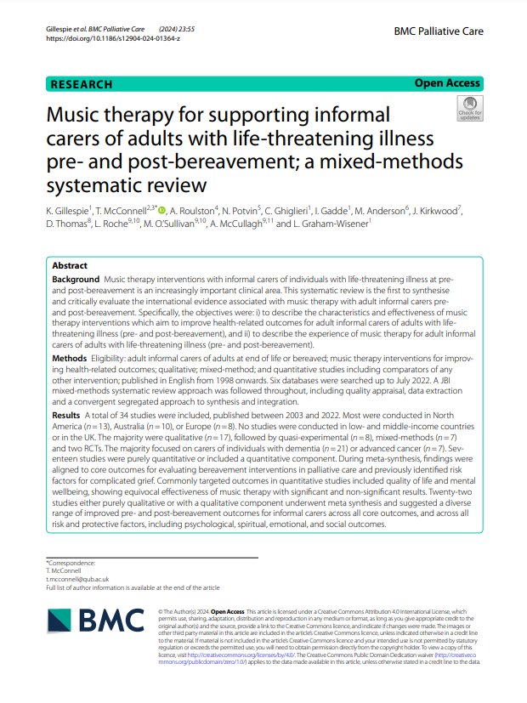
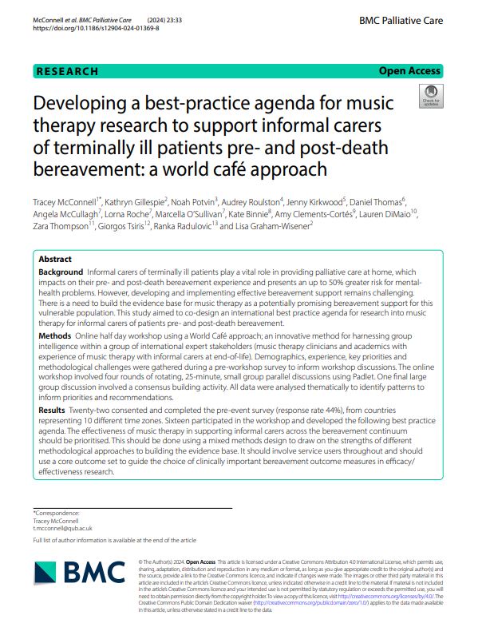
Published research

Slide 15
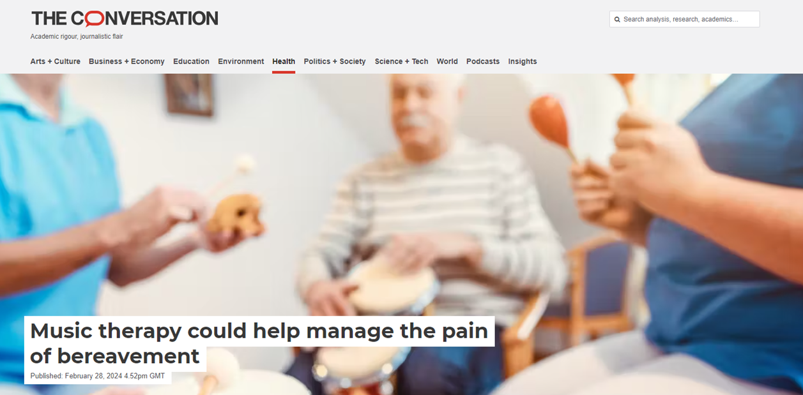
Watch this space!
Keep in touch
Email:
l.graham-wisener@qub.ac.uk
Twitter:
@lgrahamwisener

