Slide 1

SLEEP
Good sleep health is everyone’s business
Teresa Sweidan
11th September 2024

Slide 2
OVERALL AIM
To increase awareness of the importance of good sleep health with all staff working in the Western Trust area
Notes:
The aim of my project was to increase awareness of the importance of good sleep health with all staff working in the Western Trust area.
I appreciate that this is a very broad overall aim- but my wider vision was, that by doing this , there would be an increase in the awareness of good sleep health in the overall population that we work with.
So why did I want to do this?

Slide 3
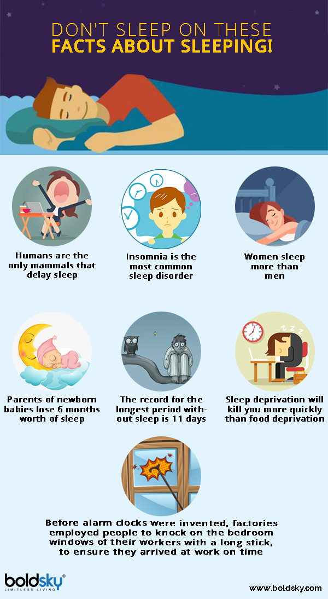
Facts about sleeping
Image by Boldsky
Notes:
First of all- In terms of the relevance to our world as AHPs, sleep forms part of the population health agenda and Population health as you know, is now a HCPC standard.
Issues relating to sleep, negatively impact on health and affect the service user and wider family circle.
You may not be able to read the small print but here are some interesting facts regarding the impact of poor sleep health
*Insomnia is the most common sleep disorder
*Sleep deprivation will kill you quicker than food deprivation .
*Women sleep more than men and the research has shown that women NEED to sleep more

Slide 4
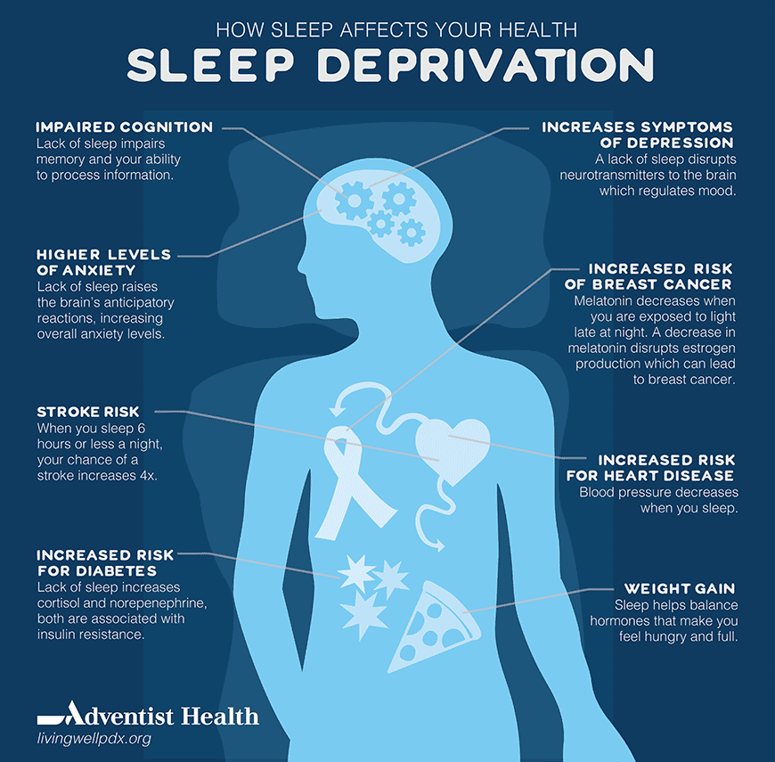
Sleep Deprivation
Image by Divya Toshniwal
Notes:
Bringing this topic closer to our world as AHPs- sleep deprivation affects health – For example- there are increased symptoms of depression, higher levels of anxiety and impaired cognition due to sleep deprivation. Note also, that when you sleep 6 hours or less a night, your chance of a stroke increases 4 times.
There are other links to heart disease (which Professor Freda Patterson highlighted earlier this year in a regional webinar ) . Sleep deprivation is also linked to breast cancer, obesity, risk of diabetes, fertility, the immune system, - basically it crosses all systems with a huge cost to the health service.

Slide 5
Key Drivers
An increasing reason for referral to services
Increase in waiting lists and complexity of those waiting
Little to no evidence of working upstream
No pathways and very few resources for sleep issues
Impact of poor sleep on-
Health and behaviour
Waiting lists
Families and carers
All ages, all services, including staff
Notes:
So just a bit of background as to how I started this project and the key drivers
Whilst working in the children’s directorate, I noticed that Sleep was an issue across all of the children’s services and often was a primary reason for referral – particularly referrals from GPs to community paediatricians, and they were often seeking only a prescription for sleeping medication. I also noticed that it was nearly always a secondary reason for referral to all other services.
The result was that waiting lists were getting clogged with referrals requesting sleeping medication but there was no evidence of working upstream and trying to work on good sleep health first, plus there were no defined pathways into services for referral of sleep issues and there were very few resources for referrers to give to service users.
In terms of the impact of poor sleep: For some service users, sleep issues escalate and this impacts on other areas such as their health or behaviour, which then deteriorates even further as it is not being addressed at the early intervention/prevention stage. This leads to a more complicated picture for those on the waiting lists and puts pressure on services which in the long term is not cost effective, not to mention the pressure and the impact on families, siblings and carers.
I also became aware that poor sleep health impacted on service users across the whole lifespan, across services in all of the directorates including the community and voluntary sector and of course , it also impacts on our staff.

Slide 6
Objectives
To determine baseline knowledge and awareness of sleep health within Trust staff
To establish working groups within the Trust
To develop Trustwide action plans for staff working with children and adults.
To develop a Trustwide Sleep framework
To develop resources
Notes:
So I established some core objectives.

Slide 7
Methodology
Engaged with stakeholders
Established two working groups
Co-designed and co-produced staff surveys with these groups
Notes:
What did I do? I engaged with stakeholders from various services and groups that I was involved in at that time.
I set up a working group for those working with children and later in my current role for those working with adults to begin the conversation of the impact of poor sleep health on our population.
So from this, two staff surveys, which were co-designed and co-produced by the working groups and service users, were carried out with staff, one in 2020 and one in 2023 to determine the baseline knowledge and awareness of the impact of poor sleep health and the results from those have shaped the work to date.

Slide 8
Survey Results
Survey responses were returned from all directorates, staff groups and all settings within the acute and community sectors.
Respondents worked across all age groups of service users
In the 2023 survey, 82% of respondents reported having no training on managing sleep issues despite almost 33% having an estimated caseload of 50% of service users with sleep issues.
Respondents identified an over prescription of sleeping medication, a need for further training, awareness raising, resources, a sleep framework and sleep champions.
Notes:
So , some broad survey results:

Slide 9
Areas impacted by poor sleep health
Notes:
Just to give you a little more detail from the results of the two surveys, staff trust wide identified the following categories as areas impacted by poor sleep health with their service users:

Slide 10
These impacts of poor sleep health collectively result in:
Poorer health outcomes and exacerbation of health problems
Lack of timely intervention
Family breakdown
Increased length of stay for patients in the acute and rehabilitation settings
A negative impact on staff performance
Undue reliance on medication
Increased costs for the health service, families, and the community
Notes:
Respondents also reported that:
they could see poorer health outcomes for their service users and an exacerbation of their health problems due to poor sleep health. Linked to this is lack of timely intervention as the service users are on waiting lists and/or are not receiving early intervention and preventative work.
Sadly, family breakdown was reported as an impact
Also, there is an increased length of stay for patients in acute and rehabilitation settings- with additional associated costs
Staff performance is negatively affected by poor sleep health- think of those working long shifts and those working a pattern of days and nights
There is also an over reliance on medication with the associated costs to the health service.
Cost implications can also include missed appointments, absence from work/ education, and the impact of sleep issues on other health conditions and the exacerbation of these conditions.
I am aware of 2 SAIs on one ward in the SWAH which were linked to prescription of sleeping medication following admission to the wards.
I recently had a questionnaire returned from a patient in AAH where she reported that she was offered sleeping medication and took it even though she didn’t indicate in the rest of the questionnaire that she had any difficulties falling asleep and there were no other factors such as noise preventing her from sleeping. So, there is a real need to consider the non pharmalogical options first.
In the most recent survey results, for the question- What does your department/service currently offer service users for sleep issues- the highest response was specific practical strategies and advice however this was closely followed by the response of ‘Medication’. There were over 400 children in the WHSCT on sleeping medication last year- I would like to think now that these children have had the ground work completed with early intervention and preventative work..

Slide 11
Actions
Sleep Framework
Action Plans
Training
Resources
Funding
Collaborative work
Notes:
*A draft Trust Sleep Framework has been developed, was consulted on by Trust staff and service users and will be presented at CMT early October for approval.
Basically this framework advocates early intervention and preventative work first- working upstream and considering the non-pharmalogical options first . It promotes a tiered approach for intervention – from levels 0 to level 5 – and I will explain this a bit more in the next slide.
Following the surveys, the two working groups ( one for adults and one for children) developed Trustwide action plans which include key action areas around information, awareness raising, support, governance and accountability.
Training was provided via funding from the PHA, to specific staff groups working with service users.
Resources for staff and service users have been developed- e.g. a Poster, Leaflet, infographic, Sharepoint site and a Trust internet page with resources, links to articles and so on. Voice over PP presentations are also available . And a Sleep pagetiger is currently being developed for staff and service users.
Flow charts have also been developed within and between services, leading to improved communication between services – particularly for those working with children.
Just to advise you that all of this was completed with no funding for specific posts but there was innovation in terms of reconfiguration of monies to develop a new band 7 nursing post to work jointly with community paediatricians and address Sleep and other complex issues . Incidentally, this post-holder has advised that there is a reduction in the use of melatonin regionally in the past year, with the WHSCT having the largest decrease- although difficult to prove, I would like to attribute this to the ongoing work on sleep in children’s services since 2020
There have been good examples of Collaborative working- e.g. the GP federation SW teams who received sleep training, are now developing group work to target sleep in the community as part of their tiered approach to addressing sleep issues. (These GP fed SWs are well placed to address sleep issues in the community)
Some of you may have attended the regional webinar jointly organised with the PHA, earlier this year with Professor Patterson , a sleep researcher, originally from Fermanagh and based in the University of Delaware, who spoke in great detail on the impact of poor sleep health and is a great supporter of the work being carried out in sleep.
In terms of sleep champions- there are people emerging from various teams who have a particular interest in the sleep work and are informal champions in their areas- applying the tiered approach and working collaboratively with other services

Slide 12
Tiered Sleep Framework Model
Highly
Specialised
Sleep
Clinic
MDT Specialised Sleep Clinics
Staff Awareness
More Complex Issues e.g. Medical/Psychiatric Issues
Targeted
Universal
5
4
3
2
1
0
Notes:
So, the sleep framework lays out the purpose, vision, impact, the proposal to work in a tiered approach as shown, to address these issues- as I said, focussing on the early intervention and preventative stages, the levels 0, 1 and 2 in particular initially, always considering the non- pharmalogical options first.
Level 0 : Staff awareness: All staff in our organisation will be aware of the importance of good sleep health not just for themselves but for their service users.
Level 1- Universal level: Staff interacting with service users, their families/carers will be equipped with the basic awareness of good sleep health and be able to provide universal information and signpost accordingly.
Level 2-Targeted This is where level 1 hasn’t worked- So staff will be able to assess and provide more targeted and bespoke interventions to service users and their families/carers. This could include some bespoke group work, or e.g. 6 week programmes, which currently happen in community
Level 3- is for More complex issues needing assessed by medics/psychiatrists/psychologists . This is currently happening between CAMHS and community paediatrics but they would like to develop this further with funding.
Level 4- For those with more complex issues – they are seen in MDT specialised sleep clinics– so in paediatrics there is the nurse specialist , I mentioned previously, and a community paediatrician who run weekly clinics. In the adult world there is a sleep investigation pathway for sleep studies, diagnosis of sleep apnoea and CPAP therapy but unfortunately there are very lengthy waiting lists for these adult patients.
Level 5 are the highly specialised sleep clinics such as specialist regional and national sleep clinics, but the levels we need to work on most and concentrate on initially are the lower tiers. 0, 1 and 2, to prevent more patients from reaching the higher tiers

Slide 13

Next steps
Launch
Disseminate
Re-evaluate outcomes
Working groups
Notes:
So, the next steps are :
To Launch the framework following approval at CMT and embed recommendations
The plan is to launch this at a service user sleep event on 10th October in the local leisure centre
To Disseminate the work to date, the resources etc. one area I am exploring this with is junior doctors and nurse prescribers- to discourage prescription of sleeping medication as the first option
To Re-evaluate outcomes- for example, I am currently scoping the use and effectiveness of sleep training received , the benefits and the need for a refresher training and development of peer support groups for those staff who have received the training.
I would like to analyse results of pilot service user surveys from wards and to establish a working group focusing on the use of sleeping medication with the aim of reducing it’s use and costs
I will continue promoting the work of the Sleep working groups and resources at various forums and develop links with the universities/and encourage research into this field

Slide 14
Conclusion
It is important to have the support of senior management from the outset to help drive this further.
AHPs are key drivers due to cross sectoral working
Notes:
This trust wide project required huge drive and motivation to keep it going over the past four years and was achieved without any additional funding –other than the training, which was mainly procured by health improvement from the PHA.
So in conclusion: Staff increasingly recognise the impact of poor sleep health on our service users and are enthusiastic and want to provide support at varying levels, no matter their role within the Trust but it is important to have the support of senior management from the outset to help drive this further.
I have presented the findings and developments to a number of directorates and I am hoping today, that by sharing this information with you, I will encourage you to bring this back to your area of work and use a similar model of approach to address poor sleep health as you
AHPs are key drivers to achieve this, due to their cross sectoral working
I would really like you to encourage good sleep health , particularly with your AHP colleagues who are perfectly placed to drive this forward, all working together to achieve best outcomes for the population impacted by poor sleep health.

Slide 15
For more information:
teresa.sweidan@westerntrust.hscni.net
Notes:
If anyone would like to contact me for more information…

Slide 16

Thank you closing slide

