Slide 1



Expansion of Acute Care at Home
A Quality Improvement Project
Notes:
Background to the team and history; 2014, growth in location, staff and range of patients
Faced with a growing older population and increase in hospital admissions (Department of Health 2017), healthcare providers in Northern Ireland are struggling to cope with the increasing demands on an already overstretched system (Bengoa et al. 2016).

Slide 2
Strategic and Operational drivers
Stabilisation of Local Acute Hospital and support ED and flow from hospital
Bed Pressures within the SHSCT Acute Hospitals
Pressures within Primary Care
Medical staff shortages,
Growing waiting lists, demand for services and increased numbers of patients with complex needs.
Notes:
Health and social care facing ongoing challenges both locally and regionally

Slide 3

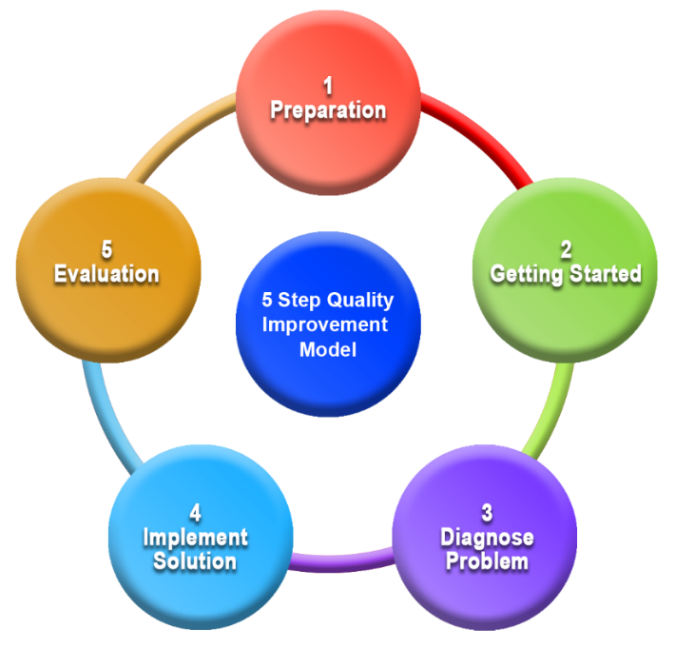
Aim
‘To increase active patients daily in Acute Care at Home by 50% by Oct 2023. And 100% by April 2024’
Notes:
QI project included identifying drivers, process mapping, problem diagnoses and PDSA cycles

Slide 4
How was the project carried out ?
Robust data collection to further exploit growth of the active caseload
Gate keeping triage function to negate access to a range of medical inpatient beds in Daisyhill
Making use of virtual monitoring
Increased POCT diagnostics
In-reach case finding by the team into the hospital
Service user focus groups to influence change
Notes:
As the Physiotherapist and Occupational Therapist on the team we were involved in all aspects of the project but in particular focused on service user involvement and collaboration with acute and primary care teams, aimed at ensuring safety and clinical excellence. This was achieved through governance procedures including mandatory training, appraisal, supervision, incident reporting and robust induction programmes.
In order to grow the referrals coming to ACAHT from the acute sector we held awareness with acute colleagues and opened up a referral pathway for senior ED AHPS.

Slide 5


Outcomes and results
Since 2022/23, Referrals received in 2023/24 have increased by 28% and referrals accepted have increased by 40% during embedment of project and continue to rise.
Inappropriate referrals from hospital were reduced by 25%.
The service and project demonstrated value for money by bed days saved. However most importantly we were able to treat these acutely unwell older people at home.
Service user focus groups produced overwhelming positive feedback about the service, with all participants rating the service highly and patients and carers stated they would use the service again in the event of a further acute episode of ill health.
.
Notes:
This project demonstrates how in existing financial pressures, a review of current resources and processes within the wider organisation can be reconfigured into a HAH service to aide expansion.
This team and project just wouldn’t work without the full team. The AHPs on the team are pushing boundaries of care within the community setting, delivering high levels of care that weren’t possible before. This has been managed through having a highly skilled and dynamic workforce who are open to new skills and blurring of roles. Physiotherapy and Occupational Therapy have been involved from the start, challenging previous ways of working in the community.
OT and physio led on changes from focus groups regarding improving the d/c process

Slide 6
Ongoing work
Collaboration was paramount throughout the project to maximize the effectiveness of the change. This included work with stakeholders, GP’s, Northern Ireland Ambulance Service and nursing homes.
From 2022/23 to 2023/24 there was a 173% increase in care home direct referrals
From 2022/23 to 2023/24 there was a 114% increase in NIAS referrals.
Our project promoted a positive learning culture throughout and ensured a sustainable improvement change whilst keeping the patient at the heart.
Ongoing engagement with NIAS and Care homes to promote triage of all over 65 care home residents through ACAHT prior to presenting at ED
Notes:
July 2024, NIAS must discuss all care home patients with AC@H Triage Dr prior to taking to ED.
September 2024, NIAS must discuss all domicillary patients with AC@H Triage Dr prior to taking to ED.

