Slide 1

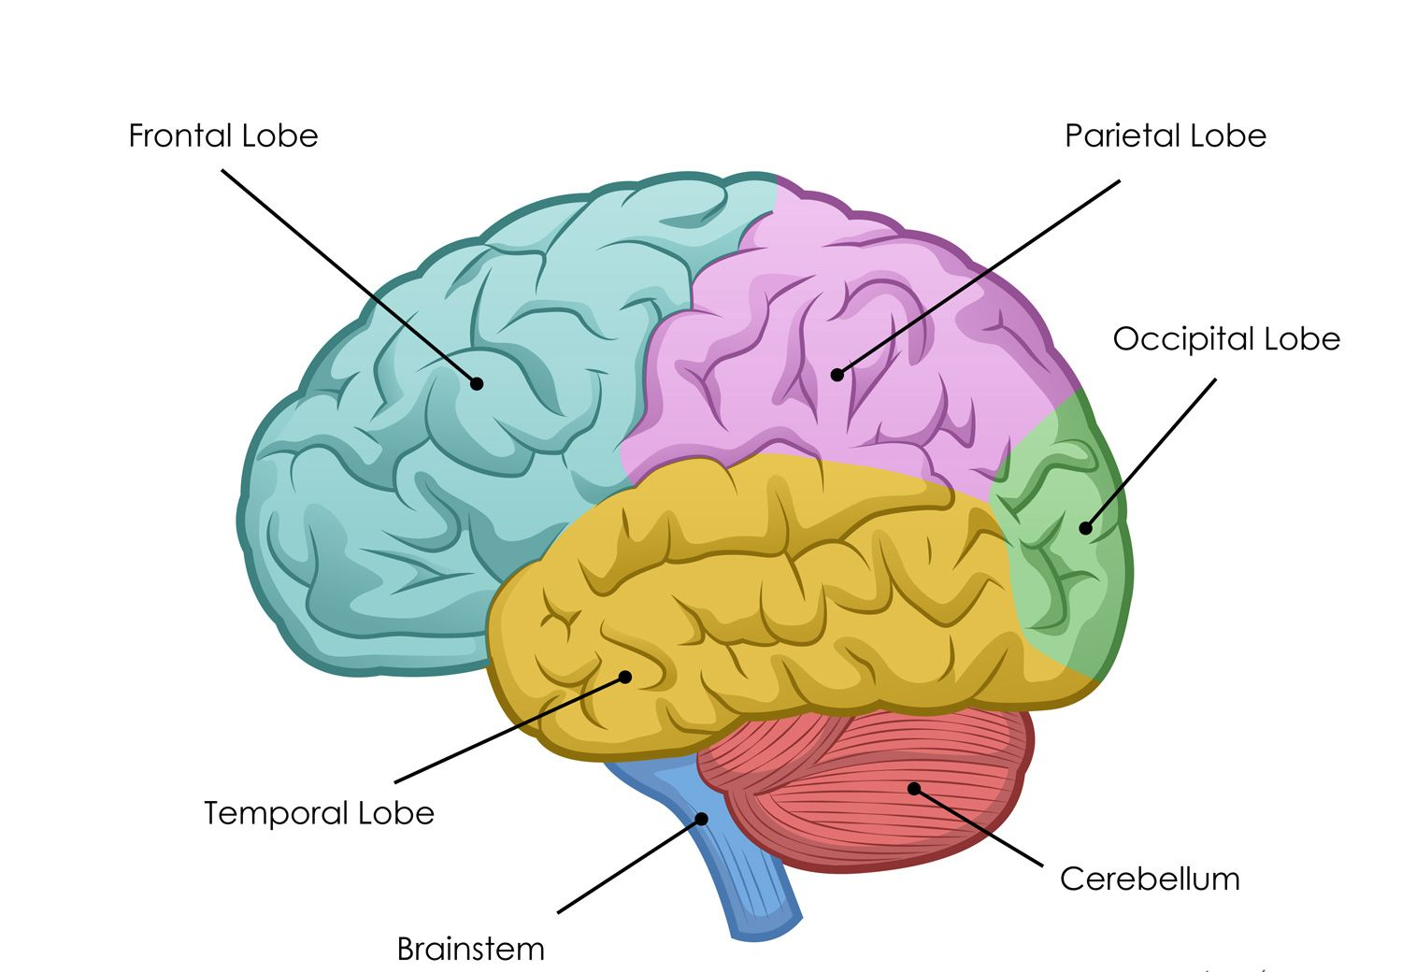
AHP RESEARCH & INNOVATION 2024
Evaluating the Impact of Physiotherapy on Improvements in Health for Patients with Primary Brain Tumours during Radiotherapy
Finlay, P.
paula.finlay@belfasttrust.hscni.net
Physiotherapy Department,
Cancer Centre,
Belfast Health and Social Care Trust

Slide 2
Purpose
AHP RESEARCH & INNOVATION 2024
Primary brain tumours account for 3% of tumours (UK)
Profound Disability
Poor prognosis
Death
Need for timely neuro-rehabilitation and palliative care
Gaps in service: on NI AHP peer review (2015) and in NI Cancer Strategy (2022)
Benefits of exercise identified in cancer care
ECOG performance status used in decision making
Physiotherapy Service set up in 2016 to provide physiotherapy to all patients with primary brain tumours attending radiotherapy (XRT)

Slide 3
Aims
AHP RESEARCH & INNOVATION 2024
Methods
Demographic data gathered
Initial neurological assessment with provision of information and exercises
Physiotherapy treatment sessions as indicated
Post treatment assessment and use of outcome measures: Modified Rivermead Mobility Index (MRMI); Berg balance and fatigue scores
Onward referrals as needed
Patient satisfaction via questionnaire
Data collection and analysis using MS Excel
Determine the effectiveness of physiotherapy using outcome measures
Evaluate physiotherapy service delivery
Assess patient satisfaction

Slide 4
Results
AHP RESEARCH & INNOVATION 2024
Results
1 Year Audit
Physiotherapy Referrals
Combined nurse specialist and XRT referral | 70.1%
Seen promptly by physiotherapy pre-XRT or within 1-week of start date of XRT | 91.4%
Direct contacts | 562
Physiotherapy Intervention
Active physiotherapy rehabilitation and education | 65.4%
Screening assessment and education | 33.1%
Physiotherapy contact details | 100%
Exercise program | 82.7%
Onward referrals | 64.6%
Demographics
127 patients
51-70 years: 44.1%
High grade primary tumours: 73.2%
- Glioblastoma Multiforme: 38.6%
- Frontal lobe 24.4%

Slide 5
Results
AHP RESEARCH & INNOVATION 2024
Results: Physiotherapy Outcome Measures
MRMI | Improved | 16.4%
 | No worse | 77.6%
Berg Balance | Improved | 46.4%
 | No worse | 50.1%
Fatigue Score | Improved | 43.1%
 | No worse | 36.2%
 | Worse | 20.7%
Patient Satisfaction | ‘Strongly Agreed’ physiotherapy was helpful | 96%
 | Rated physiotherapy as ‘Excellent’ ‘Good’ | 88% 12%

Slide 6

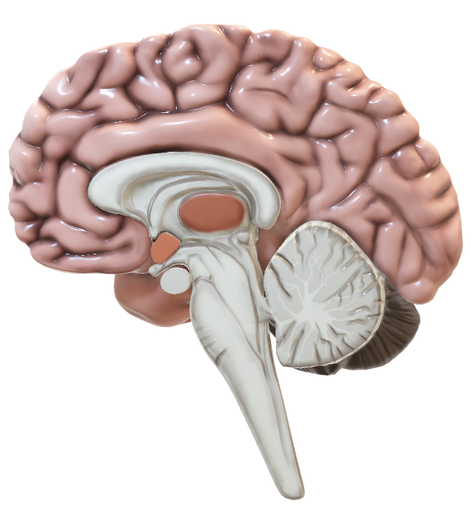
Conclusion & Recommendations
AHP RESEARCH & INNOVATION 2024
Improved multidisciplinary referral pathways have ensured timely access to physiotherapy for patients with brain tumours attending radiotherapy.
Physiotherapy intervention can maintain/improve mobility and balance and reduce fatigue, thereby improving QOL and fitness for ongoing treatments.
Gaps still exist in service provision from diagnosis to palliation with limited physiotherapy community services. This service could be extended across the patient’s cancer journey and to other cancer centres.
References

