Slide 1


EMBRACING A POPULATION HEALTH APPROACH BY MAXIMISING EARLY BREAST CANCER DETECTION: ​
​
THE IMPORTANCE OF MAMMOGRAPHERS' PROFICIENCY IN PERFORMING THE EKLUND TECHNIQUE​
KATE GREENE
MAMMOGRAPHER
BELFAST HEALTH AND SOCIAL CARE TRUST
Notes:
I recognised the need for standardised training on performing the eklund technique due to staff feedback within departments that I have worked in and from my own personal initial difficulties with this technique
I noticed both recently qualified staff and senior staff struggled with obtaining these images
As a result of this I decided to research mammographers perceptions on current training techniques and how confident they feel when performing a mammogram on service users with breast implants

Slide 2
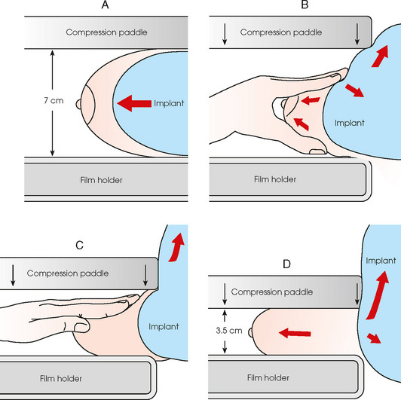
WHAT IS THE EKLUND TECHNIQUE?
  The Eklund technique is used to visualise breast tissue when implants are in situ
(Public Health England, 2017)
  Mammographers use this technique to achieve optimal compression of the breast tissue while also ensuring that the implant does not obstruct the tissue
Notes:
2.Breast tissue in clients who have had augmentation is obscured by the implant during routine mammography.
3.Detection of breast cancer at an early stage is therefore more difficult due to the impaired view of the breast tissue
5. In these images the implant is pushed back against the chest wall and the breast tissue is pulled forward so that all the breast tissue can be seen in the mammogram.
6.The success of this
technique relies heavily on the skill and expertise of the performing mammographer.
7. Achieving optimal compression for visualizing breast tissue guarantees a high standard of image quality, enabling the detection of lesions as small as 1mm.

Slide 3
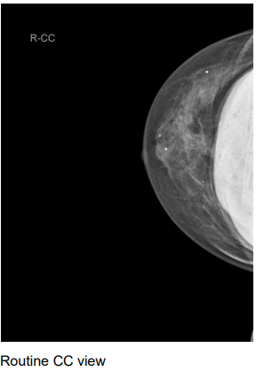
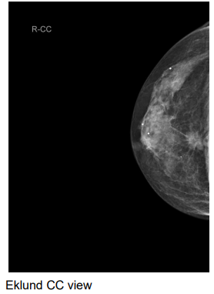
Study objectives
STUDY
OBJECTIVES
  To assess mammographers' perspective on current training methods
  To identify areas for development in executing the Eklund technique
Images of a client with breast augmentation where a lesion is clearly demonstrated on the Right CC view only using Eklund technique (Public Health England, 2017)
Notes:
Given the complexities of performing Eklund projections, mammographers require a high standard of training. If this technique is not executed correctly, it could increase the risk of implant rupture and result in incomplete visualization of the available breast tissue.
Current training methods to perform Eklund projections often rely on conventional approaches and can vary across departments.
This can potentially hinder mammographer performance and therefore reduce overall image quality
Therefore..This study aims to
read from slide..
You can see from the following images just how important the eklund view is. when the implant is pushed back optimum compression is obtained and therefore optimum breast cancer detection

Slide 4

METHODS
  A quantitative approach
  Digital questionnaire-9 close ended questions
  31 NI Radiographers qualified in mammography were recruited
  Confidentiality of participants was always ensured
Notes:
1. A quantitative study consisting of a structured survey with 9 close ended questions was conducted
2. The survey was circulated across breast units in Northern Ireland. Digital and hard
copy versions were made available
Had to be qualified with a pgcert in mammography

Slide 5
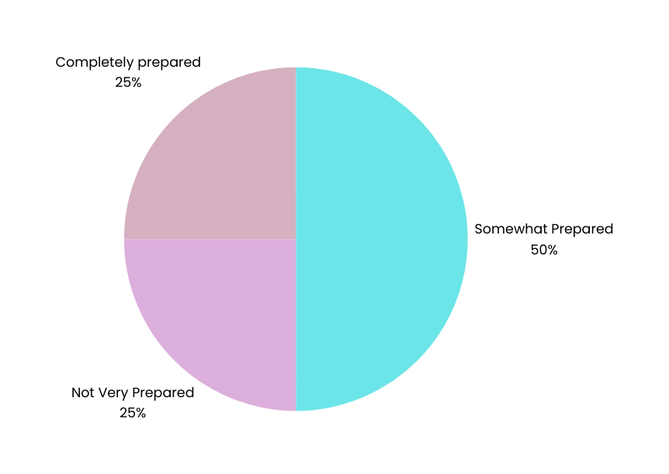
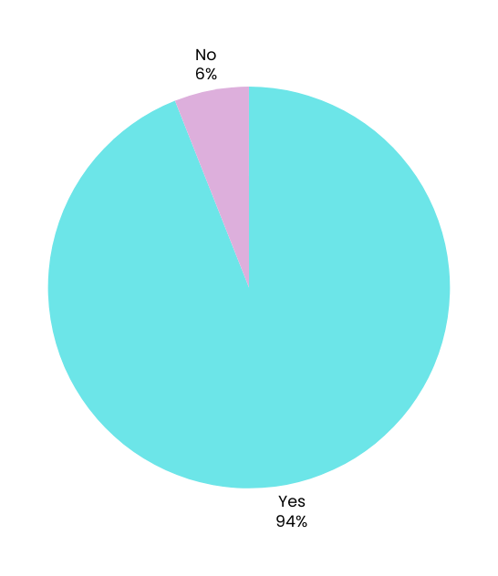
Results
RESULTS
  Only 25% of participants felt completely prepared for clinical practice
  81% of participants still experienced challenges in applying the technique
  94% of mammographers stated that they would prefer more hands-on training opportunities
Notes:
29 out of 31 participants demonstrated that they would prefer increased hands-on practice during training and would consider the use of a simulation tool to support their learning.
When asked if they likely to recommend improvements or changes to the current training methods for mammographers 80% said yes

Slide 6

CONCLUSION
FUTURE WORK
  To ensure equality amongst service users with breast implants imaging performance must be consistent
  This study highlights the need for more comprehensive and up-to-date training programs
  Simulation techniques and innovative devices could support this development
Notes:
This research highlights that training to undertake Eklund projections needs to be further
developed.
Simulation techniques and innovative devices could support this training and
should be considered.
Through the implementation of such training this would allow mammographers to
optimise their performance and facilitate the early detection of breast cancer.
We can determine that these findings may have implications for future healthcare policies,
funding for training programs and implementation of quality assurance measures in future breast
cancer screening initiatives

