Slide 1
Cuddle Pocket Implementation
Hannah Morgan
And
Colleen McQuillan

Slide 2
CONTENT WARNING
This presentation discusses miscarriage and baby loss.

Slide 3
What are Cuddle Pockets?
Cuddle pockets are a single use, knitted square with a cotton lining
Parents are encouraged to hold their baby on the journey to hospital
Charities ‘Cuddles UK’ or ‘Blue Light Babies’
Used for babies under 24 weeks gestation
Allow for pregnancy remains to be transported to hospital with dignity and sensitivity

Slide 4
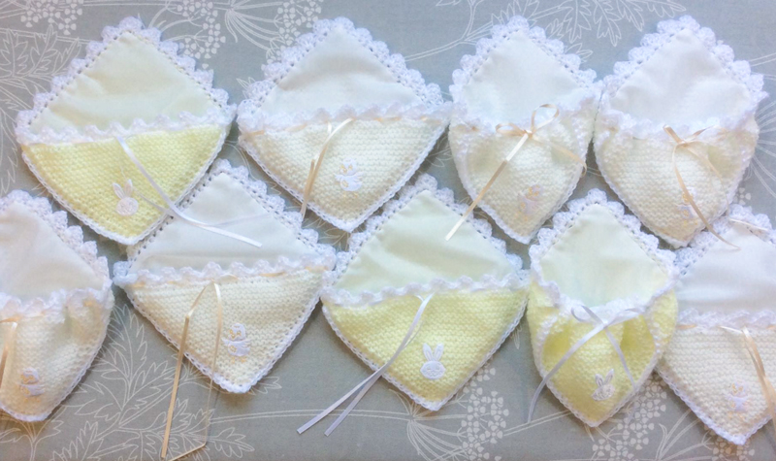
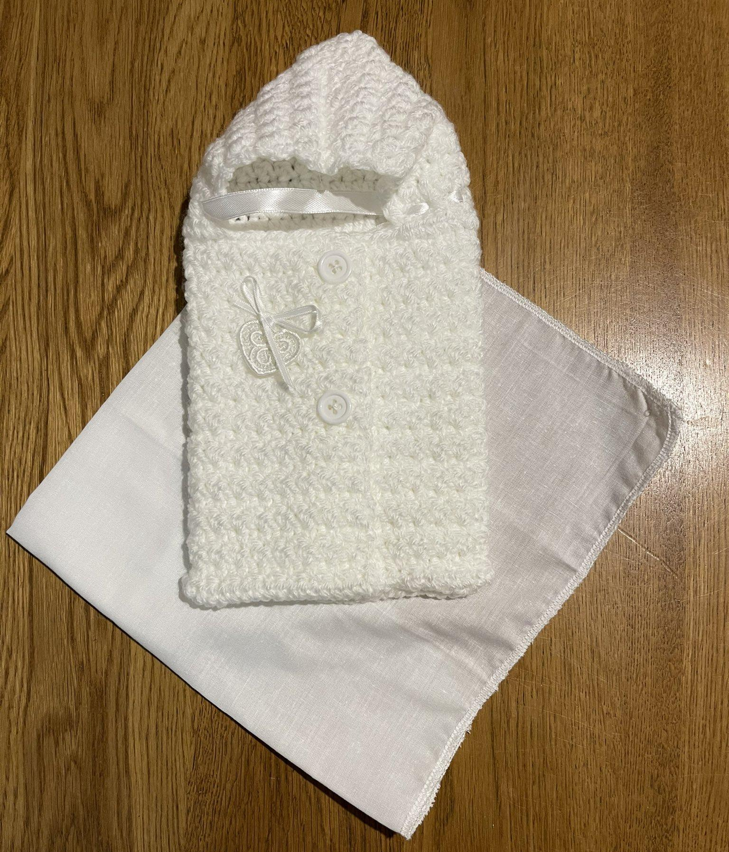
What are Cuddle Pockets?
(Cuddles UK)
(Blue Light Babies)

Slide 5
Background
The Northern Ireland Ambulance Service (NIAS) attends:
100-110 emergency calls relating to miscarriage and/or pregnancy loss per year (<24 weeks gestation).
40 emergency calls relating to preterm births per year
The British Association of Perinatal Medicine (2022) encourage the use of Cuddle Pockets, where appropriate, for parents to hold and comfort their baby with dignity

Slide 6
Background
Pregnancy Loss Review (2023)
Lack of standardised, gestation appropriate receptacle to collect and transport babies or baby loss / pregnancy remains
Unacceptable to use bedpans, kidney dishes or sanitary towels to lay babies or pregnancy remains onto
Pregnancy / Baby remains should never be considered clinical waste and should be handled with dignity

Slide 7
Aim / Methods
Staff were asked to complete an online survey accessed via QR code
Aim to seek the view of NIAS staff on the inclusion of cuddle pockets in paediatric response bags
Anonymous and voluntary
Microsoft Forms used as survey host
GDPR compliant

Slide 8
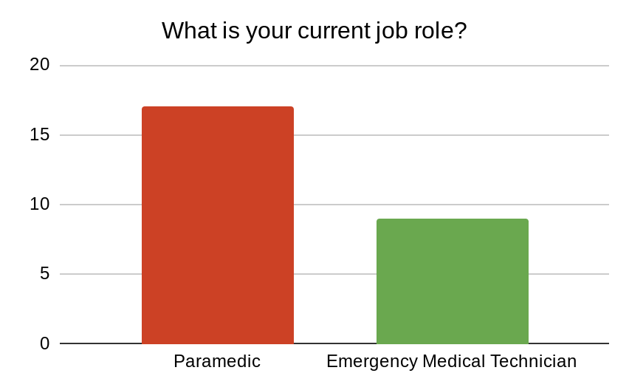
Results : Quantitative
Average completion time of 14 Minutes and 45 seconds
Total of 27 staff completed the survey

Slide 9
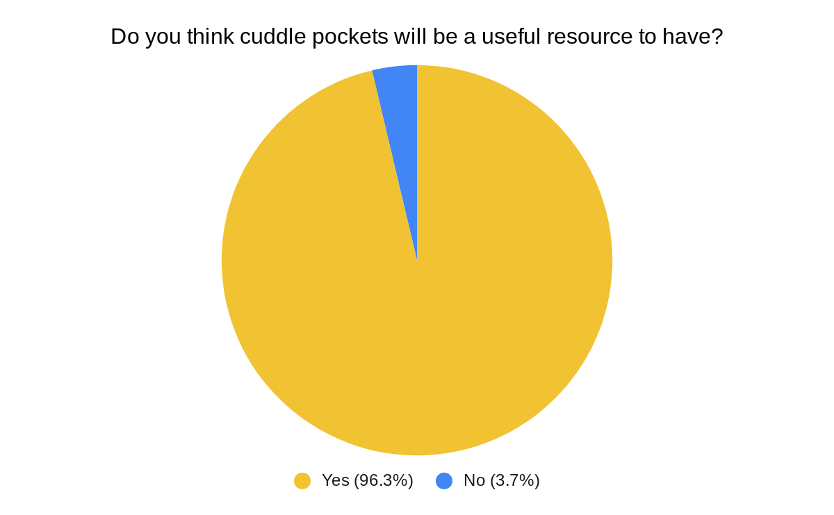
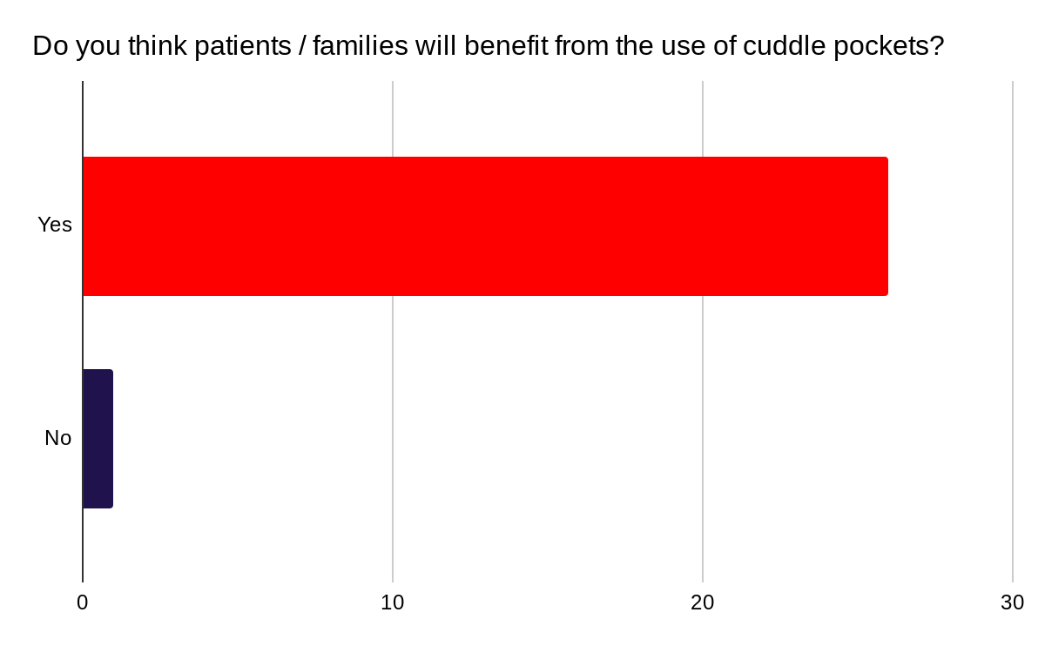
Results: Quantitative

Slide 10
Results: Qualitative
“In what ways, if any, do you think cuddle pockets could be useful to your practice?”
“I believe that they will show families that we, as a crew, acknowledge that there was life and we recognise that this family have suffered a huge loss. It brings trust and vulnerability into the picture”
“Improving quality of care, meeting the standards set by the tissues act and wider research to improve prehospital early pregnancy care”.
“Would reflect a more professional and prepared service”.

Slide 11
Results: Qualitative
“In what way, if any, do you think the use of cuddle pockets would benefit patients / families?”
“A practical and dignified way for them to hold and be with their baby”
“Recognition of their loss in a more compassionate and caring way”
“This is more dignified, thoughtful and caring, perhaps helping the family to better manage this terrible loss and leaving them with a slightly less traumatic memory”

Slide 12
Conclusion
‘Cuddle pockets’ were received positively by frontline staff
This data was presented to NIAS Senior Management Team who were keen to support this initiative
Cuddle pockets will shortly be implemented across the NIAS fleet
Thanks to Cuddles UK and Blue Light Babies who supply these free of charge for the benefit of patient care

