Slide 1


Community First Responder Involvement in
Out of Hospital Cardiac Arrest in Northern Ireland
Julia Wolfe
Research and Development Manager

Slide 2
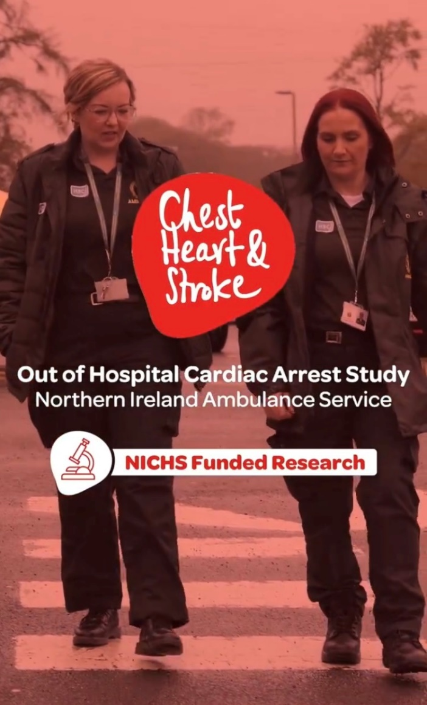


Out of Hospital Cardiac Arrest (OHCA) study
5-year retrospective review of OHCA in NI
Jan 2018 and Dec 2022
Funded by Northern Ireland Chest Heart and Stroke
In collaboration with Queen’s University Belfast

Slide 3
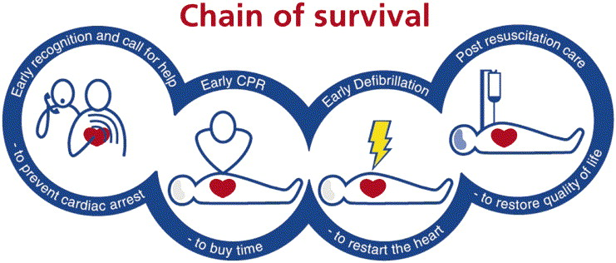
Out of Hospital Cardiac Arrest (OHCA)
A person’s heart suddenly stops beating, leading to a collapse, outside a hospital setting
If it is not treated within the first few minutes, the person will die
The Chain of Survival highlights the lifesaving steps that need to happen

Slide 4
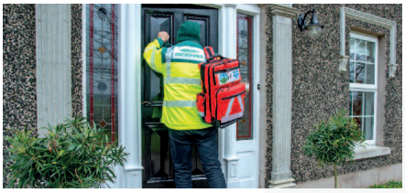
Community First Responders (CFRs)
Volunteers trained by NIAS
Based within their own communities, they often arrive on scene prior to an emergency ambulance
Immediate lifesaving measures
400 CFR volunteers across 22 schemes
Complement the response of NIAS

Slide 5
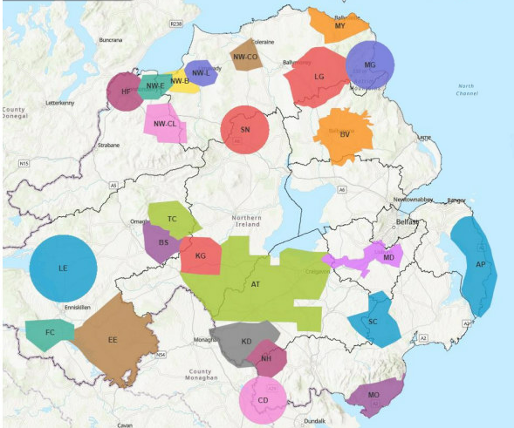
Aim
To explore CFR records to measure the impact they have on the chain of survival in NI

Slide 6
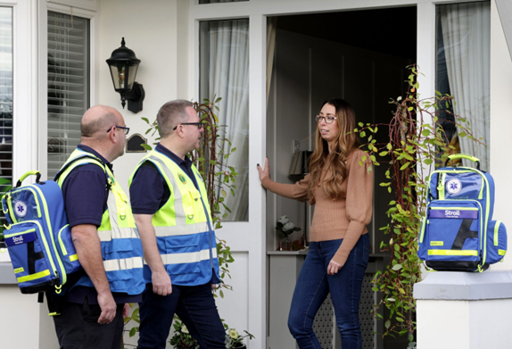
Methods
Retrospective review of OHCA CFR records
January 2018 and March 2023
Data was manually extracted
Descriptive statistical analysis
The corresponding records of the NIAS crews in attendance were also examined to extract Return of Spontaneous Circulation (ROSC) data

Slide 7
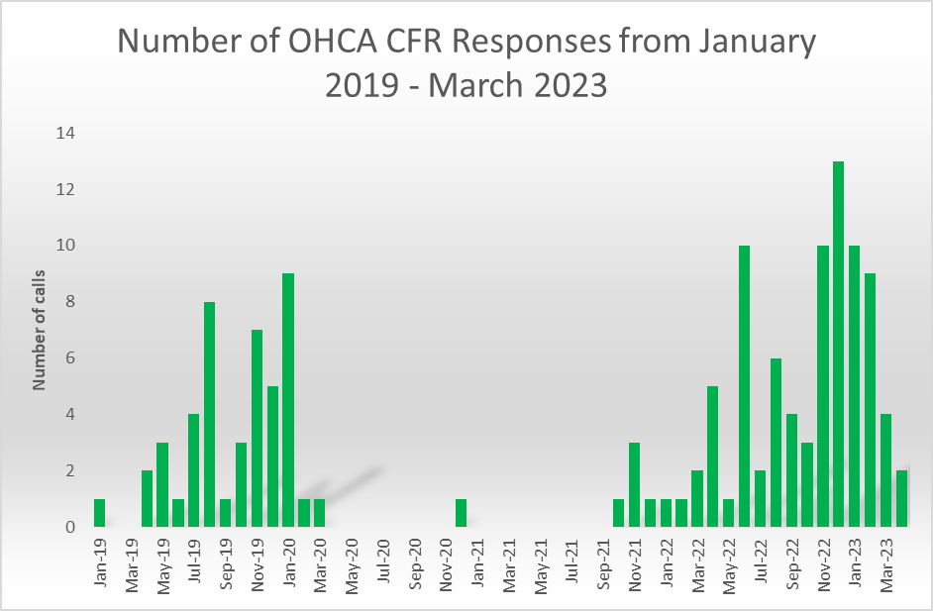
Results
Between January 2018 and March 2023, 135 records were completed by CFRs for OHCA calls they attended.
Schemes stood down due to the Covid-19 pandemic.

Slide 8
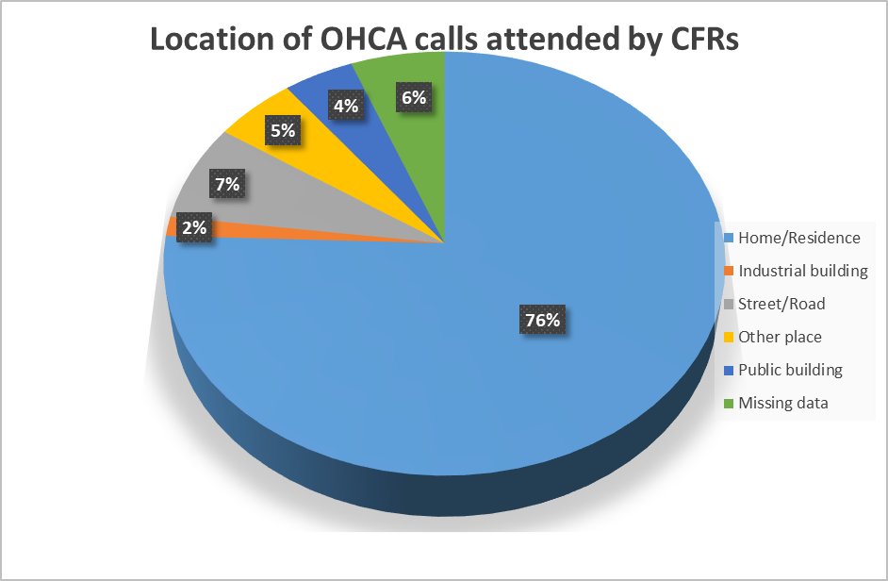
Results
Majority of OHCAs took place at home or in a place of residence (76%)

Slide 9
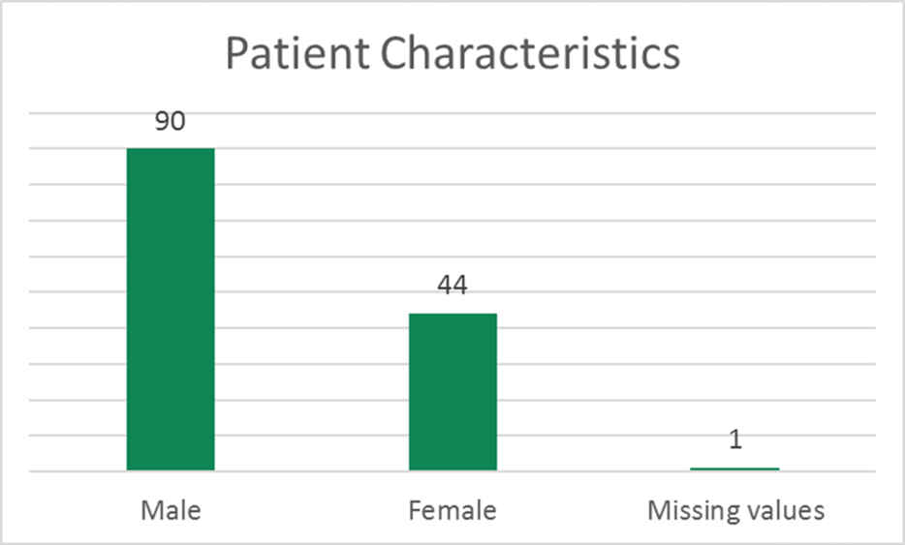
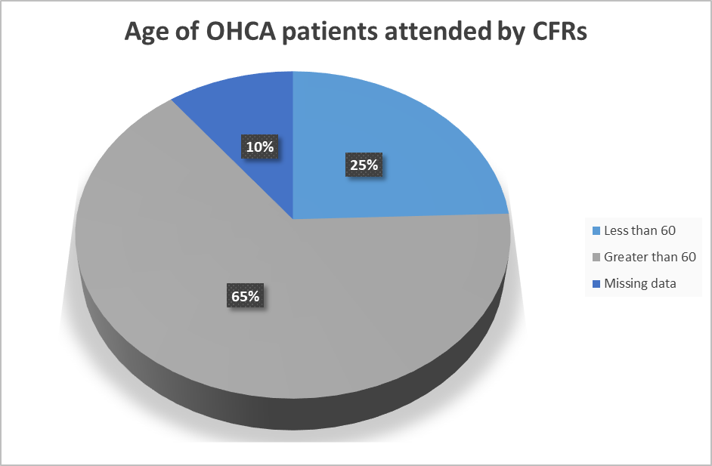
Results
Almost two thirds of the OHCA patients were male (n=90)
65% above than 60 years old

Slide 10
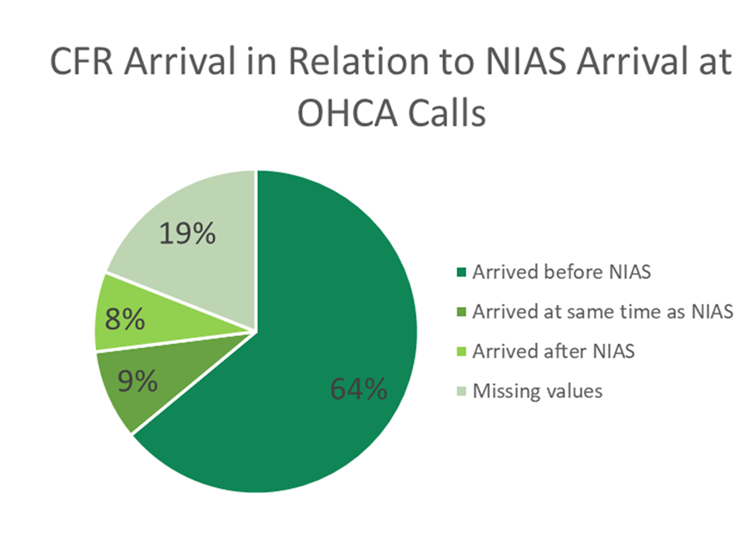
Results
In 64% of the cases (n=86), CFRs arrived on scene before a NIAS response.

Slide 11
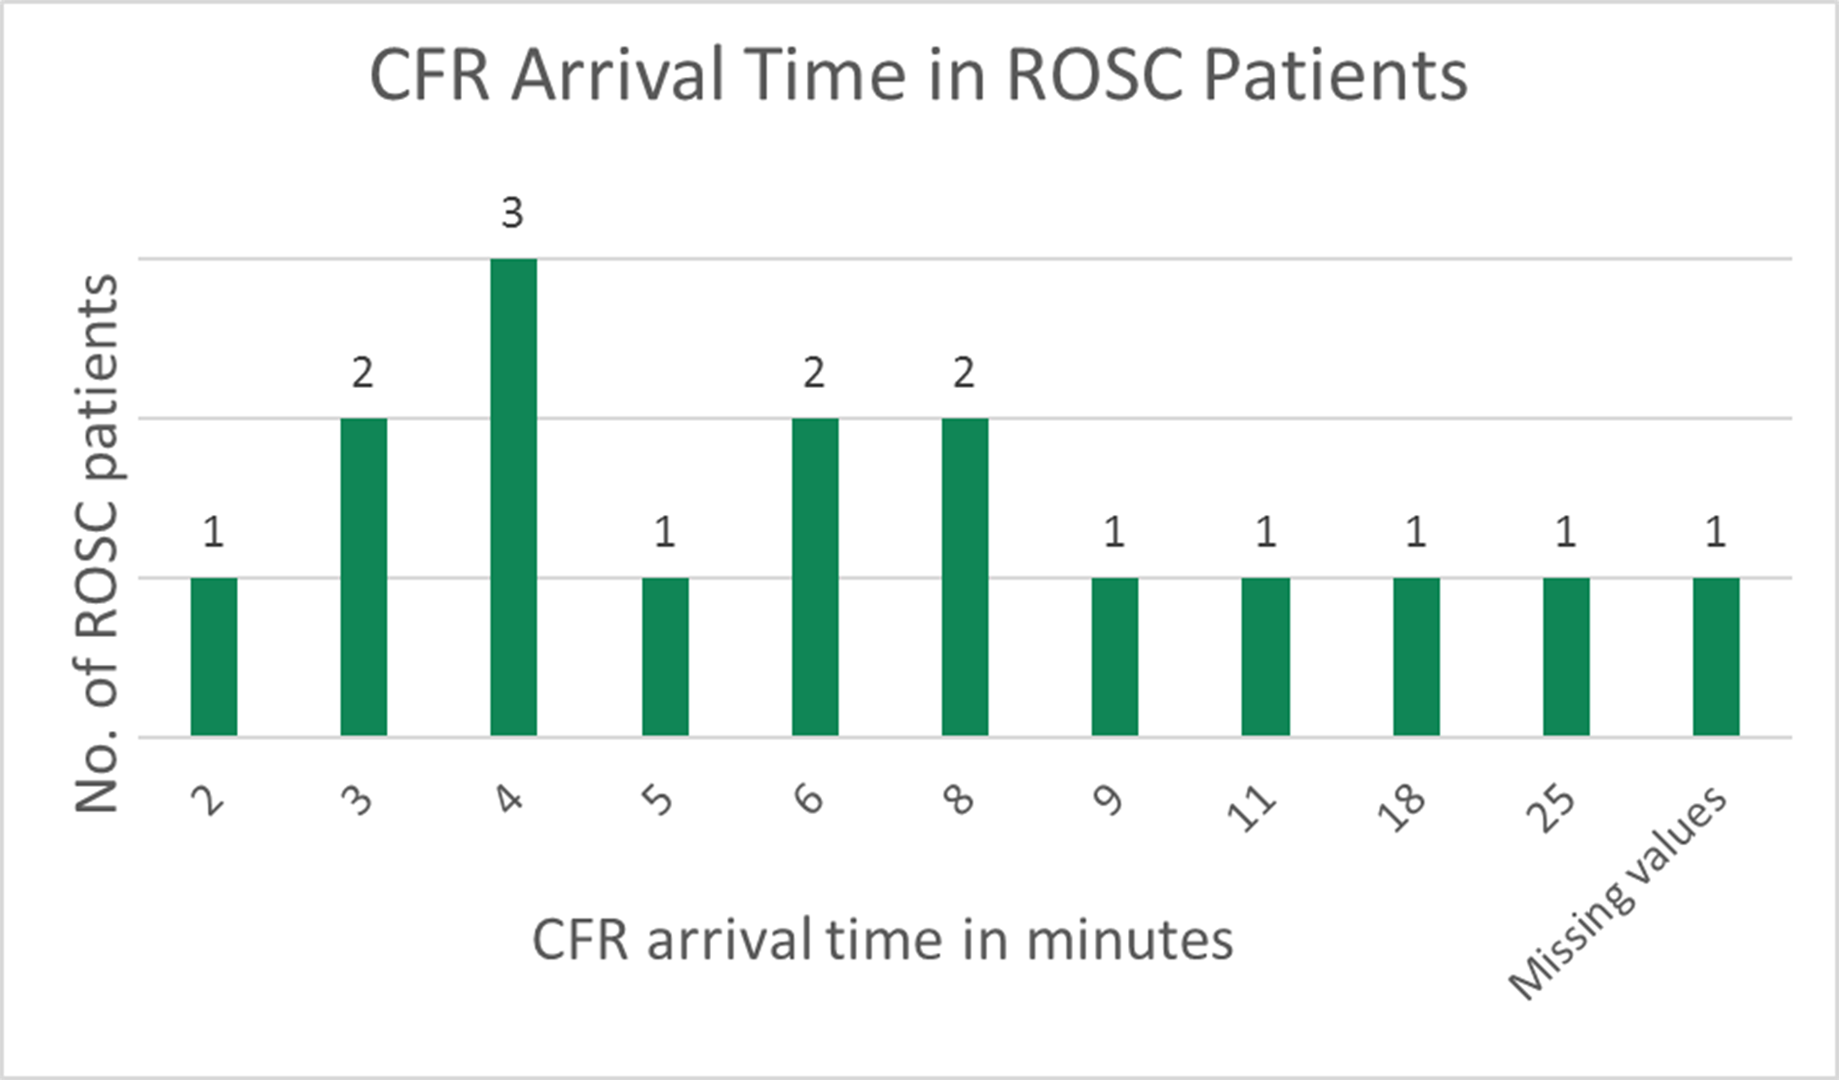
Results
Of the 135 patients attended, 12% (n=16) had a ROSC recorded on NIAS crew records
Of these, 31% had CFRs arrive on scene within three to four minutes.

Slide 12
Limitations
Small sample size
Missing data - level of completeness
Retrospective
No method to compare the total number of records received against the total number of OHCA patients attended by CFRs

Slide 13
Conclusion
First overview of CFR involvement in OHCA in NI
Funded by NICHS, in collaboration QUB
Future projects will be designed to address limitations
Future analysis:
  exploring the effectiveness of CFR involvement
  the perceptions of CFR volunteers themselves and those they serve in their community

Slide 14


Thank you
Any questions?
research@nias.hscni.net
@JuliaMilesWolfe
Emma McCorkell¹, Julia Wolfe¹, Stephanie Leckey¹, Michael Allen¹, Simon Fell¹, Amy Sealey¹, Dr Aleksandar Novakovic² and Professor Adele Marshall²
¹Northern Ireland Ambulance Service Health and Social Care Trust,
²Queen’s University Belfast

