Slide 1




AHPs Take 5?
AHP Population Health Subgroup
“Supporting Cultural Change”
SHSCT Denise Hall, Physiotherapist (Chair)
WHSCT Teresa Sweidan, Physiotherapist, Jacqueline Stinson Podiatrist, Ellen Mc Gonigle, Occupational Therapist
BHSCT Norma Higgins, Therapeutic Radiographer

Slide 2
AHP Population Health Workshop Ballymena 19.04.23 Public Health Agency
Population Health is “an approach aimed at improving the health of an entire population. It is about improving the physical and mental health outcomes and wellbeing of people within and across a defined local, regional or national population, while reducing health inequalities. It includes action to reduce the occurrence of ill health, action to deliver appropriate health and care services and action on the wider determinants of health. It requires working with communities and partner agencies” Buck et al 2018, The Kings Fund.
The workshop adopted an emerging “systems approach” to build collective understanding of the issues, develop creative ideas and opportunities needed to develop an AHP population health approach in N. Ireland
Aim was an opportunity to build networks across Trusts and AHP professions
To share ideas and follow up on actions prioritised at the workshop
Our AHP subgroup was established theme“ Supporting Cultural Change”

Slide 3

Aim: To determine the baseline knowledge of the Take 5 steps to wellbeing campaign within Allied Health Professionals (AHP) in Northern Ireland to inform next steps.
OBJECTIVES
To understand AHP workforce awareness of Take 5.
Identify barriers and enablers to implementation.
Recognise examples of good practice.
Notes:
The Take 5 steps to wellbeing is a national and regional campaign adapted by Public Health Agency (PHA) implemented by local trusts, mental health strategy, community and voluntary sector.
The 5 steps are Give, Be active, Connect, Keep Learning and Take Notice.
AHPs work across the ethos of the 5 steps to wellbeing which correlates with AHP population health approaches and Population health is now a HCPC standard.
Take 5 steps to wellbeing has strong awareness in Mental Health sectors, we were not sure what AHP position was?
Aim: To determine the baseline knowledge of the Take 5 steps to wellbeing campaign within Allied Health Professionals (AHP) in Northern Ireland to inform next steps.
Objectives:
Our working hypothesis was that AHPs could support this cultural change.

Slide 4
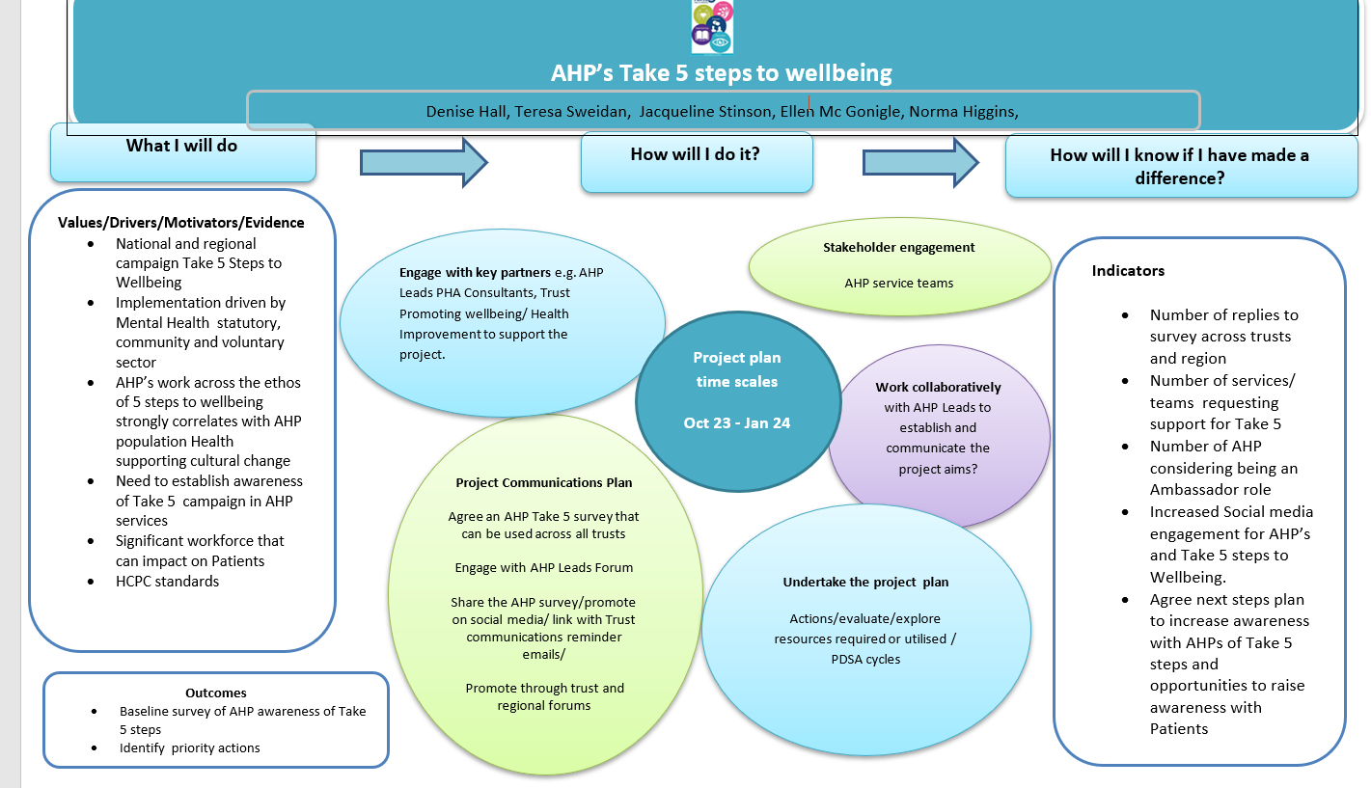
Steps
Notes:
For our methodology we put together a plan on a page- in true OBA style –what we will do, how will we do it and how will we know that we have made a difference- so this includes our project methodology, indicators and outcomes
The project team engaged with key stakeholders e.g. AHP leads, services, and PHA consultants, Trust Health Improvement/wellbeing teams to discuss project ideas, refine methodology and determine potential support. Following this-An electronic regional AHP survey was the agreed method to collect both quantitative and qualitative data. This was co-produced and shared with regional AHP leads for dissemination. A communication plan was implemented regionally.
Data was collated and analysed using Microsoft Forms .

Slide 5



Electronic survey open Monday 4th – Monday 18th December 2023
Survey circulated to:
5 Trusts AHP Leads
Public Health Agency AHP Consultants
Northern Ireland Ambulance Service
AHP Federation 831 Responses

Slide 6
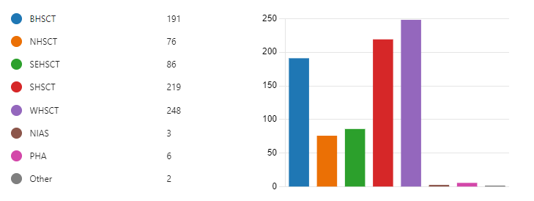
Q1. Which Trust/organisation do you work for?
Notes:
First question:
A good response from the 5 main trusts- the 3 highest may be a reflection of the fact that these are the 3 trusts represented in the project group representation
The two others include:
Make a Melody Music Therapy.
Student paramedic
The next slide indicates the percentage response rate

Slide 7
Percentage Response Rate per Trust area
Trust Area | Percentage Response Rate
Western Trust | 25%
Southern Trust | 17%
Belfast Trust | 12%
SE Trust | 9%
Northern Trust | 7%
NIAS and PHA excluded from above as numbers small.
Overall response rate from the 5 trusts is 14%.
Notes:
NIAS and PHA excluded from above as numbers small.
Trust responses ranged from 25% to 7% with an average response rate of 14% from the 5 HSC Trusts.

Slide 8
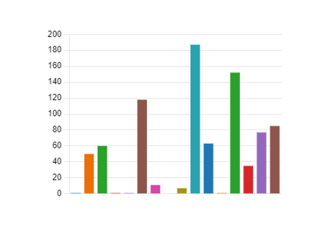
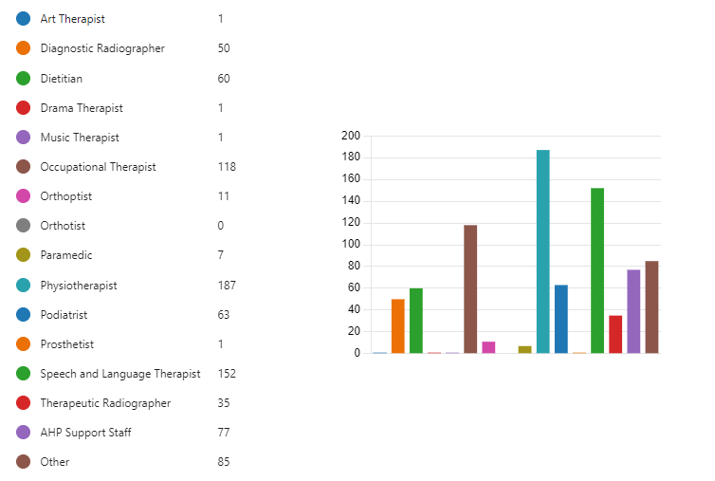
Q2. What is your profession?
Notes:
Responses from 13/14 AHP disciplines. (no orthotist)
Other included: Admin, clerical, administrator, appliance officer and audio typist

Slide 9
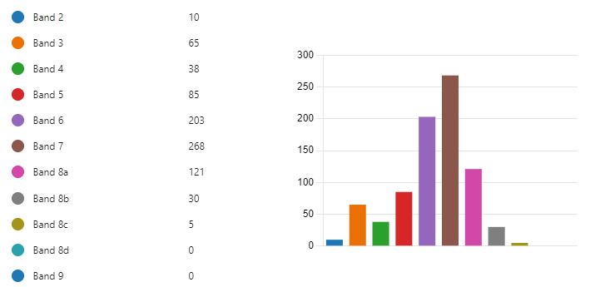
Q3. What band are you?
Notes:
All bands of staff responded

Slide 10
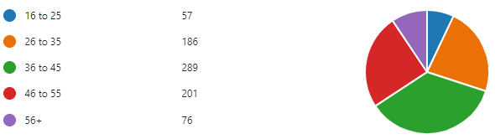
Q4. What age range are you?
Notes:
All age ranges of staff responded

Slide 11
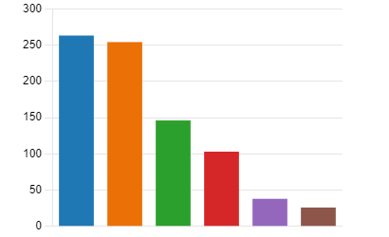
Q5. Are you aware of the Take 5 Steps to Wellbeing campaign?
 | Not aware of it | 263
 | Have heard of it but unaware of the specifics | 254
 | Aware of it but have never used it | 146
 | Aware of it and use it on occasions for my own benefit | 103
 | Aware of it and use it fairly regularly for my own benefit | 38
 | Aware of it and use it consistently for my own benefit | 26
32%
31%
17%
12%
5%
3%
Notes:
32% reported that they were not aware of the Take 5 message.
31% reported that they had head of it but were unaware of the specifics
17% reported that they were aware of it but never used it
12% reported being aware of it and using it on occasions for their own benefit
5% reported they were aware of it and use it fairly regularly for their own benefit
3% reported that they use it consistently for their own benefit

Slide 12
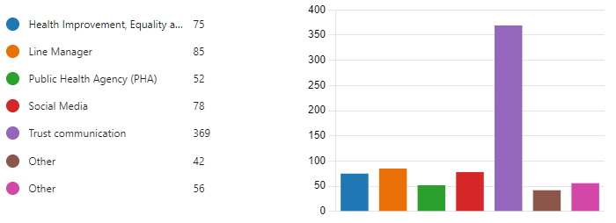
Q6. If you have heard of the Take 5 Steps to Wellbeing campaign, where did you hear about it?
‘Other’ Responses
Local paddle sport club Men’s Health Group Surestart Pharmacy | University Local schools Online
Notes:
Trust communication, by far, was the format most respondents had become aware of the Take 5 campaign
Other responses-

Slide 13
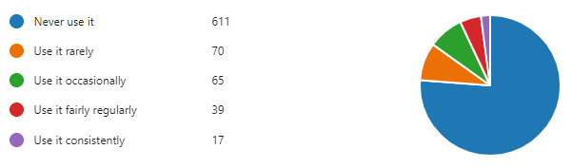
Q7. Do you use the Take 5 Steps with service users?
2%
74%

Slide 14
Q8. The Population Health Group would like to explore how to support AHPs with the implementation of the Take 5 message. Have you any activities up and running or planned?
Team building activities e.g. Quiz
Volunteering
Worker of the Week – certificate
Connecting Through Song Group
Men’s Sheds
Cooking groups
Social groups
Mindfulness and relaxation groups
Exercise classes/Group work
Walking/Running activities
Ward activities
Establishing population health groups
Leadership/staff meetings
Awareness sessions
Conversations with parents/carers
Linking patients with community & voluntary organisations
Notes:
122 respondents ( 15%) gave examples of how the Take 5 steps to wellbeing are being used

Slide 15
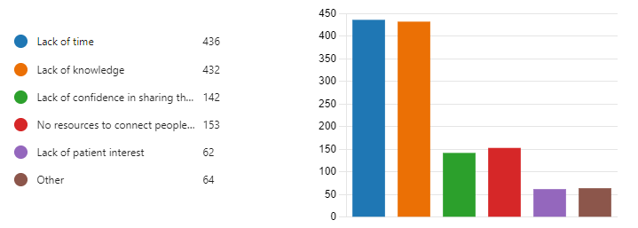
Q9. What are the barriers to using the Take 5 steps to wellbeing message?
Lack of time | 436
Lack of knowledge | 432
Lack of confidence in sharing the Take 5 message | 142
No resources to connect people to | 153
Lack of patient interest | 62
Other | 64
Notes:
The two most common barriers to implementation were lack of time and knowledge, this was followed by lack of resources to connect people to and lack of confidence in sharing the Take 5 message.

Slide 16
Q9. What are the barriers to using the Take 5 steps to wellbeing message?
Additional responses:
Difficulty to engage particular client group e.g. children, learning disability, over 65s
No opportunity to discuss with parents of learning disability clients
Lack of resources to connect people to
Lack of encouragement to do so
I also prefer the ‘Kent NHS 6 ways to wellbeing ‘ as it includes care for the planet which shouldn't be left out
No client contact
Forget to use the resources
Never thought to use the resources
Unaware of Take 5
Notes:
These are additional responses to ‘ What are the barriers?’

Slide 17
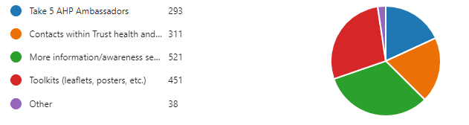
Q10. How do you feel you could be supported?
Take 5 AHP Ambassadors | 293
Contacts within Trust health and wellbeing teams | 311
More information/awareness sessions | 521
Toolkits (leaflets, posters, etc.) | 451
Other | 38
Notes:
Respondents identified the need for further support to implement the Take 5 message – as you can see here. There was an interest in Take 5 AHP ambassador roles. Next slide shows the additional responses

Slide 18
Q10. How do you feel you could be supported?
Additional responses:
Incorporate into agenda items, team meetings and other trust AHP groups
Access to a catalogue of community-based resources
Encompass-my portal
Incorporate into ‘Every contact counts’
Social media campaign including TV and radio campaigns
Free counselling for staff to debrief following intense work with service users
AHP Health and wellbeing champions
More staff
Share examples of Take 5 activities happening across the region
Assistance to make relevant to particular service user groups e.g. children, learning disability, older people
Planned activities for service user groups to improve their health and wellbeing

Slide 19
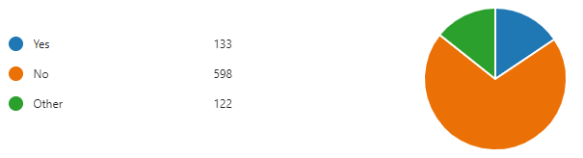
Q11. Would you consider being an AHP Ambassador?
16%
Notes:
The final question was Would you consider being an AHP ambassador?
16% would consider being an AHP ambassador
Responses under ‘Other’- included wanting more information regarding the role first and encouraging our health and wellbeing champions in the Trust to consider the AHP ambassador role
So in summary- the survey indicated that
A broad representation of responses were received from AHP services.
Awareness of the Take 5 message within the AHP workforce at 68% is a platform to build upon. The use of Take 5 message is an area of development both for staff wellbeing and for embedding with service users in practice through increasing awareness and confidence of Take 5 within AHP workforces.
Potential weaknesses which may have impacted on response rate were; not all trusts had representation within the Sub group, December timings, significant service pressures and email access. The use of posters, team meeting promotion may have increased survey responses?

Slide 20
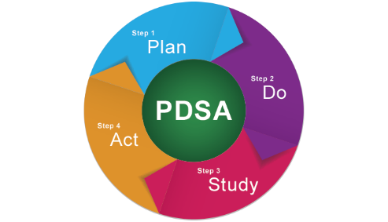
Progress to date
AHP Subgroup representatives have met with trust Health Improvement Leads: Take 5 posters, easy read, Occupational Health, AHP Ambassadors, videos, webpages, Community & Voluntary work
Liaison with Public Health Agency
Meetings ongoing with regional Trust AHP Assistant Directors and Professional Leads
Development of Regional electronic document to share survey results and resources for use by AHPs
Trust Health Improvement Leads for Take 5
NHSCT Selena.Ramsey@northerntrust.hscni.net
SET Brien.Frazer@setrust.hscni.net
BHSCT Clare.Flynn@belfasttrust.hscni.net
WHSCT Sonia.Montgomery@westerntrust.hscni.net
SHSCT Vacant
Notes:
Liaison with Public Health Agency
videos, social media, Living well campaign, website Mental Health focus

Slide 21

Next Steps
AHP workforce can be supported with their own awareness of Take 5 benefits
Build on links with Trust Health Improvement Leads networks
Support Take 5 message within AHP Wellbeing champion/ Ambassador roles
Share learning from survey with AHP and electronic resources for Take 5 steps.
To be promoted as part of wider system approach to nurturing wellness for AHP workforce and encourage awareness with service users?
Thank you
Notes:
Thank You

