Slide 1
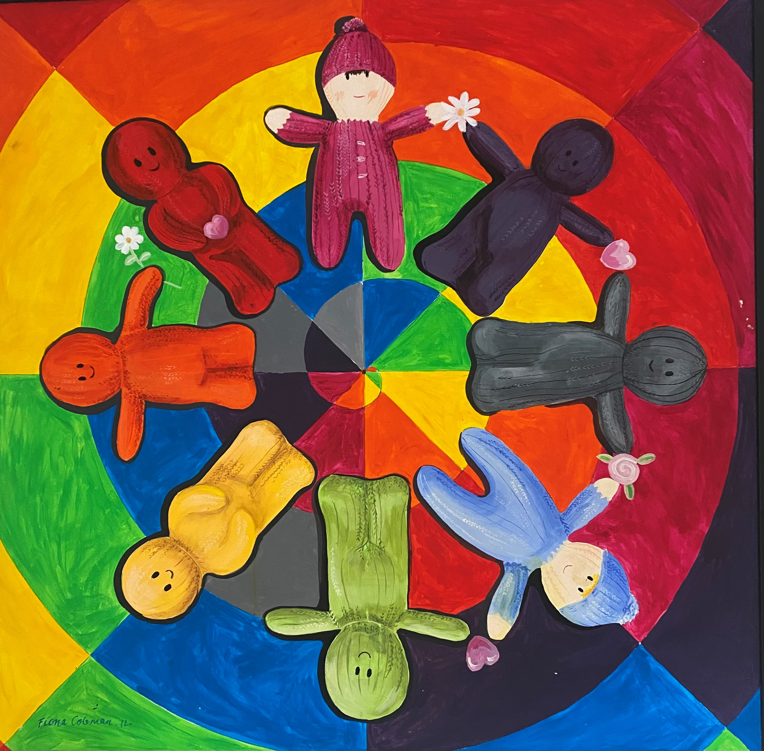
A whole system approach to promoting physical activity within early years
AHP Research & Innovation Conference 2024 11th September 2024
Pauline McMullan, AHP Consultant, PHA
Gerard Walls, Senior Health & Social Wellbeing Improvement Officer, PHA

Slide 2

What is physical activity?
WHO (2010) defines physical activity as:
“any bodily movement produced by skeletal muscles that requires energy expenditure”

Slide 3
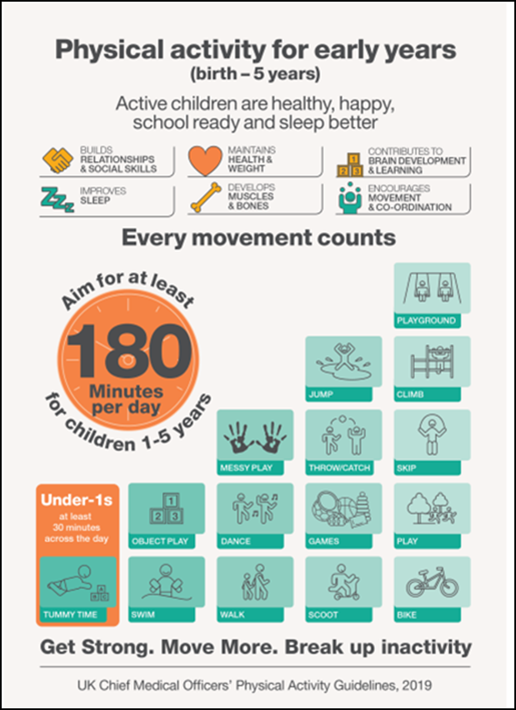
UK CMOs’ Physical Activity Guidelines, 2019
Physical activity for early years: birth to 5 years (publishing.service.gov.uk)

Slide 4
Research
To find out about awareness and knowledge of the UK CMO physical activity guidelines amongst people involved in delivering early years services in NI.
Identify training needs and contribute to the development of any necessary training materials and resources which can support professionals to promote the guidelines in their role.

Slide 5
Methodology
A survey was developed by Health intelligence Unit PHA in conjunction with the Regional Early Years Physical Activity Group 7th Sept 2023 – 3rd November 2023
Information on work area
Awareness and knowledge of UK CMO physical activity guidelines
Any physical activity training received to date and views on this
Whether respondents currently promote physical activity as part of their current role
Views on the need for further training
Findings analysed and report finalised in February 2024

Slide 6
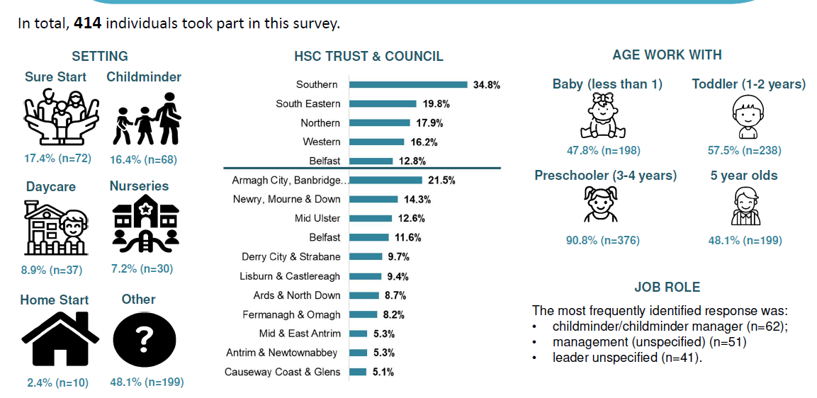
Sample

Slide 7
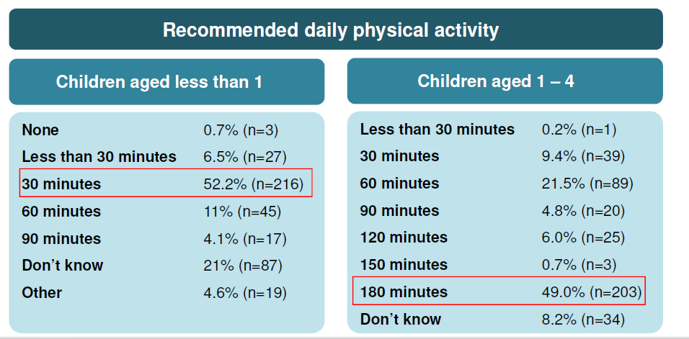
Awareness and knowledge of CMO guidelines
54.6%, n=226 said they were aware of the UK CMO physical activity
guidelines for early years.

Slide 8
Promotion of physical activity guidelines
9 in 10 (94.7%, n=392) said they currently promote physical activity as part of their role
2 in 3 (68.4%, n=282) said they currently use resources to promote physical activity
3 in 4 (74.1%, n =303) said they encouraged parents to be active at home with their children
The main way respondents promoted the early years CMO guidelines was verbal advice (47.8%, n=198). 1 in 3 (32.6%, n=135) indicated they did not promote the guidelines
1 in 4 (24.6%, n=102) said they received physical activity training for early years as part of their current role
2 in 3 (64.5%, n=264) said they had not received sufficient training to talk to parents and guardians about physical activity

Slide 9
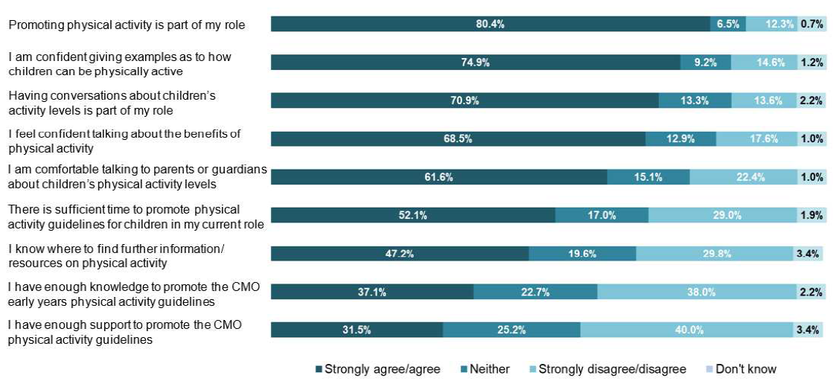
Promotion of physical activity guidelines

Slide 10
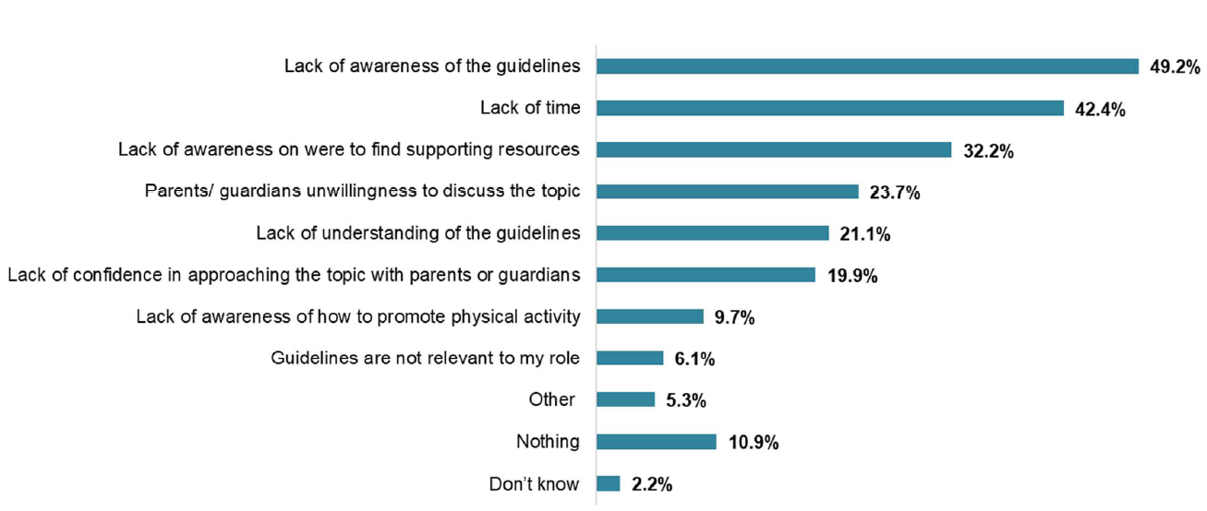
Barriers to promoting CMO guidelines

Slide 11
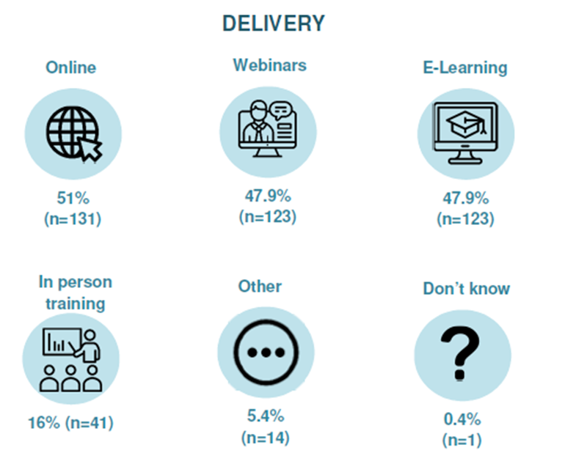
Views on future training
Two in three (66.7%, n=276) said they needed further training to support them to raise awareness and promote physical activity within their role.
Topics
Information on what guidelines are | 73.2%
Practical resources and tips on being active | 69.1%
Practical examples and delivery of physical activity | 66.4%
Practical advice on initiating the conversation with parents/guardians | 55.3%
How to encourage children to be physically active | 53.6%
Benefits of physical activity | 51.2%
How to raise awareness of physical activity | 49.8%

Slide 12
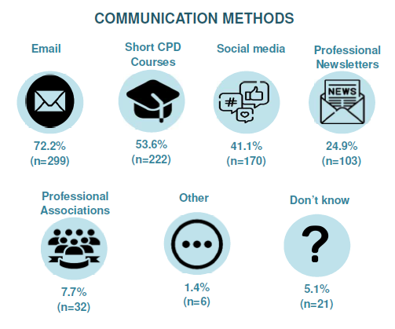
Views on future training/resources
Resources to support you
Educational resources for parents | 78.5%
Physical activity toolkit | 53.6%
Social media graphics/video | 48.8%
Promotional leaflets on physical activity benefits | 40.3%
Animations | 40.1%
Online resource hub | 38.4%

Slide 13














Ongoing workplan
Developing Resources
Education and Training
Communication Plan

Slide 14
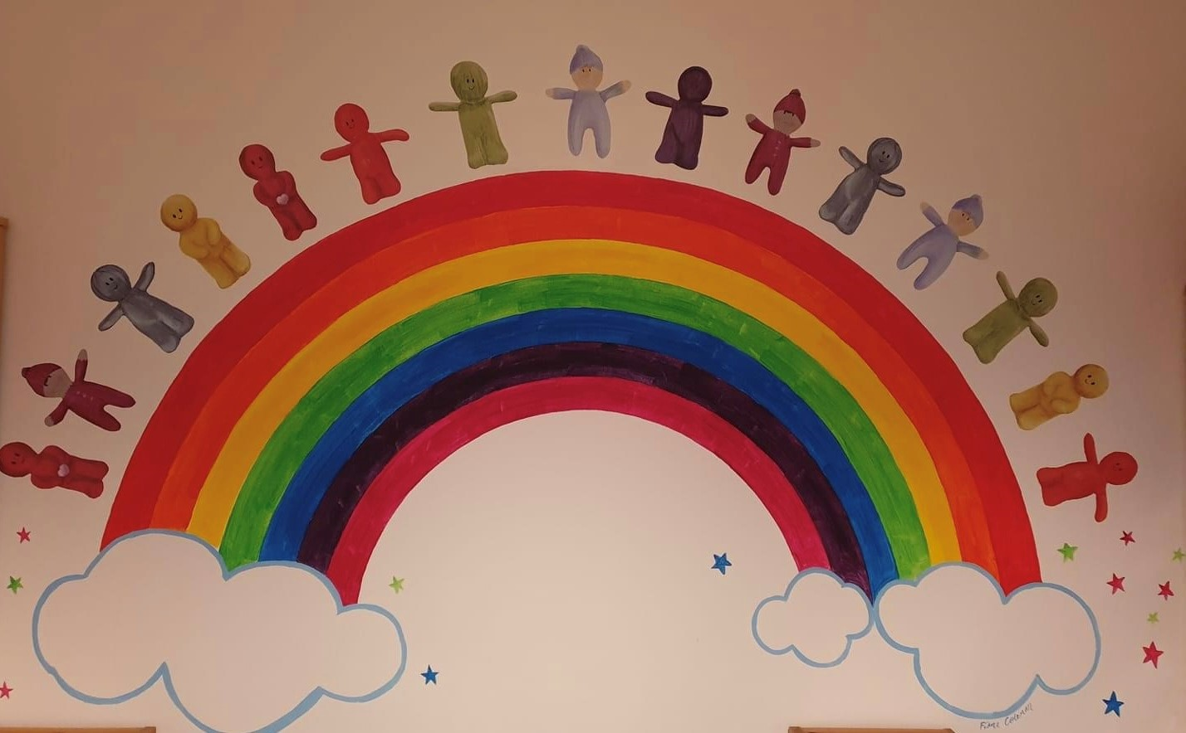
Conclusion
We all have a key role in promoting physical activity,
through empowering and enabling others.
Let’s Make Every Contact count!
Thank you for listening
Pauline.McMullan@hscni.net

Slide 15
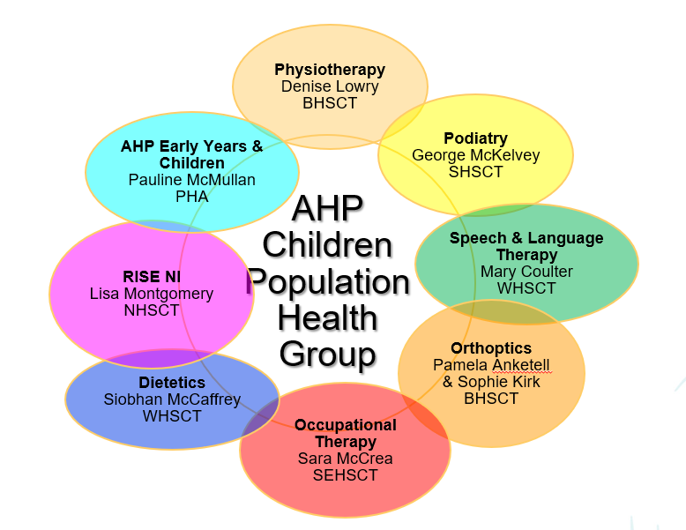
Acknowledgements
Gerard Walls PHA (Chair)
Colette Brolly PHA
Pauline McMullan PHA
Bryan Leonard PHA
Orlaith Moley PHA
Elaine Wilmot, Health Intelligence, PHA
Áine Hagan, Health Intelligence, PHA
Clare Drummy SHSCT
Nicola Arbuckle NHSCT
Jayne McKillen SEHSCT
Camilla Lowry WHSCT
Ben Hanvey BHSCT
Jackie Adair SEHSCT
Regional Early Years Physical Activity Sub Group

